Slide 1
capitalisation strategy Rome, 7-8 June 2017

Slide 2
URBACT III – 4 main objectives
To improve the capacity of cities to manage sustainable urban policies and practices in an integrated and participative way
To improve the design of integrated urban & sustainable strategies/ action plans in cities
To improve the implementation of integrated urban & sustainable strategies/ action plans in cities
To ensure that practitioners and decision makers at all levels have access to knowledge and share know-how on all aspects of sustainable urban development

Slide 3
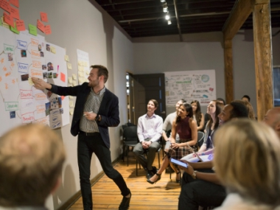
A capacity-building & capitalisation programme
TRANSNATIONAL EXCHANGE & LEARNING
CAPACITY-BUILDING
CAPITALISATION
DISSEMINATION
NETWORKS
TRAININGS
KNOWLEDGE
PLATFORM
Notes:
EM
Networks: three different types of networks- action planning (to create a Local Action Plan), Implementation (to overcome challenges related to implementation of local policies), Transfer (one identified good practice to be transferred to other cities)
Capacity-building: National and EU trainings on how to put in place integrated and participatory approaches/ local policies
Capitalisation-communication: publications, events, website, National URBACT Points

Slide 4
Transfer Network – a tool for capitalisation
‘Good Practice City’ sharing the experience > a ‘mentor’ role
‘Transfer cities’ understand>adapt>reuse the good practice
ADDITIONAL BENEFITS:
GOOD PRACTICE CITY
Refining and improving its own methodology
Wider recognition of the potential for re-use and greater visibility
TRANSFER CITIES
Producing a ‘Diary of Transfer experience’ > experimentation
Building the capacity to deal with urban issues
Notes:
AB
REFER to Diet for green planet - Mollet del Valles example of transfer:
Understand: Mollet del Valles (52 000 people) before joining the network had no diet policy at local level but an ambition to promote the surrounding rural area and stimulate local economy. Albert Garcia says that for them Sodertalje was like a "UFO" something that was completely new and unusual from Spanish standards but at the same time an unexpected way to fulfil their goals. When joined the network, the city undertook a survey to the users of school canteens, gathered perceptions, facts and data. Thanks to this survey, the City realised that school canteens were using pre-cooked and frozen food and meals, the food was coming from thousand of Km away, and the cooks were heating food rather than cooking it.
Adapt & Reuse: Mollet decided to change this, and adapt the model to Sodertalje to their legal framework. Unlike Sodertalje, they used public procurement in Sept 2014 as a tool to integrate healthy habits and principles in the public canteens. The city also adopted a Diet Policy at local level and established the Food Council to give advise to public canteens. By September 2016, Mollet has transformed their 7 public canteens following Sodertalje model and has established a monitoring system to follow up progress and changes.

Slide 5
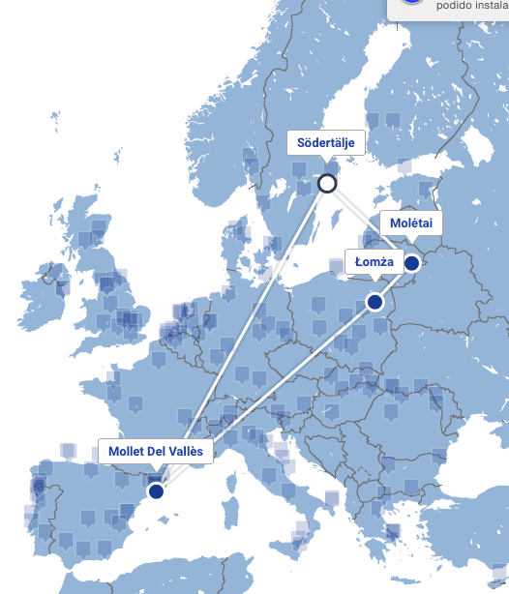
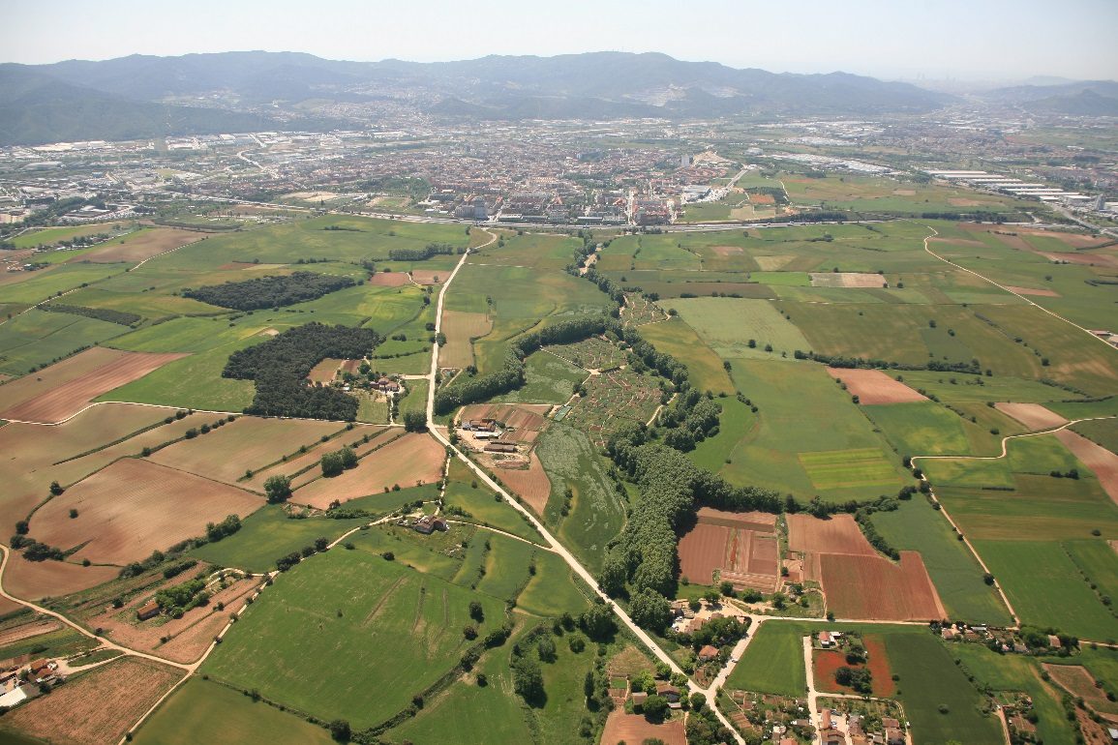
Mollet del Vallès, Spain
Notes:
52.000 inhabitants - 15 km from Barcelona
A city with 2 souls: 50% URBAN and 50% RURAL
The Rural area belongs to a natural protected area: 1.000 hectares
LINK URBAN and RURAL
Topic: political decision to use the purchase of food in public canteens as a tool to reach environmental goals and to adjust the diet to a sustainable development: Diet for a Green Planet concept:
Tasty and healthy food
Organically grown
Less meat, more vegetables and wholegrain
Seasonal food
Locally produced
Reduced food waste
84 public canteens 17 000 meals/day 57% organic food
Mollet adopted this diet policy to their local context through public procurement in 2014. In 2015, approval of a Diet Policy at local level to promote healthy diet to canteens, reduce food waste, Quality instead of lowest price was given priority.
Results: 7 public canteens out of 25 provide local, seasonal and organic food, growing from 4,000 menus/month at the end of the project to 12 000 menus/month. From 2 hectares local producers now explore 9 hectares of land. Local producers now supply other 7 public canteens outside Sodertalje. There are currently investments for an agricultural park with the government of Catalunia and six other cities for cooking equipment and processed food, storage food, facilities, services, etc.

Slide 6
Capitalisation Strategy
the story so far…
Notes:
My presentation will cover the progress made so far on the programme’s capitalisation strategy – which I stress is still very much work in progress – and the specific topics we propose to focus on in 2017 to get up and running, and help us test and refine our strategy as we go along.
Very much an interative process

Slide 7
What is URBACT capitalisation?
Capitalisation as a core pillar of URBACT
Specific Objective 4: To ensure that practitioners and decision-makers at all levels (EU, national, regional and local) have increased access to URBACT thematic knowledge and share know-how on all aspects of sustainable urban development in order to improve urban policies.
To reach beyond the URBACT beneficiaries
Notes:
Contribution of activities to the specific objective 4: the programme will develop actions to consolidate and share knowledge on sustainable urban development (good practices, policy recommendations, etc.) so that it is widely used by relevant players in the field. More especially, the capitalization and mainstreaming actions will aim to reach players beyond the URBACT beneficiaries: cities not involved in URBACT networks, as well as the different levels of government involved in urban development (regional, national, European).

Slide 8
Break it down
Cluster and exploit knowledge coming from networks
Both ‘bottom-up’ and ‘programme-led’
Upscale URBACT knowledge to the higher policy level
Taking account of wider initiatives
Effectively categorise knowledge on URBACT.eu to make it knowledge hub
For those who know what they are looking for, and those who don’t know what they don’t know
Notes:
To reach that ambitious goal, we need specific objectives for our capitalisation strategy.
The first one – cluster and exploit knowledge coming from the networks is based on the knowledge generated in the URBACT networks. In addition to the planning and implementing of capitalisation activities on programme level, we propose also to allocate a certain part of the budget for ‘network-led’ initiatives. Proposals coming from the networks themselves on how they could ensure capitalisation on their knowledge gained. This has the advantage of lettng city practitioners decide what is most important for them. It also allows for some ‘quick wins’ to get capitalisation activities underway in 2017. We propose a global budget of 200k for the programming period for this type of activity. This would complement the ‘programme led’ capitalisation, based on the programme’s analysis of the most relevant topics.
The second objective is to upscale URBACT knowledge to the higher level policy arena. This involves looking beyond the URBACT networks to the wider urban policy framework and see where the demand is, and respond to that need. IT is more ‘demand-driven’.
The third objective is to ensure that all the knowledge production and content generation is effectively categorised on the urbact website, making it the knowledge hub for sustainable urban development.

Slide 9
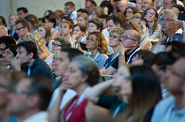
Target audience
Stakeholder mapping at programme level
National URBACT points mapping for national/sub-national level
Notes:
These are our heros. Urbact practitioners and decision makers at local, national, and EU level.
That’s a lot of potential heros! In order to reach out to them, we need to break them down into more specific groups and identify organisations and individuals that need to know about us.
This is underway: mapping of key stakeholders and partners at programme level; gap analysis to know which cities are still in the dark; and the precious resource that is NUP to identify national and local actors

Slide 10
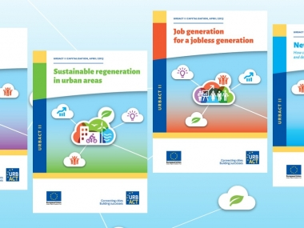
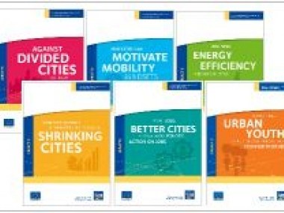
The situation until now
High quality production under URBACT II capitalisation
BUT: many didn’t know they existed
Format not easy to react to current hot topics
Moving from ‘publication’ to ‘participation’
2/3 who read, ‘used’ knowledge
Notes:
URBACT Capitalisation is not starting from scratch. A series of workstreams was carried out 2012_2015 resulting in in-depth, qualitative studies and publications.
The evaluation of these publications shows a good ratio between reading and ‘using’ the knowledge; but a large gap was identified in getting the readers there in the first place. One of the major reorientations between UII and UIII capitalisation will be a more varied approach to the delivery channel for the content, adapting it to the most effective way for the user.

Slide 11
SOME APPROACHES FOR CAPITALISATION
Methods
Expertise
Storytelling
Blended learning
Cooperation with other organisations (programmes, networks, etc.) operating in the area of sustainable urban development
Channels
Online/ Website (tool and channel)
Events
Publications
National URBACT Points
Media
Tools
Library, articles, video, podcast, animation, social media
Conferences, seminars, policy labs, hackathons
Newsletters, studies policy briefs, case studies…
National roll-out
Press releases, press conferences
2017 activities will allow testing of new, different methods and tools
Notes:
Specific tools, channels and methods should be selected according to each topic, the specific audience, what we have to say and the best way of delivering that.
This means not having one tool for all (like the workstreams in UII) but a variety of tools and methods at our disposal.
These can cover short term and longer term activities.
We need to be flexible and innovative; iterative approach to tools that can be adapted along the way.

Slide 12
Resources
2015-2021: €1.45 million
Split over project-led, programme-led capitalisation and support
2015-2021: 6 Programme experts
2017: Capitalsation Head of Unit, Communication & Capitalisation Officer, Head of Secretariat
Notes:
Cap budget is set at just over 1.45 million for the period. Based on the specific goals described previously, we have split this into network led and programme led capitalisation, with the majority of the budget going to programme led initiatives. You will see this reflected in the updated Budget proposal later on today.
Human resources in the form of 6 programme experts for capitalisation (but not only), and one dedicated Head of Unit, contribution of cap & com officer and head of secretariat.
Quite tight on secretariat side, in terms of the amibition, another reason why it is important to have activities with different levels of intensity and delivery schedules.

Slide 13
EU Urban Agenda
Update

Slide 14
Name of the Partnership | Duration
Air Quality | 2016-2018
Urban Poverty | 2016-2018
Affordable Housing | 2016-2018
Inclusion of Migrants & Refugees | 2016-2018
Circular Economy | 2017-2019
Digital Transition | 2017-2019
Urban Mobility | 2017-2019
Jobs and Skills in the Local Economy | 2017-2019
Sustainable Use of Land | Mid 2017-mid 2020
Energy efficiency | Mid 2017-mid 2020
Climate adaptation | Mid 2017-mid 2020
Innovative and responsible public procurement | Mid 2017-mid 2020

Slide 15
URBACT offers: gains:
Integrated and participatory method
Experience of wide range of small/medium cities
Potential to integrate actions into wider capitalisation framework
Privileged access to multi-level governance
Exposure to non-URBACT cities
Framework for influencing policy level
New input to themes important for cities

Slide 16
Action Plan 2017
Topics

Slide 17
Criteria for deciding 2017 topics
Topics addressed by the approved URBACT networks
Avoid duplication
Fit with priorities of the Urban Agenda for EU

Slide 18
2017 programme topics
Innovative approaches to sustainable urban development
Reducing disparities in deprived urban areas
Affordable housing
Gender equality
‘Just cities’
‘Cities of the future’
Integrated and participative urban development

Slide 19
Network-led topics
Digital cities
Migrants
…

Slide 20
Next steps
Development of actions for each topic approved
scope, outputs, budget
Launching network-led initiatives
November 2017: final strategy for MC approval

