Slide 1
for capitalisation
Let’s practice capitalisation!
7 June 2017 | Rome, Italy
@keep_EU
Rafael Agostinho
Interact Programme

Slide 2
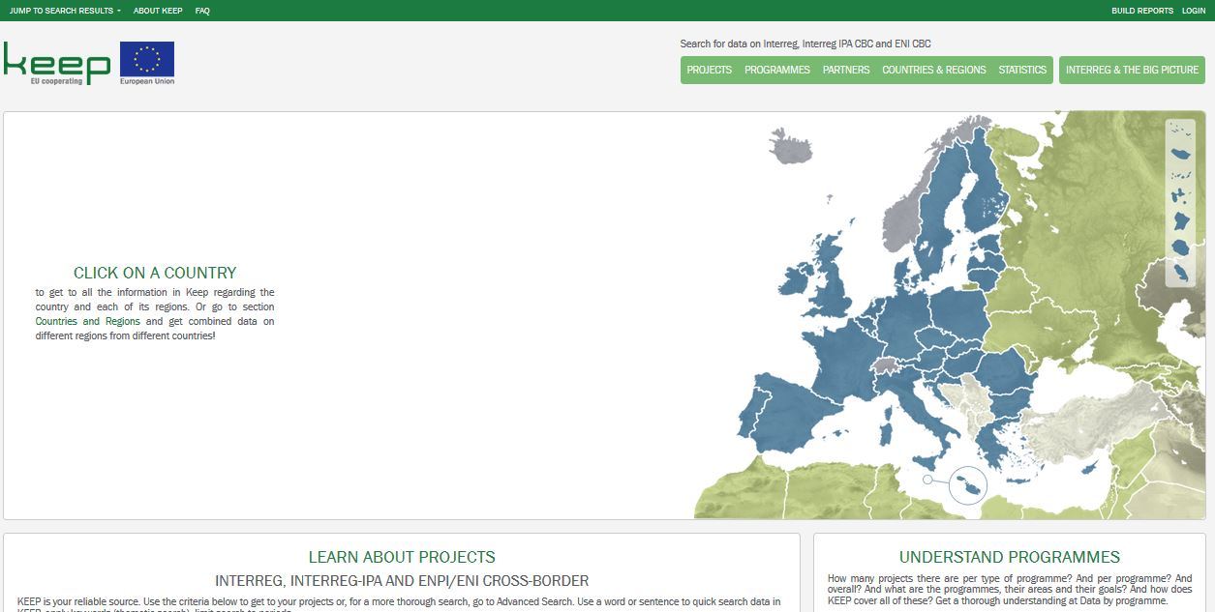
KEEP

Slide 3
KEEP
Why are we here talking about KEEP????

Slide 4
KEEP
Website
Database
x

Slide 5
KEEP
(1) strengthening research, technological development and innovation by:
(a) enhancing research and innovation (R&I) infrastructure and capacities to develop R&I excellence, and promoting centres of competence, in particular those of European interest;
(b) promoting business investment in R&I, developing links and synergies between enterprises, research and development centres and the higher education sector, in particular promoting investment in product and service development, technology transfer, social innovation, eco-innovation, public service applications, demand stimulation, networking, clusters and open innovation through smart specialisation, and supporting technological and applied research, pilot lines, early product validation actions, advanced manufacturing capabilities and first production, in particular in key enabling technologies and diffusion of general purpose technologies;
(2) enhancing access to, and use and quality of, ICT by:
(a) extending broadband deployment and the roll-out of high-speed networks and supporting the adoption of emerging technologies and networks for the digital economy;
(b) developing ICT products and services, e-commerce, and enhancing demand for ICT;
(c) strengthening ICT applications for e-government, e- learning, e-inclusion, e-culture and e-health;
(3) enhancing the competitiveness of SMEs by:
(a) promoting entrepreneurship, in particular by facilitating the economic exploitation of new ideas and fostering the creation of new firms, including through business incubators;
(b) developing and implementing new business models for SMEs, in particular with regard to internationalisation;
(c) supporting the creation and the extension of advanced capacities for product and service development;
(d) supporting the capacity of SMEs to grow in regional, national and international markets, and to engage in innovation processes;
(4) supporting the shift towards a low-carbon economy in all sectors by:
Agriculture and fisheries and forestry.
Climate change and biodiversity
Clustering and economic cooperation
Community integration and common identity
Construction and renovation
Cooperation between emergency services
Costal management and maritime issues
Cultural heritage and arts
Demographic change and immigration
Education and training
Energy efficiency
Evaluation systems and results
Governance, partnership
Green technologies
Health and social services
ICT and digital society
Improving transport connections
Infrastructure
Innovation capacity and awareness-raising
Institutional cooperation and cooperation networks
Knowledge and technology transfer
Labour market and employment
Logistics and freight transport
Managing natural and man-made threats, risk management
Multimodal transport
New products and services
Regional planning and development
Renewable energy
Rural and peripheral development
Safety
Scientific cooperation
SME and entrepreneurship
Social inclusion and equal opportunities
Soil and air quality
Sustainable management of natural resources
Tourism
Traditional energy
Transport and mobility
Urban development
Waste and pollution
Water management
Waterways, lakes and rivers
11 thematic objectives / 45 investment priorities
Partners
Dozens of fields per project
Dozens of countries
42 thematics
Projects
Hundreds of regions
Ongoing
5+ types of programmes
Closed
3 programming periods
199 programmes
Include / only MRS / which ones

Slide 6
KEEP
Partners
Dozens of fields per project
Fields per project
Period
Programme name
Project acronym
Serial number of call or direct award
Project name in the original language
Project name in English
Project description
Project description in English
Project expected results
Project achievements
Project achievements in English
Project website
Project start date
Project end date
Total eligible budget / Total eligible expenditure
European Union funding
Project ERDF budget
Project IPA II budget
Project ENI budget
Other EU
Project ERDF equivalent budget
Project part of European Union Macro-Regional or Sea Basin Strategy / none
Expected outputs
Delivered outputs
Contribution to the Programme's specific objective
Contribution to the Programme's Thematic Objective ERDF
Contribution to the Programme's Thematic Objective ENI
Contribution to the Programme's Investment Priority ERDF
Cost of infrastructure component
Project status
Fields per partner
Project acronym
Type of partner
Organisation name in English
Organisation name in original language 1
Department /unit / division
Country
Town
Street
Postcode
nuts3_code (or equivalent country/region when partner is located outside NUTS-described territory)
Partner's contact person (first name)
Partner's contact person (last name)
E-mail
URL
Partner total eligible budget / expenditure
Partner ERDF budget
Partner IPA II budget
Partner ENI budget
partner other EU budget
Partner ERDF equivalent budget
Legal status (public or private)
Fields per call
Serial number of call or direct award
Start date of call
End date of call
Budget of call
Projects
Calls

Slide 7
KEEP
Programmes
Programme website
Projects in KEEP / partners on map
EU funding (outstanding EU funding)(excluding technical assistance)
Total budget(excluding technical assistance)
Funding instrument(s)
Eligible geographical area
Specific objective
Thematic objective and Investment priority
Result indicator (measurement unit)
Output indicator (measurement unit)
Specific objective
Thematic objective and Investment priority
Result indicator (measurement unit)
Output indicator (measurement unit)
Specific objective
Thematic objective and Investment priority
Result indicator (measurement unit)
Output indicator (measurement unit)
Specific objective
Thematic objective and Investment priority
Result indicator (measurement unit)
Output indicator (measurement unit)
Specific objective
Thematic objective and Investment priority
Result indicator (measurement unit)
Output indicator (measurement unit)
Specific objective
Thematic objective and Investment priority
Result indicator (measurement unit)
Output indicator (measurement unit)
Specific objective
Thematic objective and Investment priority
Result indicator (measurement unit)
Output indicator (measurement unit)
Last month that data in KEEP was retrieved from the Programme's website or received from the Programme
Fields missing in data supplied by this programme
Language of the data in KEEP
No. of projects within the scope of this programme (no. of projects of this programme in KEEP, % of overall)
No. of project partners within the scope of this programme (no. of project partners of this programme in KEEP, % of overall)
No. of calls launched by this programme (no. of calls covered in KEEP)
Notes on the data

Slide 8
KEEP
Get as many detailed views as needed
Cluster projects into an INFINITE number of high-level views

Slide 9
KEEP
Uses:
o Thematic search for projects.
o Clustering by thematic for capitalisation studies.
o Collect project partners (companies) for tendering processes.
o Search for projects from other programmes.
o Check for programme data.
o Search for data from other programmes or from specific regions.
o Double-funding checks (reassure MAs and JTSs).
o Show (heat map) areas where investment in certain fields is lagging behind.
o Programmes make it mandatory to refer to KEEP before applying for funding.
o Search for results of Interreg.
o Promote projects.
o Collect ideas.
o Look for partners per geographical area / fields of activity.
o Reporting.
o Statistical purposes.

Slide 10
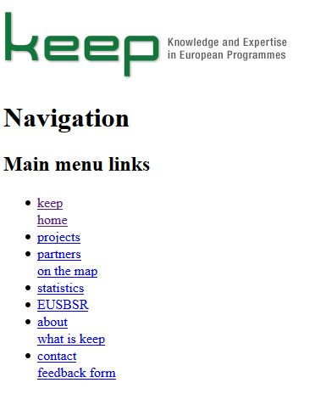
Evolution of KEEP
2009: Project started, DB created
2011: 1st website

Slide 11
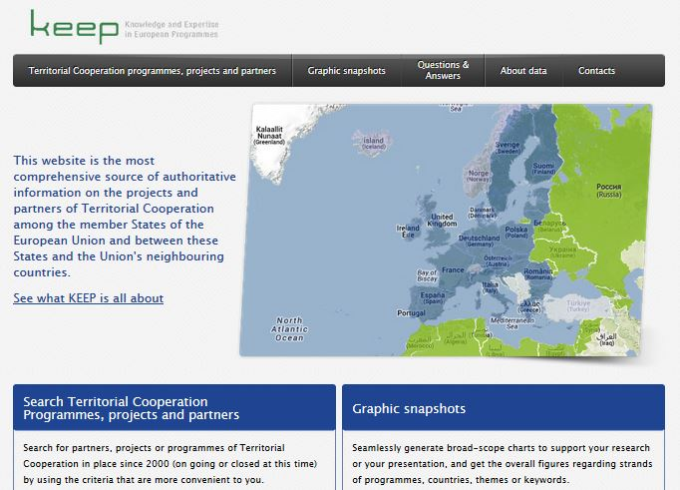
Evolution of KEEP
2013: 2nd website

Slide 12
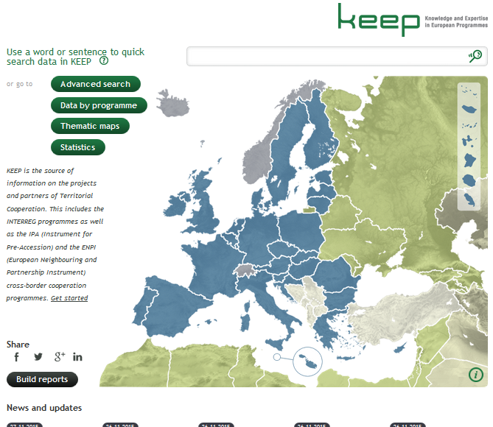
Evolution of KEEP
2015: 3rd website

Slide 13
Evolution of KEEP: 2015/16
Work on new content / functions for website:
Responsive website
New project-partner-call data fields
New project search criteria, including regions
Statistics including regions
New programme data fields
New section facilitating networking and finding partners
Self updating reporting tool
Tool ready for manual & automatic updating of project-partner-call data

Slide 14
Evolution of KEEP: 2015/16
Work on new content / functions for website:
Easier links between the results of the searches and their representativeness
Links between Project search and Statistics
New output library
Automatic keyword assignment
Pre-formatted links
Automatic language assignment and one landing page per EU language + Norwegian

Slide 15
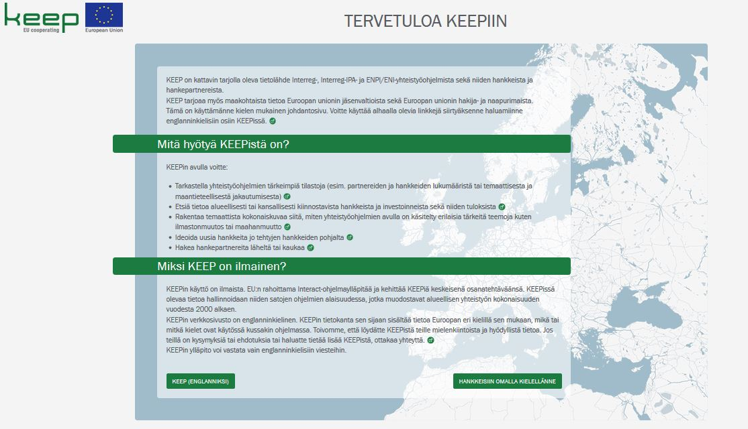
Evolution of KEEP: 2016/17

Slide 16
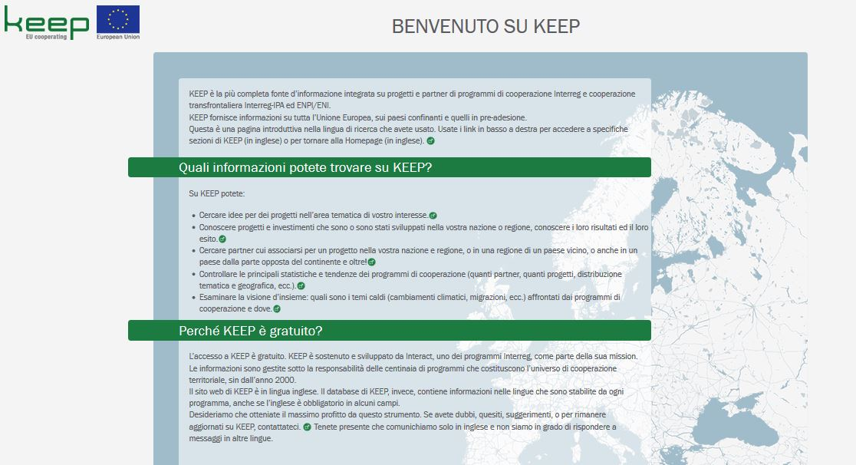
Evolution of KEEP: 2016/17

Slide 17
Evolution of KEEP: 2017
Fine-tuning of website and procedures
Data collection
Search for new functions (e.g. support to capitalization)

Slide 18
KEEP
KEEP to support capitalisation
(agreed to study possible rollout within TO7)
Aggregate common programme indicators
Freeze statistics regarding quantitative indicators
Devise a TO7 map of Europe
Show good practices
Provide statistical charts on maps

Slide 19
KEEP
KEEP to support capitalisation
(agreed to study possible rollout within TO7)
Aggregate common programme indicators
Rollout currently being analysed also in connection with Evaluation

Slide 20
KEEP
KEEP to support capitalisation
(agreed to study possible rollout within TO7)
Aggregate common programme indicators
Rollout currently being analysed also in connection with Evaluation
Freeze statistics regarding quantitative indicators
Output to be data-driven. Technically it is feasible within some weeks from the time when enough data is published

Slide 21
KEEP
KEEP to support capitalisation
(agreed to study possible rollout within TO7)
Aggregate common programme indicators
Rollout currently being analysed also in connection with Evaluation
Freeze statistics regarding quantitative indicators
Output to be data-driven. Technically it is feasible within some weeks from the time when enough data is published
Devise a TO7 map of Europe
Late 2017 / early 2018: Map of Europe showing TO / IP per NUTS 1/2/3 (and, per region, the most covered themes within the region)

Slide 22
KEEP
KEEP to support capitalisation
(agreed to study possible rollout within TO7)
Aggregate common programme indicators
Rollout currently being analysed also in connection with Evaluation
Freeze statistics regarding quantitative indicators
Output to be data-driven. Technically it is feasible within some weeks from the time when enough data is published
Devise a TO7 map of Europe
Late 2017 / early 2018: Map of Europe showing TO / IP per NUTS 1/2/3 (and, per region, the most covered themes within the region
Show good practices
To be used in connection with output repository and library. One possibility: Programmes signal good practices, which become a search criterion

Slide 23
KEEP
KEEP to support capitalisation
(agreed to study possible rollout within TO7)
Aggregate common programme indicators
Rollout currently being analysed also in connection with Evaluation
Freeze statistics regarding quantitative indicators
Output to be data-driven. Technically it is feasible within some weeks from the time when enough data is published
Devise a TO7 map of Europe
Late 2017 / early 2018: Map of Europe showing TO / IP per NUTS 1/2/3 (and, per region, the most covered themes within the region
Show good practices
To be used in connection with output repository and library. One possibility: Programmes signal good practices, which become a search criterion
Provide statistical charts on maps
Rollout currently under study for release probably in 2018

Slide 24
KEEP
We will work all of this out for you
All we need is
Data &
Use

Slide 25
Cooperation works
All materials will be available on:
interact-eu.net
keep.support@interact-eu.net (or go to section About KEEP at keep.eu)

