Slide 1
Interreg: Capitalise the cooperation experiences
Gianluca Comuniello
European Commission
DG Regional and Urban Policy – Unit D2
7 June 2017

Slide 2
Capitalisation… what does it cover?
Capitalisation is about gathering, organising and building upon existing programme and projects results, within specific fields.
Capitalisation could concern data about the implementation of programmes, projects, impacts and methods used in order to make the knowledge generated by Interreg more accessible and usable for other programmes, projects or stakeholder groups.
Capitalisation looks into specific results in thematic fields in order to obtain additional improved results, to boost performance, delivery and to multiply the effects of achievements delivered.

Slide 3
To put it nicely…
"Project results can be turned into policy-making material"
Tarja Richard, Interreg MED programme

Slide 4
Capitalisation… how to do it?
You have to gather results: analysis and coordination
You have to promote results: events/campaigns… everything with simple language!!!!
You have to re-use the results: create effects and impact!
You have to influence policies: effects become lasting and change public decisions and legislations

Slide 5
To put it nicely…
"If it is good, a project does not stop with the funding period"
Interreg Italy-Malta Lithos Project Implementers

Slide 6
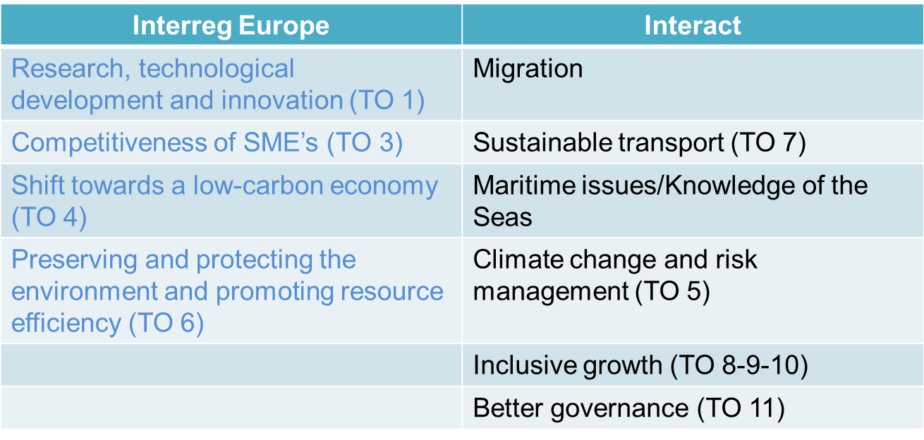
Capitalisation… how we can help?
Thematic support is being provided by the Interreg Europe and the Interact programmes to all Interreg programmes

Slide 7
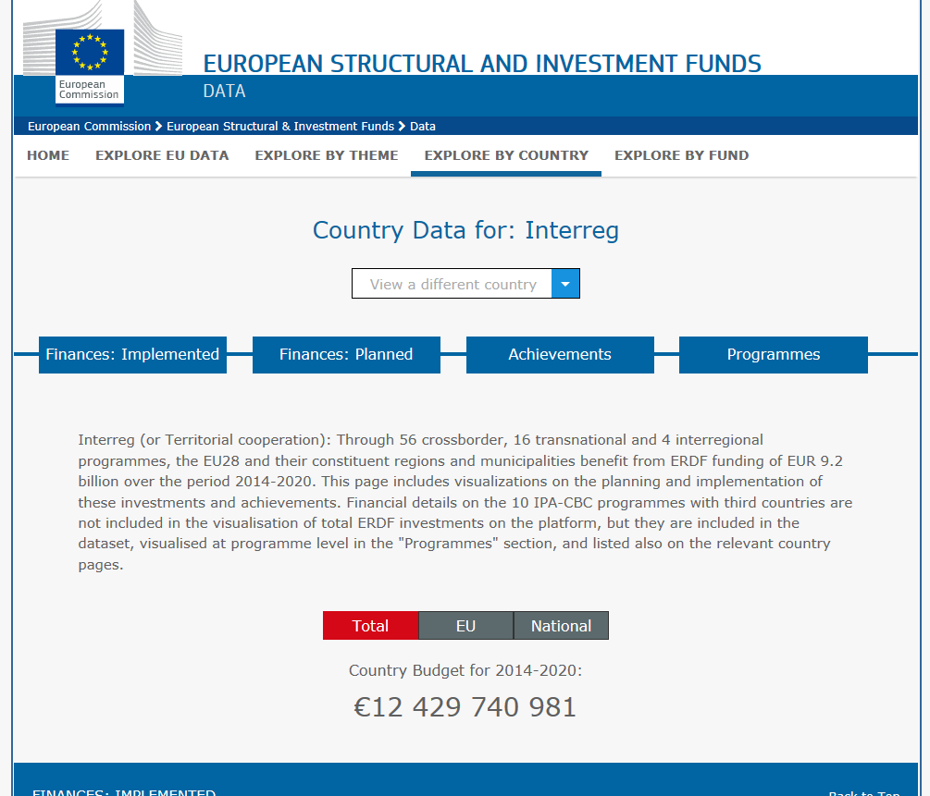
Capitalisation… how we can help?
By providing "as it happens" tool to gather data about what Interreg programmes are doing throughout Europe…

Slide 8
Capitalisation… how we can help?
By communicating your great projects…

Slide 9
Capitalisation… how we can help?
By providing a new set of data/policy solutions available thanks to the
Cross-Border Review

Slide 10
Cross-Border Review… some figures
Launched by Commissioner Creţu in Sept. 2015
2. Focus on legal & administrative obstacles in EU border regions
3. Three pillars:
Study on legal and administrative obstacles in EU border regions (2015-2016)
Stakeholder dialogue – workshops (2015-2016)
Public consultation (2015)
4. Communication from the Commission due in September 2017

Slide 11
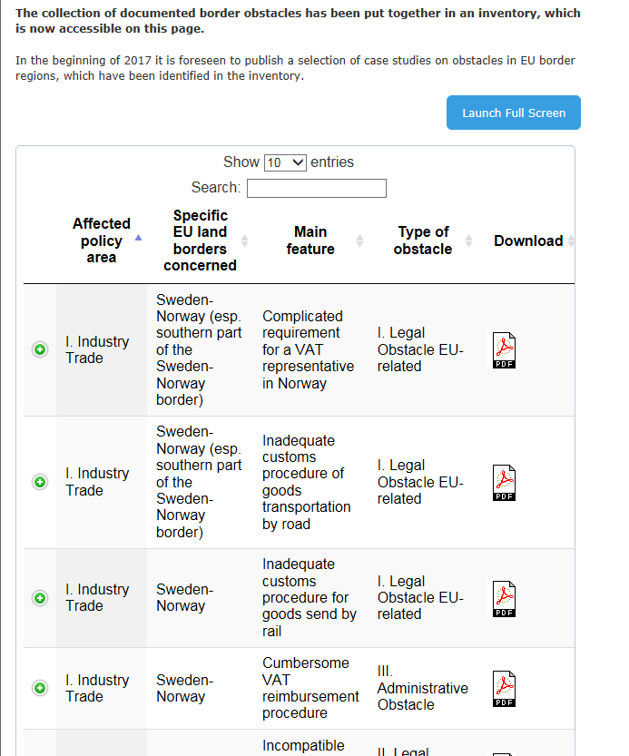
Cross-Border Review… the data you can use
A database of 200+ border obstacles and the solutions provided to overcome them… if any

Slide 12
Cross Border Review… Case studies
Nr. | Topic | Border/Case
1 | Exportation of goods and cross-border provision of commercial services | IE-UK
2 | Border-regional business activities and cross-border development of entrepreneurship (business incubators, start-ups, centres, venture capital) | BG-EL
3 | Mobility of cross-border workers (commuter flows) | DK-SE
4 | Mobility of trainees, students and teachers | DE-NL
5+6 | Recognition of diploma or professional qualification certificates | ES-PT; BE-DE-FR-LU
7 | Access to social insurance system (e.g. pensions, disability insurance) | BE-DE-FR-LU
8 | Access to health care services (i.e. primary, secondary and tertiary care) | EE-LV
9 | Compatibility of health systems (e-health) | SE-FI
10 | Scope and quality of regional/local and cross-border transport infrastructures and of related maintenance services (e.g. snow removal on roads and rail tracks etc.) | DE-PL
11+12 | Public transport by bus, rail, light rail or metro (e.g. quality, service, permits) | DE-FR, AT-SI
13 | Spatial planning (national, regional, local) and cross-border territorial planning | BE-FR
14 | Emergency and rescue services | SK-HU
15 | Public security and crime prevention (police cooperation) | DE-CZ

Slide 13
THANK YOU!!! gianluca.comuniello@ec.europa.eu

