Slide 1
Internal capitalisation
Let’s practice capitalisation!
6 June 2017 I Rome, Italy
Interact Programme

Slide 2
Table of Contents
Concept of capitalisation
What is capitalisation in your programmes?
Expectations or the event
Capitalisation activities in INTERACT II and lessons learnt
Interact III capitalisation plan
Interact capitalisation activities
Interact capitalisation networks and their features
Information

Slide 3

Session 2 – Sharing experiences
Concept of capitalisation, main expectations

Slide 4

Capitalisation is …

Slide 5
Capitalisation, do we all have the same understanding?
Capitalisation is about gathering, organising and building upon existing programme and projects results, within specific fields.
Capitalisation could concern data about the implementation of programmes, projects, impacts and methods used in order to make this knowledge generated by Interreg (capital) more accessible and usable for other programmes, projects or stakeholder groups.
Capitalisation (of results) looks into specific results in thematic fields in order to obtain additional improved results, to boost performance, delivery and to multiply the effects of achievements delivered.

Slide 6

How do we implement capitalisation?
Gathering results → analysis (projects), coordination
Promotion of results → promotional and capitalisation events/targeted campaigns, networking events, simplicity of language
Re-use of results → validation/follow-up, effects?
Influence policies → link with public decisions, modifing legislations

Slide 7
What is capitalisation in your programmes?

Slide 8
Your expectations for this event

Slide 9

Session 3 – Common challenges and tools needed
Working groups discussion: how to exchange methodologies and experiences related to capitalisation in the future

Slide 10
Working groups discussion
How to exchange methodologies and experiences related to capitalisation for the future?
Which methodologies/approaches could be of interest and could be transferred to your programmes? (based on the document circulated, point 1.1):
  What works well and should be continued?
  What are we missing?
What kind of information is needed to work with capitalisation?
  Discuss part 2 of the document circulated, proposal of repository of practices
What are the next steps and how to exchange among programmes about the management practices used? (e.g. basecamp, exchange of cap. Plans, WS, events)
How might capitalisation look post 2020?
  At which point in programme life cycle should the process of 'capitalisation' begin?
  How should the process of ‘capitalization’ be set up? (e.g. inception reports, capitalization plan, communication plan, etc.)
  Who should be involved and at which levels i.e. programme level, pan-European (Programmes, Interact, EC)?

Slide 11

Session 4 – Interact capitalisation activities
INTERACT II and Interact III

Slide 12
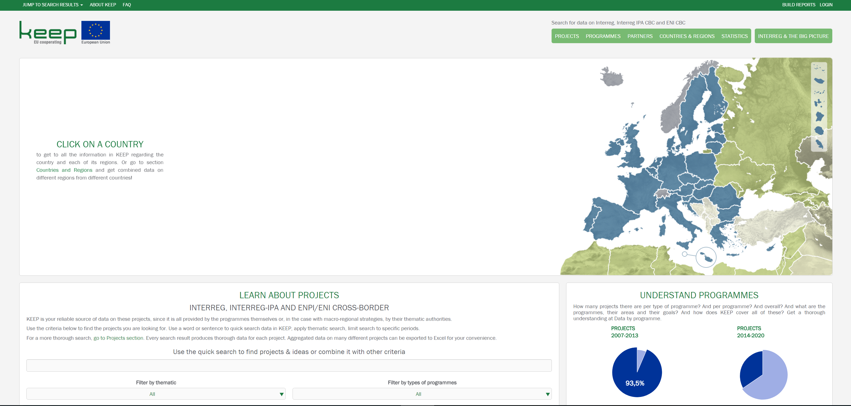
Capitalisation: what INTERACT II did?
KEEP

Slide 13
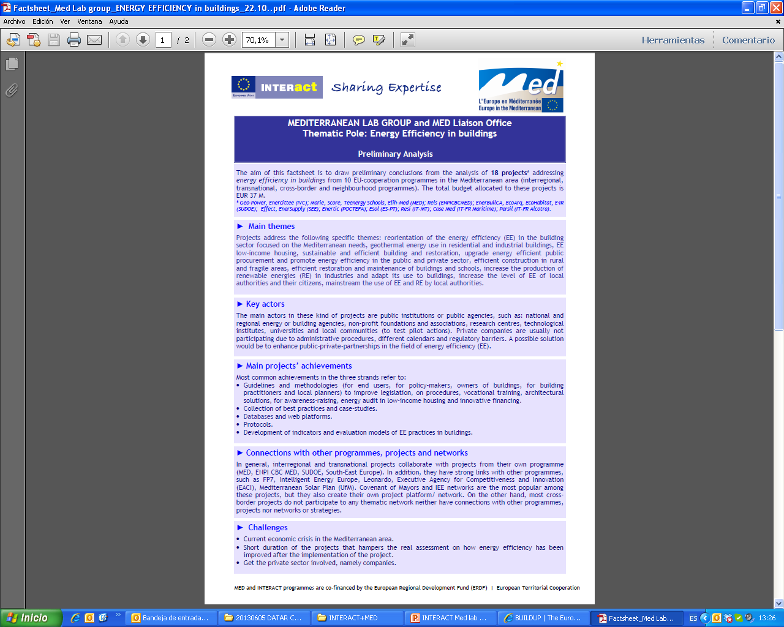
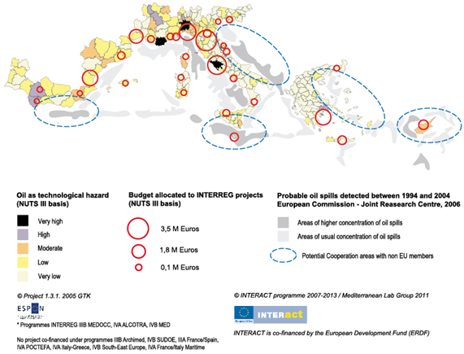
Capitalisation: what INTERACT II did?
Mediterranean Lab Group

Slide 14

Capitalisation: what INTERACT II did?
Booklet: European Cooperation in action! 2007 - 2013
How cooperation across borders has changed people's lives

Slide 15
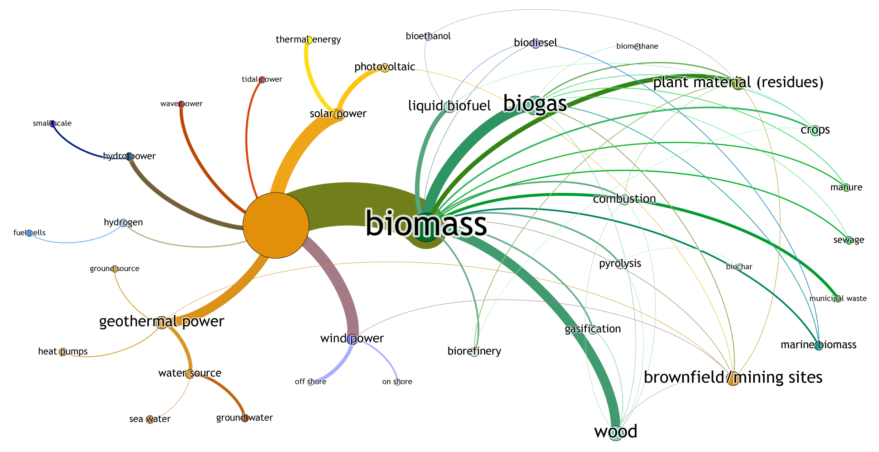
Capitalisation: what INTERACT II did?
Study on ETC energy projects

Slide 16

Capitalisation: what INTERACT II did?
Study on Culture and Creative Industries projects
Identification of main project activities.
This approach allowed us to answer questions regarding the frequency of project activities in relation to the thematic focus areas for the funding period 2007-2014.
For example:
What types of cooperation activities have been funded most frequently in the field of Cultural Tourism?
What is the importance of education and life-long learning in multi-national creative industries projects?
Which types of activities tend to occur in tandem with other types of activities?

Slide 17
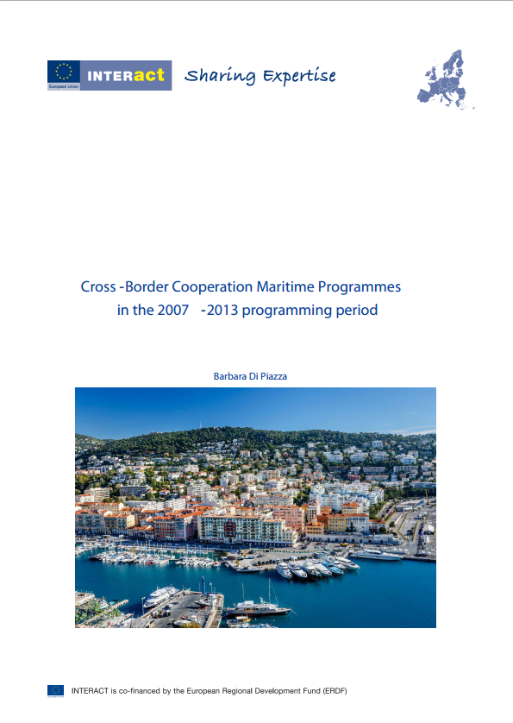
Capitalisation: what INTERACT II did?
Study on Cross-Border Cooperation in Maritime Programmes in the 2007-2013
The study focuses on 14 maritime cross-border programmes
identified 200 marine/maritime projects – around - have been granted EUR 315,7 million ERDF, i.e. around 25% of the programmes’ funds.
to highlight the contribution of cross-border projects linked to the most relevant themes of the marine/maritime policy
The report highlights the potential of marine/maritime cross-border projects to add value to policy and strategy development, and contribution to EU2020 goals.
The study is addressed to programme implementers and potential project applicants in search of inspiration and taking advantage of already funded projects.

Slide 18

Capitalisation: what INTERACT II did?
The Scoping Studies
The purpose of the Scoping Study was two-fold:
First, experts assessed what role can cross-border, transnational and interregional cooperation play to deliver each Thematic Objective and Investment Priority of the 2014-2020 ESIF framework.
Second, experts looked at the environment, climate change, accessibility and sustainable transport trends on a European level over a longer time period (1990-2020) and compared them with the Interreg activity.

Slide 19
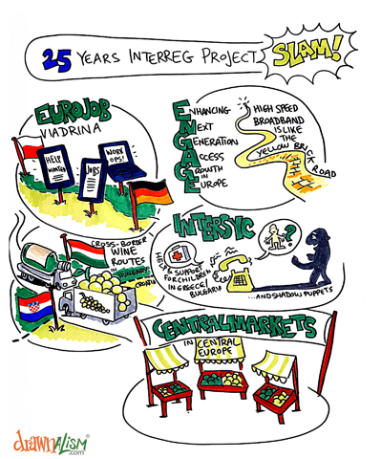

Capitalisation: what INTERACT II did?
Project Slam Interreg 25 years
Specific call and methodology to identify and present Programme’s and project results during the “25 years of Interreg” Conference in Luxembourg (15-16 Sept,).
Methodology made available to Programmes with all related materials: Call for proposals, Pre-selection of 5 projects, Preparation of the performances and Session, tools developped, videos of the session, etc.

Slide 20

Lessons learnt from INTERACT II
Programmes’ capitalisation processes need to be structured and integrated from the start of the programming period
Need for effective re-use of thematic knowledge
Support result orientation
Involve stakeholders, other tan usual projects or programmes practitionners

Slide 21
Interact Capitalisation Plan
Objectives
To define the main actions and work
Identification, analysis and promotion of capitalisation approaches;
Set-up and implementation of thematic networks;
Promotion of Interreg results.
Clear identification of themes
Specific survey to Programmes, according to thematic choises

Slide 22
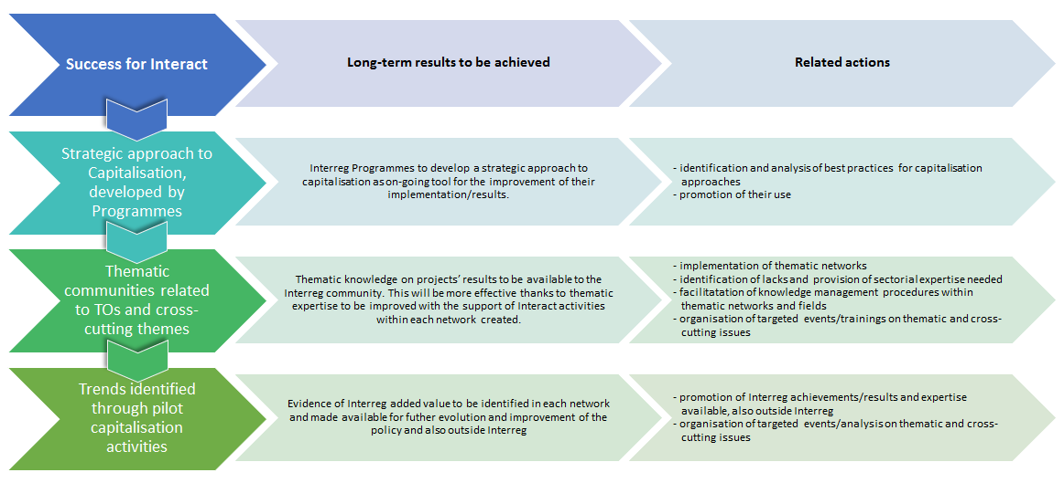
Capitalisation of Interreg results: how?
Interact has defined a series of long-term strategies, results :
1
2
3

Slide 24
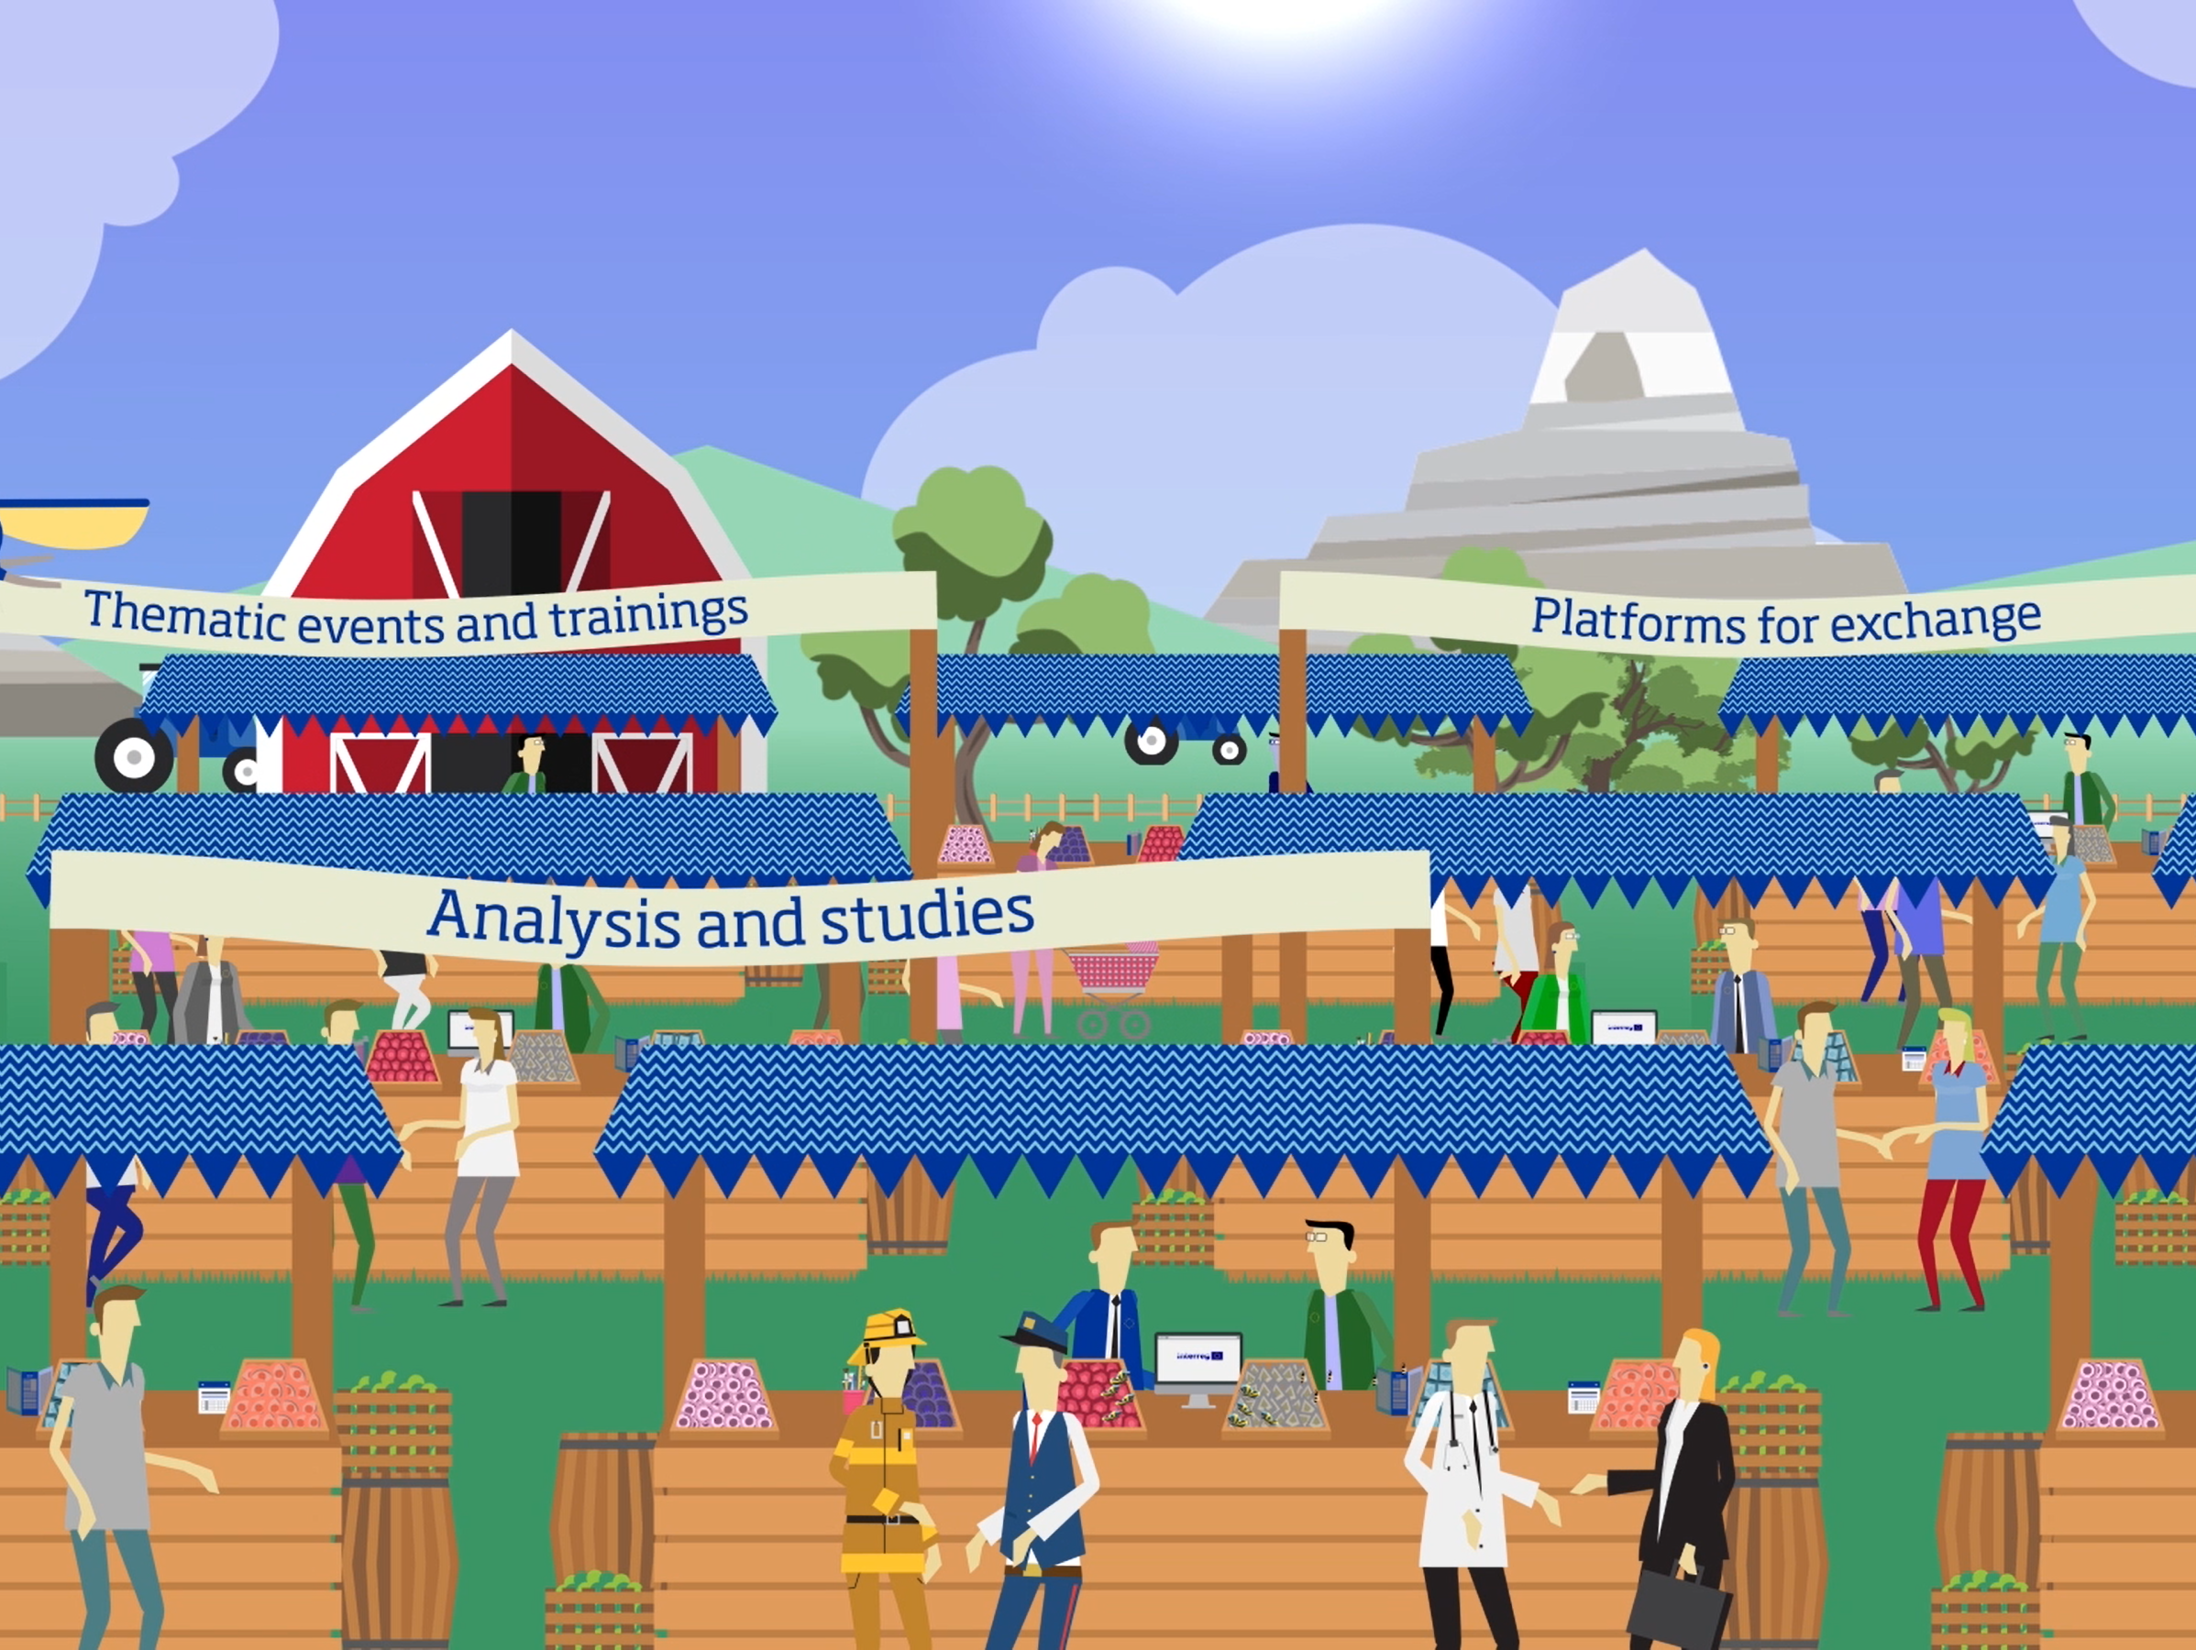

Slide 25
Support to Capitalisation
Capitalisation as management practice: Workshops, trainings, publications and materials | Thematic network: Meetings, on-line platforms, pubications
Event on Capitalisation practices (2007-2013), challenges and approaches (2014-2020) | Interreg response to migration network
ComCap workshop - hints to promote Interreg results (Budapest – 5-6 July 2017) | Sustainable transport
Interreg Talks (EWRC – October 2017) | Knowledge of the seas network
Publication and repository of capitalisation practices (July 2017) | Climate change network
Publication on promotion of results (July 2017) | Inclusive growth network
 | Better governance network

Slide 26
Interact Capitalisation Networks
The capitalisation networks will :
constitute a resource for gaining new contacts and knowledge, providing opportunities and inspiration;
be a support framework to refer to for advice, support, coaching, mentoring for its members and even beyond.
establish synergies with other initiatives and contexts which are not related to the Regional Policy and whose focus is in line with the issues addressed through the capitalisation networks.
serve both the purpose of learning/receiving as well as of promoting/sharing knowledge, information and achievements of Cooperation Programmes.
The main users of the networks will be the Interreg, Interreg IPA CBC and ENI Programmes.

Slide 27
Thematic support to Interreg Programmes
Interreg Europe | Interact
Research, technological development and innovation (TO 1) | Migration
Competitiveness of SME’s (TO 3) | Sustainable transport (TO 7)
Shift towards a low-carbon economy (TO 4) | Maritime issues/Knowledge of the Seas
Preserving and protecting the environment and promoting resource efficiency (TO 6) | Climate change and risk management (TO 5)
 | Inclusive growth (TO 8-9-10)
 | Better governance (TO 11)

Slide 28
Interact Capitalisation Networks: Topics
Interact carried out a capitalisation survey among cooperation programmes in November 2015 to better define its supporting role in the field of capitalisation.
A list of themes and cross-cutting topics were identified to respond with a more structured approach for its capitalisation work.
TO7 – Sustainable Transport Network
TO5 - Climate change and Risks Network (covering the topic cross-border disaster management)
TO8, TO9 and TO10 – Inclusive Growth
TO11 – Better administration and cooperation
These networks are going to be implemented starting from 2016 until the closure of Interact III.
Beside these new networks, Interact will continue to work on three networks which have already been started,
Knowledge of the Sea,
Interreg response to migration challenges
Mediterranean Lab Group (specific topics and ad-hoc services)

Slide 29
Interact Capitalisation Networks: features
A way to capitalise Interreg results...

Slide 30
Other activities
In addition to the general support and capitalisation networks, Interact III implements also a series of other activities, such as:
Coordination with other Interregional (Pan-European) Programmes
Coordination of capitalisation activities will be ensured with URBACT, ESPON and Interreg Europe,
A specific coordination with latter is already on-going in order to include Interreg knowledge in its Policy Learning Platforms,
Interact will work in order to achieve a strong liaison with Interreg Europe's Policy Learning Platforms and to provide information on Interreg trends and role within Thematic Objectives 1, 3, 4, 6, aligning thematic knowledge.

Slide 31
Challenges and aims of Interreg Capitalisation
Challenges | Aims | Activities (examples)
Thematic concentration and better quality of projects | Gathering information | KEEP Factsheets on capitalisation approaches Capitalisation conference Capitalisation Networks (ICNs): - Desk analysis and reports - Peer-to-peer exchanges
Avoiding double funding
Focus on results 2014-2020 | Providing thematic expertise and analysis | Capitalisation Networks (ICNs): - Desk analysis and reports - Peer-to-peer exchanges
Lack of thematic expertise
Raising awareness and communication | Promotion, transfer and re-use of results | Synergies with bigger networks (within ICNs) Capitalisation conference CapCom Training Interreg Talks
Influencing policies | Advocacy/influencing Interreg stakeholders and beyond | ICNs CapCom Training Interreg Talks

Slide 32
Capitalisation shall transform the Programme’s achievements into long lasting and durable values
(Danube TN Programme Capitalisation Strategy)

Slide 33

Next Interact events
Save the dates:
Working group on Simplified Cost Options, 13 June 2017, Malta
Audit Authorities (AA) network meeting, 14 - 15 June 2017, Malta
Certifying Authorities (CA) network meeting, 15 June 2017, Malta
eMS user group meeting, 28 June 2017, Vienna
Interreg finance management camp, 4-7 July 2017, Riga
Cap&Com Workshop, 5-6 July 2017, Budapest
Interreg Project Management camp, 12-15 September, Netherlands
Interreg Talks, October 2017, Brussels @ EWRC

Slide 34


Cooperation works
All materials available on:
www.interact-eu.net
Contact: Ivano Magazzu, ivano.magazzu@interact-eu

