Slide 1


Let‘s practice capitalisation!
Inclusive Growth
Let‘s practice Capitalisation!
7 June 2017 | Rome, Italy
@InteractEU
Mercedes Acitores and Daniela Minichberger,
Interact Programme

Slide 2
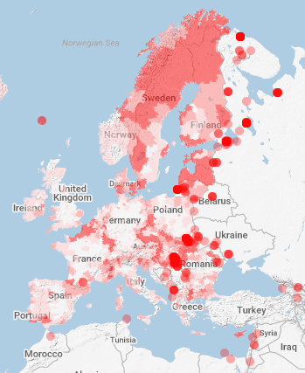
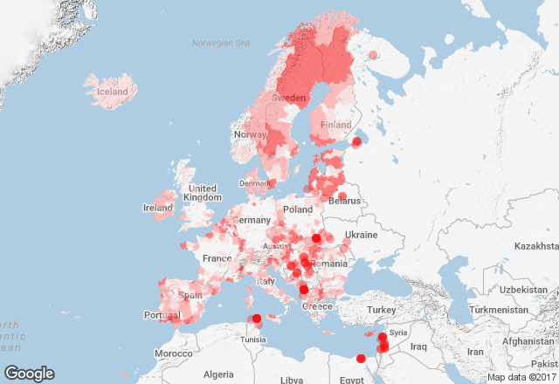
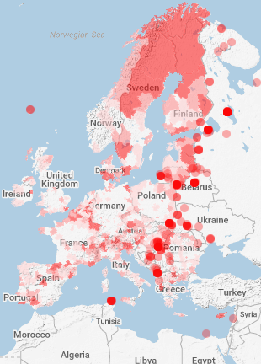

Selection of INTERREG projects 2007-2013 in this topic
Education and Training
Labour market and Employment
Health and Social Services
Source: KEEP

Slide 3
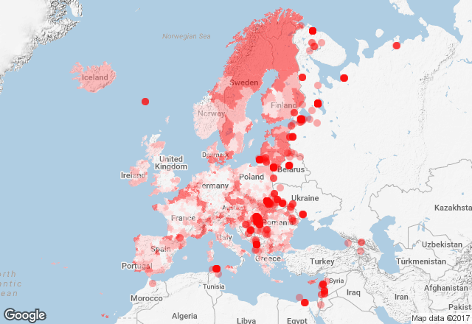
INTERREG projects 2007-2013 dealing with TOs 8 , 9 and 10
Distribution of 1848 projects dealing with Education, Employment and Social Services in programming period 2007-2013
Source: KEEP

Slide 4
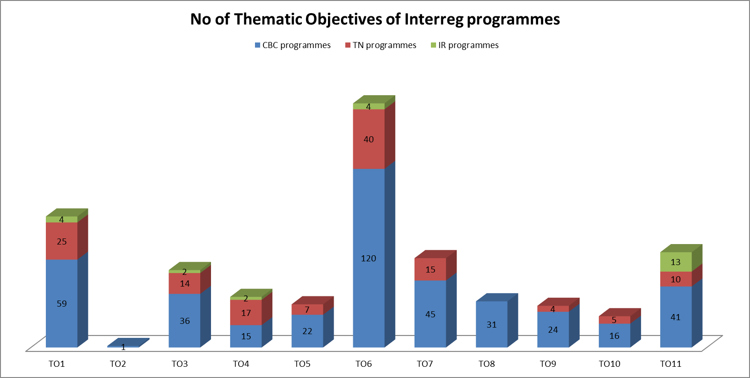
INTERREG 2014-2020 – overview of TOs
TOs:
(8) promoting employment and supporting labour mobility through:
(9) promoting social inclusion and combating poverty through:
(10) investing in education, skills and lifelong learning by developing education and training infrastructure;

Slide 5
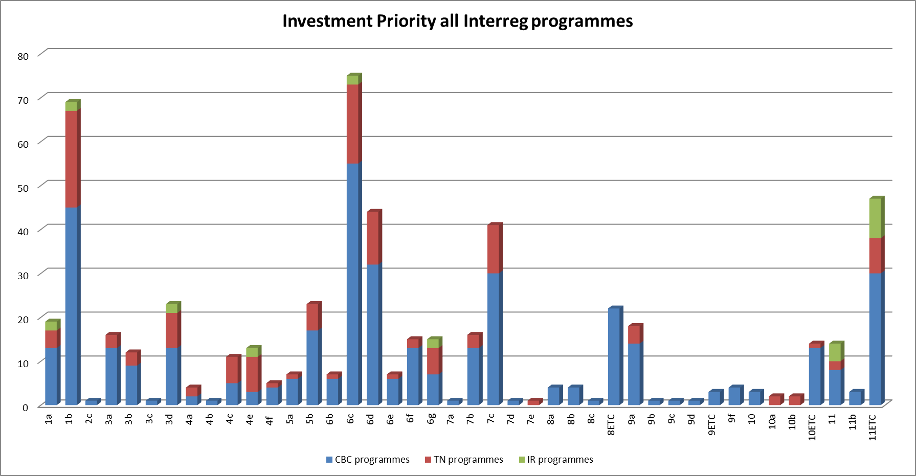
INTERREG 2014-2020 – overview of Investment Pritorities
(8) promoting employment and supporting labour mobility through:
(8a) development of business incubators and investment support for self-employment, micro-enterprises and business creation;
(8b) supporting employment friendly growth through the development of endogenous potential as part of a territorial strategy for specific areas, including the conversion of declining industrial regions and enhancement of accessibility to and development of specific natural and cultural resources;
(8c) local development initiatives and aid for structures providing neighbourhood services to create new jobs, where such actions are outside the scope of Regulation (EU) No […]/2012 [ESF];
(8d) investing in infrastructure for public employment services;
8)ETC specific, for cross-border cooperation: integrating cross-border labour markets, including cross-border mobility, joint local employment initiatives and joint training;
(9) promoting social inclusion and combating poverty through:
(9a) investing in health and social infrastructure which contribute to national, regional and local development, reducing inequalities in terms of health status, and transition from institutional to community-based services;
(9b) support for physical […] economic and social regeneration of deprived urban and rural communities and areas;
(9c) support for social enterprises;
9 ETC specific, for cross-border cooperation: promoting gender equality and equal opportunities across borders, as well as promoting social inclusion across borders
(10) investing in education, skills and lifelong learning by developing education and training infrastructure;
10)ETC specific, for cross-border cooperation: developing and implementing joint education and training schemes

Slide 6

Capitalisation Survey - overview of results

Slide 7



Capitalisation network on Inclusive Growth!
The Inclusive Growth Network is addressed to the Interreg community, thematic experts, stakeholders and other EU co funding programmes that are interested in working on several matters, such as employment & self-employment, labour mobility, social inclusion, improving professional skills and lifelong learning.
This platform will focus on:
making available relevant data,
facilitating the exchange of practices and
gaining knowledge about the current experiences and themes,
with the aim to support a common Interreg response to the EU Inclusive Growth policy.

Slide 8
Activities within the Networks

Slide 9


Let‘s start a fruitful journey together!

Slide 10
Cooperation works
  All materials will be available on:
  www.interact-eu.net
mercedes.acitores@interact-eu.net
daniela.minichberger@interact-eu.net

