Slide 1


Let‘s practice capitalisation!
Ideas and cross-fertilisation
with Thematic Networks –
Climate Change and Risks
Let‘s practice Capitalisation!
8 June 2017 | Rome, Italy
@InteractEU
Manuel Gonzalez, Interact Programme

Slide 2
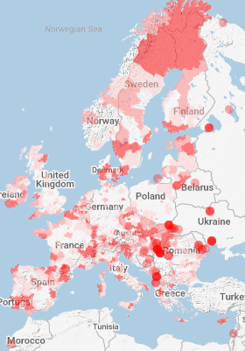
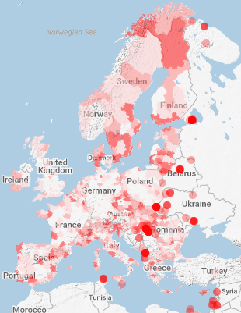
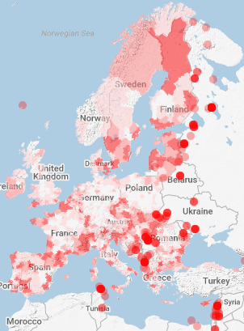

Selection of INTERREG projects 2007-2013 in this topic
Ciimate change and biodiversity
Managing natural threats and risk management
Sustainable management of natural resources
Source: KEEP

Slide 3
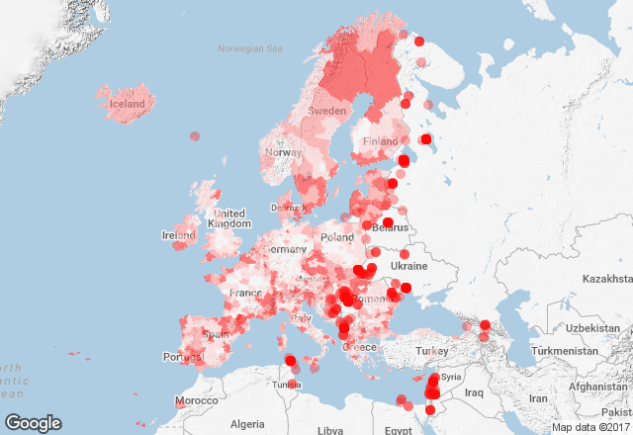
INTERREG projects 2007-2013 dealing with TO 5
Distribution of 1337 projects dealing with Climate change, risks management and sustainable management of natural resources in programming period 2007-2013
Source: KEEP

Slide 4
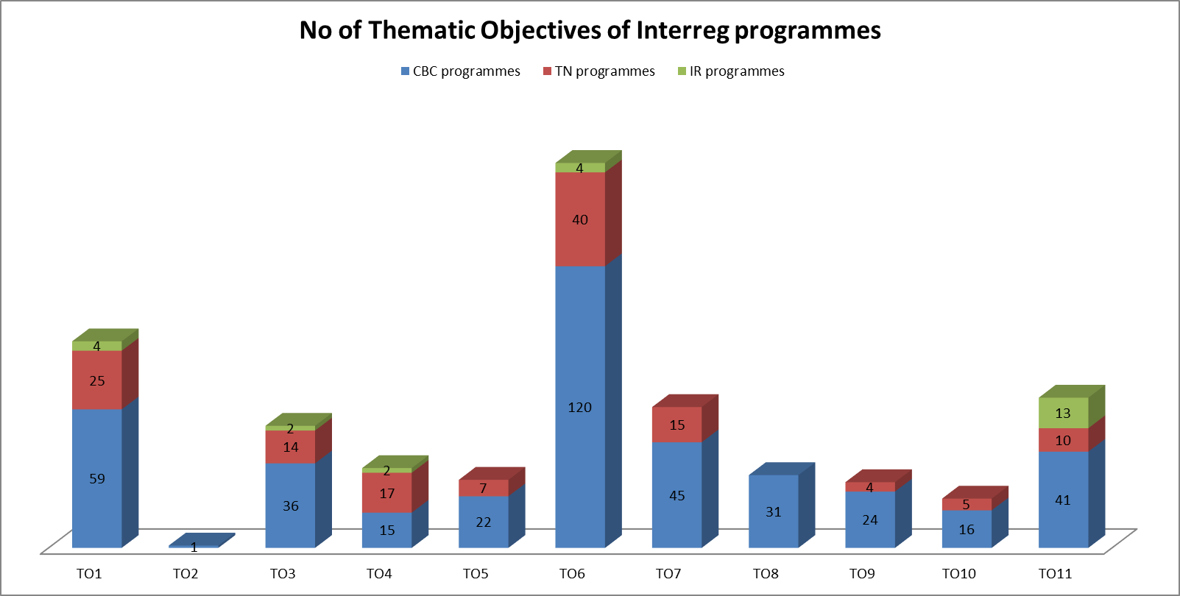
INTERREG 2014-2020 – overview of TOs
TO 5 : promoting climate change adaptation, risk prevention and management

Slide 5
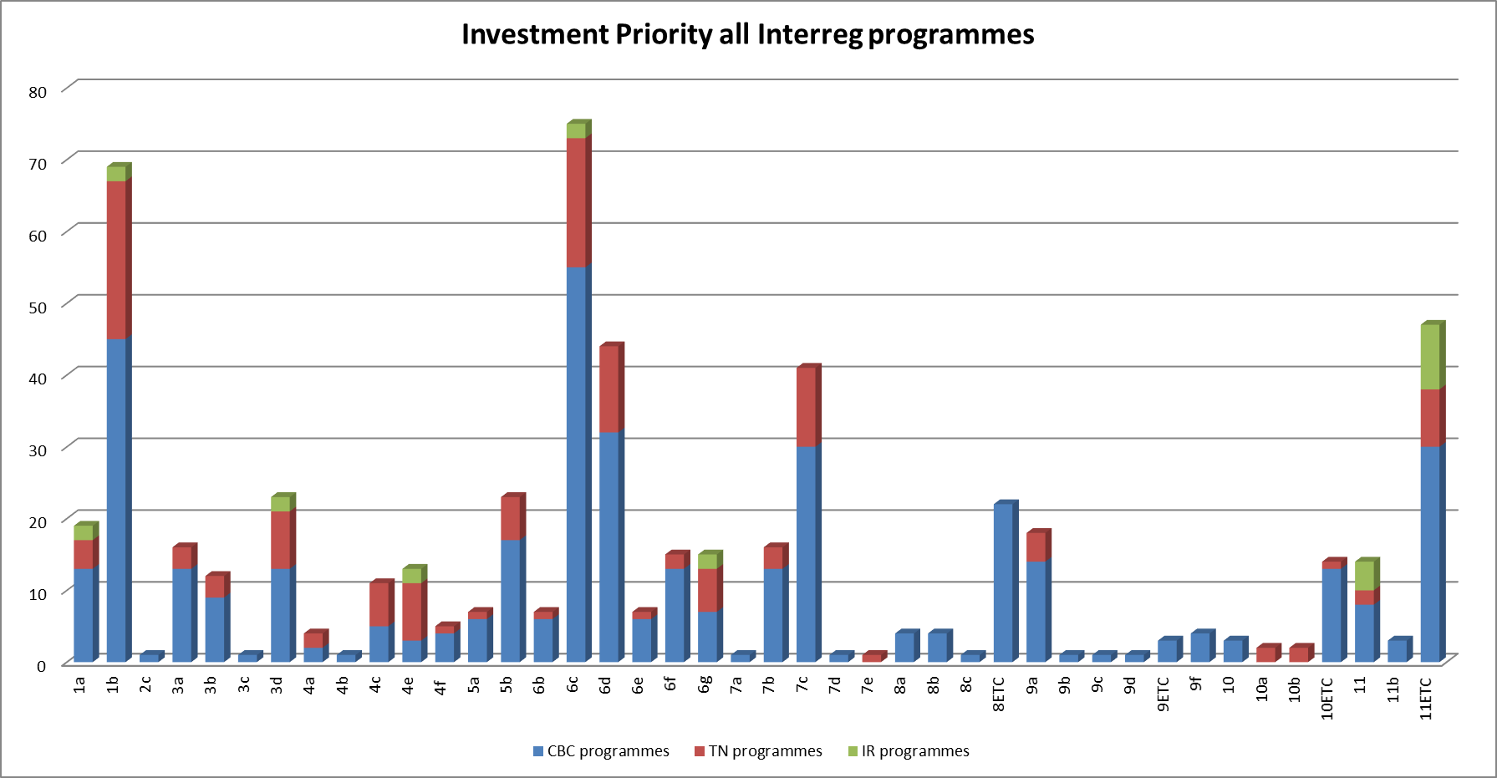
INTERREG 2014-2020 – overview of Investment Pritorities
(5) promoting climate change adaptation, risk prevention and management through:
(5a) supporting investment for adaptation to climate change, including ecosystem-based approaches;
(5) promoting climate change adaptation, risk prevention and management through:
(5b) promoting investment to address specific risks, ensuring disaster resilience and developing disaster management systems;

Slide 6

Capitalisation Survey - overview of results

Slide 7



Capitalisation network on Climate Change and Risks!
The network of Climate Change and Risks brings together practitioners from the Interreg community, regional stakeholders, experts and other EU programmes and knowledge communities active in the field of climate change and risks. The goal of this network is:
to facilitate the exchange of practices and lessons learnt among existing projects,
to gain knowledge about the current experiences and themes,
with the aim to support a common Interreg response to the EU Sustainable Growth policy.
Some of the topics addressed are joint risk management systems and environmental emergencies related to climate change, joint initiatives, strategies, services and training in awareness campaigns on combating climate change and managing environmental risks, and environmental disaster management systems.

Slide 8
Activities within the Networks
What are your expectations and priorities for 2017/18?

Slide 9
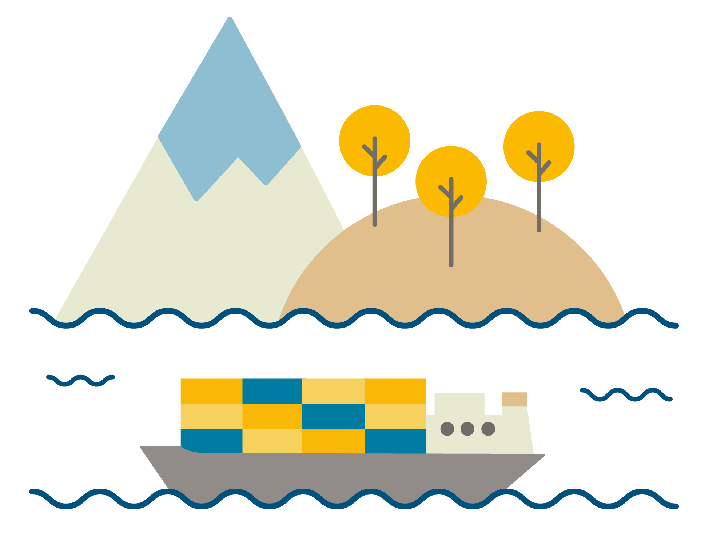

Let‘s start a fruitful journey together!

Slide 10
Cooperation works
  All materials will be available on:
  www.interact-eu.net
manuel.gonzalez@interact-eu.net

