Slide 1
Capitalisation in Interreg MED:
getting there
Nuno Vaz Silva
Project Officer
Joint Secretariat Interreg MED

Slide 3
First Try – 2007-13
Clustering projects
Started with huge brainstorms, meetings and workshops involving project partners and a consortium of external experts (from 2009 on)
Challenging (just a little) the programme format
In itinere evaluation (questionnaires, analysis);
JTS data base collecting information on main project characteristics;
Interaction with other ETC programmes.

Slide 4
First (kind of) Failure – 2007-13
Clustering projects
The relation with the external experts didn’t work so well (too different approaches programme vs experts);
Projects uncomfortable with the requested/imposed clustering process
Challenging (just a little) the programme format
Testing different types of projects – strategic and targeted calls – with mitigated results depending on the calls;
Lots of data and not so much usability/difficult to compare

Slide 5
Try again

Slide 6
Try again – 2007-13
Reshuffle of the capitalization strategy
A lot of work at internal level (progressive thematic specialization of the JTS team; major brainstorms on breaking the typical project formats; extracting the most of the aggregated data on projects themes, outputs, partners)
Increased incentive to bring projects (naturally) together

Slide 7
The turning points
The call for capitalization projects
A call to look back to what had been done and deliver new outputs from the analysis/synthesis of available results;
Improved application forms (centered in showing the (re)use of available results to achieve tangible outputs);
Regrouping projects in major thematic communities from the beginning ;
Pushing towards the cooperation inter-projects -> resulted in a couple of intermediary joint seminars and a final restitution and brainstorming joint major event in the CoR.

Slide 8
The turning points
The ComCap project – the grandfather of horizontal projects
In the framework of the last call for proposals, a project was approved with the mission to aggregate, digest and communicate the outputs and achievements of all the projects of that call.
Strongly centered in communication issues, supported each individual project and the whole group of 13 partnerships while activities were being developed.

Slide 9
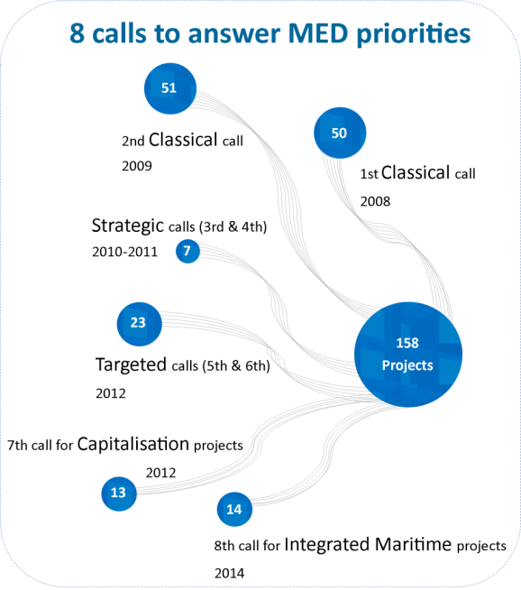
A long walk in a (very) short time
2012: call for
CAPITALIZATION

Slide 10
Getting there – 2013-20
Every day's life
JS staff organized in thematic (incredible) duos per SO;
One single web platform to gather all project websites and deliverables;
Converging templates and terminology to the harmonized proposals developed by INTERACT with the other programmes;
Increased cooperation with the other programmes (in particular those sharing some Mediterranean corner);
Preparing specific terms of reference per SO, after consulting relevant stakeholders (thematic programmes, major EU networks…)

Slide 11
Getting there – 2013-20
Explode the traditional project/programme format
Three types of modules to conceive projects:
Module 1: STUDYING: designing common approaches & strategies at TN
Module 2: TESTING: Pilot demonstration actions
Module 3: CAPITALISING: Transfer, dissemination and capitalisation

Slide 12
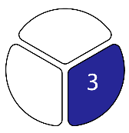
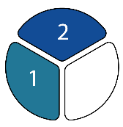
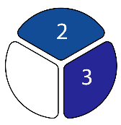
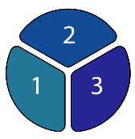
Getting there – 2013-20
Explode the traditional project/programme format
The modular projects:
The horizontal projects:
community building
joint communication
joint capitalisation/transfer
Single Module
Combination of Modules

Slide 13
The fundamental scheme
2
HP Green Growth
Facilitation
1
2/3
3
Innovation
HP Blue Growth
Results
1/2
1/2/3
HP Social & Creative
exchanges
2
Facilitation
1
2/3
HP Efficient Buildings
3
Low-carbon
economy
Axis 4 – platform
Results
1/2
HP Urban Transport
1/2/3
HP Renewable Energy
exchanges
2
HP Sustainable Tourism
Facilitation
1
2/3
Natural
and cultural
Resources
3
HP Biodiversity Protection
Results
1/2
1/2/3

Slide 14
Where this is heading – 2013-20
Individual project results are transformed to « policy-making material »
Enhanced visibility and usability of individual project results;
Increased capitalization potential through thematic communities;
Support science-policy interface approach;
Increased impact on programme territory;
Structured use of project results to improve transnational governance in the Mediterranean;
Open approach: can integrate project results from outside Interreg MED

Slide 15
Indisputable principles
The HPs constitute a support for a better implementation of the project and for a bigger impact of the project’s results.
Partners are not working just in their project but in an integrated and interconnected thematic community. It is not a matter of “wasting” time that had been foreseen for project specific activities and spend it in thematic community actions. It’s rather a question of integrating this cooperation in the process itself.
The methodology to make this architecture alive has an evolutionary nature. It is meant to be appropriated and adapted by the projects, according to their implementation.

Slide 16
Experience so far
Projects interact in effective way with each other;
Common calendars at the level of the thematic communities containing all projects activities, which can be of use to other Horizontal Projects;
Ongoing mapping of the location of project partners, the area of influence of each project, activities, policies;
Establishment of working groups gathering projects with some thematic affinity;

Slide 17
Experience so far
Joint preparation (JS, HPs and MPs) of the mid-term conference -> thematic communities are expected to show how individual results can be ‘translated’ into shared common messages and related benefit, both for the citizens and the projects as well as to policy making at regional, national and transnational level;
Direct involvement of HP in methodological definition for axis 4

Slide 18
Experience so far (trying again)
HPs play the game, but some modular projects/partners still look distrustful or not completely convinced of the purpose/usefulness of such an organization;
Thematic communities have distinct rhythms which is normal and even enriching but demanding for coordination;
The delay in delivering the web-platform makes it more difficult the overall appropriation and dissemination of the projects/communities
The borders between projects within the same thematic community are loosen but not so much between thematic communities.

Slide 19
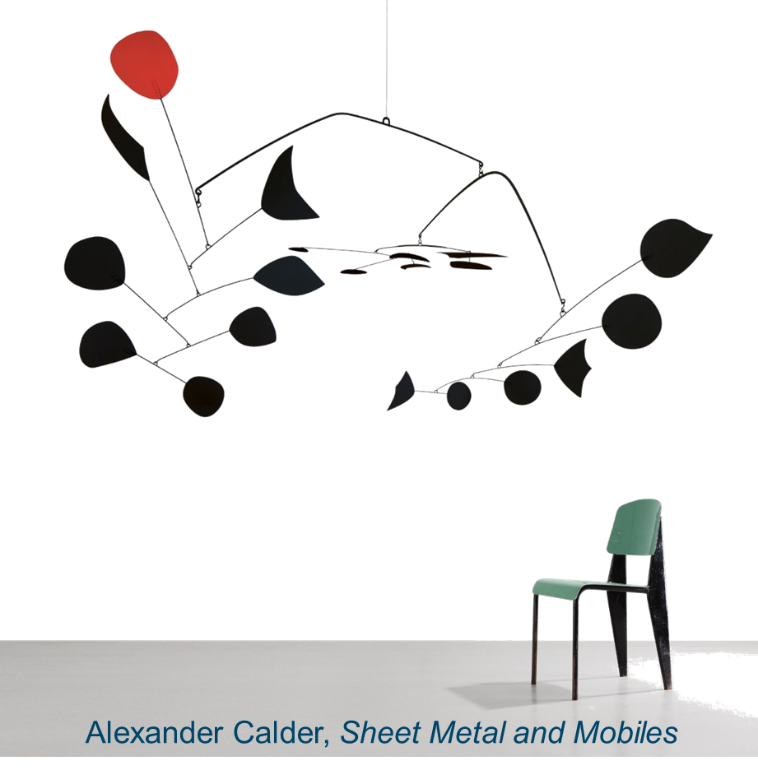
better and better ☺

Slide 20
THANK YOU
Nuno VAZ SILVA
Interreg MED Programme – Joint Secretariat
ncvazsilva@regionpaca.fr – www.interreg-med.eu

