Slide 1
Agenzia per la coesione Territoriale
___________________________________________________________________________________________________________________
Let’s practise Capitalization
Rome, June 7th 2017
Paolo Galletta
Agency for territorial Cohesion
Office VI – ETC Programs, international activities, bilateral cooperation

Slide 2
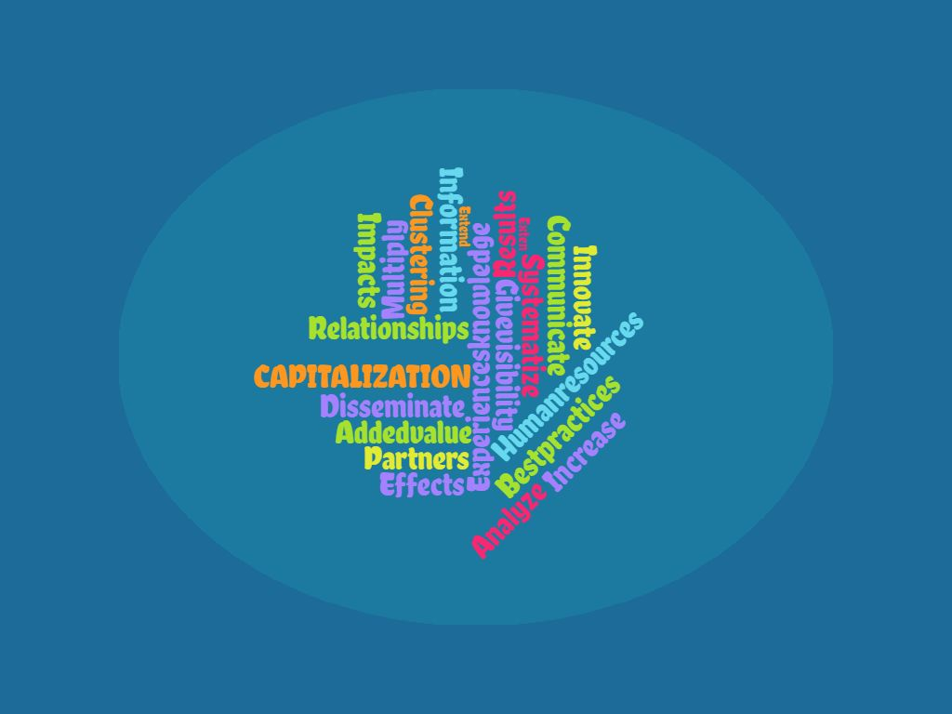
Agenzia per la coesione Territoriale
___________________________________________________________________________________________________________________

Slide 3
Agenzia per la coesione Territoriale
___________________________________________________________________________________________________________________
What is capitalization?
Capitalisation
Capitalisation is the valorisation of knowledge and results generated by previous projects in a certain thematic field meant to ensure a stronger impact on the policy making process at local, regional, National and European level.
(IT-HR Application Package - Glossary).
We have to share a common and recognized definition

Slide 4
Agenzia per la coesione Territoriale
___________________________________________________________________________________________________________________
Why we want to capitalize?
Capitalization process objectives
Identify and disseminate the results achieved in specific areas;
Draft new project proposals building up from the experiences and the knowledge already acquired;
Promote reuse and / or transfer of knowledge and experience;
Encourage further achievement through the improvement and / or consolidation of previous experience and knowledge.

Slide 5
Agenzia per la coesione Territoriale
___________________________________________________________________________________________________________________
What we capitalize?
Capitalization among programming periods
Capitalization among ETC/Mainstream
Intra-Program Capitalization
2007-2013
2014-2020
ETC Projects
Other ESI FUNDS Projects
Projects Call 1,..
Projects new Call

Slide 6
Agenzia per la coesione Territoriale
___________________________________________________________________________________________________________________
What we are doing to capitalize?
What we have done:
2007-2013: Capitalization Plans and Capitalization calls in order to prepare new 2014-2020 Programs
What we are doing:
2014-2020: Specific calls (MED-Horizontal Projects; Standard + IT-HR; Best Practices URBACT III; Interreg Platforms…)
What we can do in the future:
Promote a better understanding of Interreg projects results/outputs, in particular among structures managing mainstream Programs
Promote intra-programs synergies: MC participation; cross-cutting evaluation and communication activities; integrated monitoring systems/database/reporting;
Exploit opportunities given by integration: ITI-CLLD; art. 96.3.d

Slide 7
Agenzia per la coesione Territoriale
___________________________________________________________________________________________________________________
Italian experience
ETC Strategic Group: foreseen by Italian Partnership Agreement for the strengthening of complementarity and integration between ETC Programs and the Mainstream Programs;
Implementation of monitoring activities;
Communication activities: publication of information on ACT website; coordination and information meetings; Events (EC Day 21st September);
Report on Italian participation to ETC Programs (by the end of the year), in which there will be a section on capitalization activities.

