Slide 1
European Cooperation Day
Interreg Communication Network Seminar
Gabriel Alvarez
12 April 2016 | Gdansk, Poland
Interact is co-financed by the European Regional Development Fund (ERDF)
Notes:
Instructions for the INTERACT PowerPoint presentation template:
TITLE SLIDE/FRONT PAGE – GENERAL RULES FOR FONT/FORMAT/COLOURS
Main presentation title: Trebuchet MS font, size 36, colour Black
Presentation subtitle: Trebuchet MS typeface, size 24, Regular, colour Blue (14-64-150) - See blue colour standards in the INTERACT Style Guide
Date and place text box: Trebuchet MS typeface, size 24, Regular, colour Black
STANDARD PAGE/SLIDE – GENERAL RULES FOR FONT/FORMAT
Body text font: Trebuchet MS (+ bold, + italics)
Title above the upper pink line: Trebuchet MS – 16
This page title (above the upper pink line) is an optional field, you can leave it empty (no text will appear in printed or slide show version)
Headlines on the pages: Trebuchet MS – 32
First level text on the pages: Trebuchet MS – 24
Size of other body text (2nd level etc) : minimum 16
Format of the text:
No use of “justified”
Text box on standard pages: in line with the pink upper line, never larger
STANDARD PAGE/SLIDE – GENERAL RULES FOR COLOURS
Upper title above upper line: Blue (14-64-150)
Colour of body text: Black
Main titles: Blue (R 14, G 64, B 150)
Body text: Regular (normal)
Text highlights: Pink colour (216-0-115) - See pink colour standard in the INTERACT Style Guide
Quotes: Italics and blue (14-64-150) - See blue colour standards in the INTERACT Style Guide

Slide 2
Concept
Communication seminar | European Cooperation Day
An EU-wide communication campaign to:
Disseminate project results
Raise awareness about the importance of territorial cooperation
It is done through the organisation of events to engage local communities
Interreg, Interreg-IPA CBC and ENI programmes are responsible for the organisation of the events
It takes place every year on 21 September and surrounding days
Coordinated by Interact and supported by European Commission, European Parliament and Committee of the Regions

Slide 3
Overview
Communication seminar | European Cooperation Day
Four years with over 700 local events
Events taking place in over 40 countries
Participation of 70% of the programmes

Slide 4
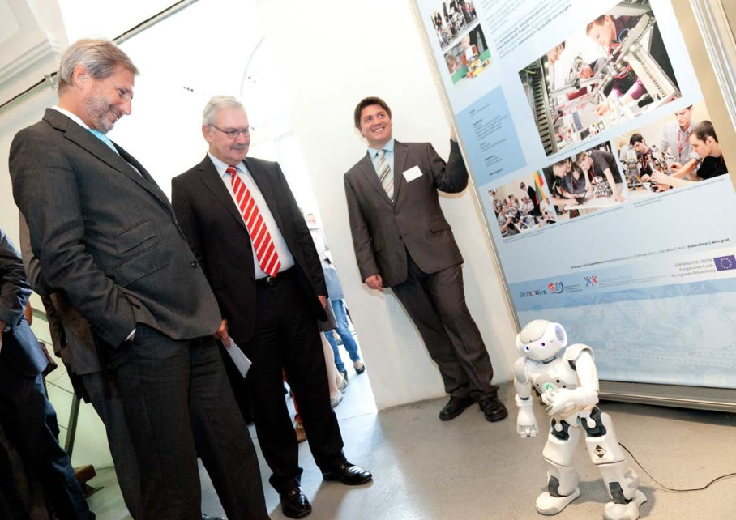
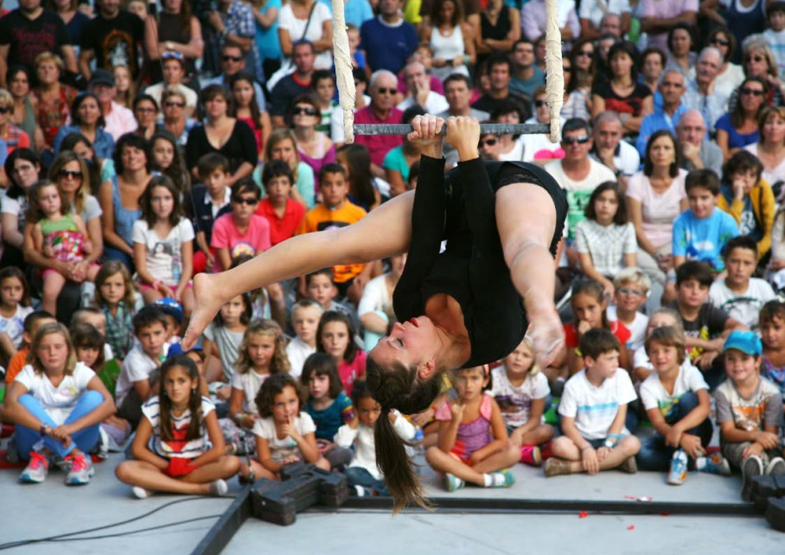
Types of events
Communication seminar | European Cooperation Day

Slide 5
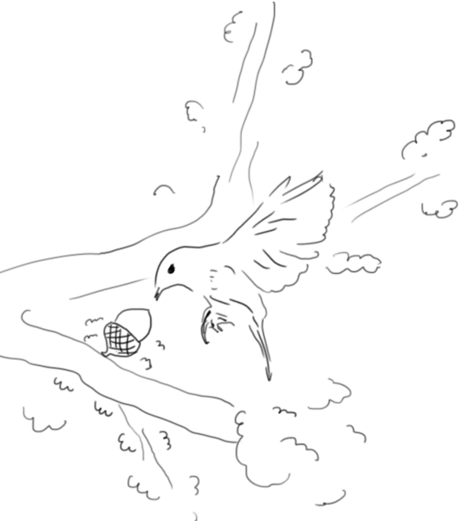
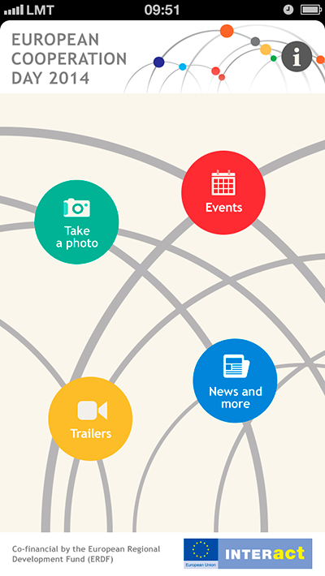
Celebrating five years
Communication seminar | European Cooperation Day
Kick-off event
Contest
Promotional video
Promotional materials
Website
Social media
Visual identity
Guide

Slide 6
Group discussions – 2017 and beyond
Communication seminar | European Cooperation Day
Renaming the initiative:
Interreg day?
Interreg ENI day?
Staying put with European Cooperation Day
Fine-tuning the target group:
Local communities
policy makers
both
Nature of the events
Going thematic
Keeping it open

Slide 7
Thank you for your attention
Please do not hesitate to contact us for any further information
or visit www.interact-eu.net

