Slide 1
2021-2027 Indicators and intervention logic REGIO B2 Evaluation and European Semester Unit

Slide 2
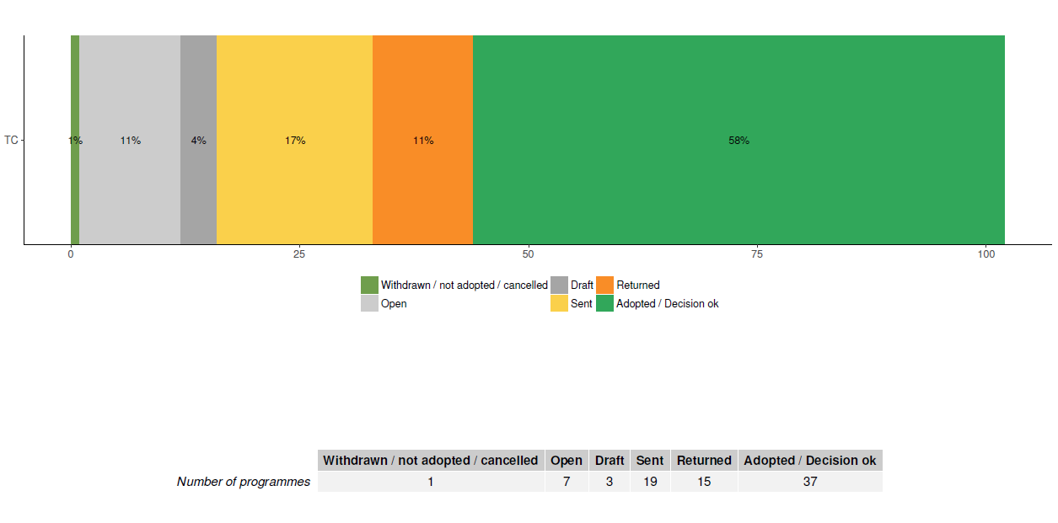
Points of discussion
1) The indicator system
2) Thematic allocations
3) What we have seen in the methodology documents
4) Open Data Platform
5) Final remarks
Overview of ETC programme status, September 2022

Slide 3
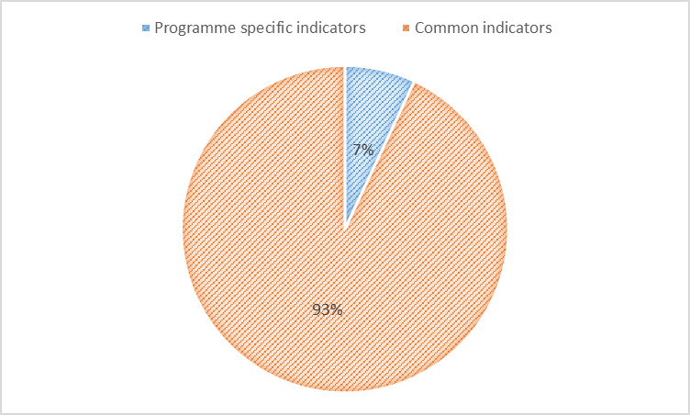
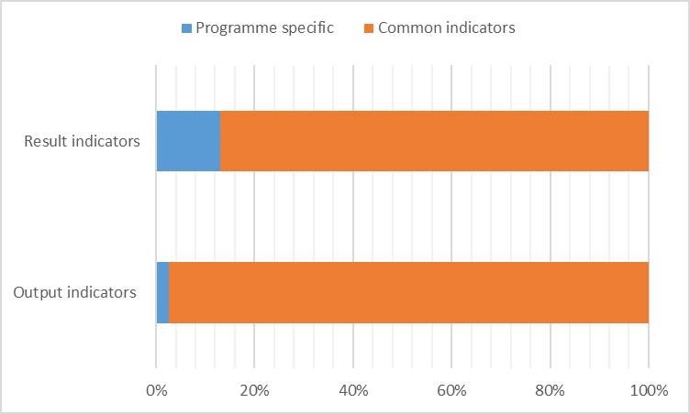
(1) Indicators
(adopted programmes, September 2022)
Aprox. 1500 indicators encoded:
1400 common
100 specific
Among the common indicators encoded:
1150 Interreg indicators
250 ERDF indicators

Slide 4
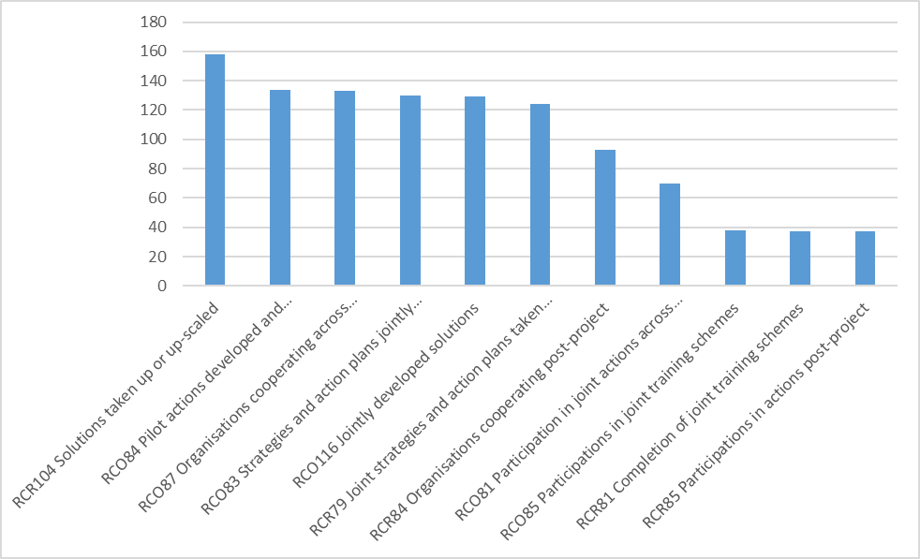
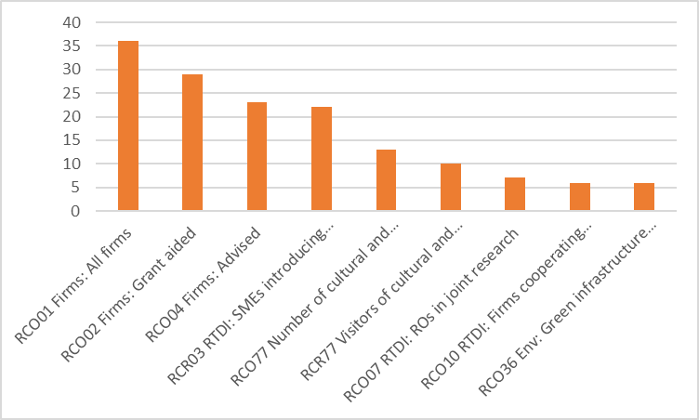
(1) Indicators

Slide 5
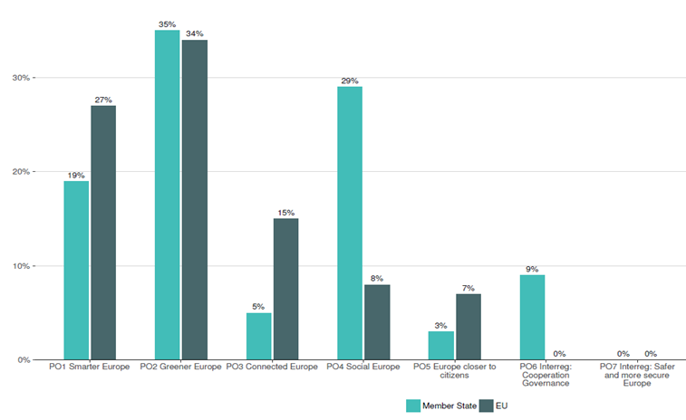
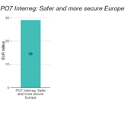
(2) Thematic allocations

Slide 6
(3) What we have seen in the methodology documents
A positive shift towards using the common indicators
A high coverage of the actions proposed through the selected indicators
Two main approaches for target calculation (unit cost, outputs/project)
Low values for milestones due to the need to report on finalised operations

Slide 7
(4) Open Data Platform
Chapter 3 of EU allocations datastory : https://cohesiondata.ec.europa.eu/stories/s/2021-2027-EU-allocations-available-for-programming/2w8s-ci3y
Interreg page in development: https://esif-development.azure-westeurope-prod.socrata.com/funds/2014-2020
In a few months we will have
Programme pages for each programmes
Refined charts on achievements (showing Interreg strands)

Slide 8
(5) Final remarks
The targets should be representative for the full budget of the programme
The use and definition of indicators to be explained to beneficiaries
Start reflecting on how to collect the data for the result indicators
Keep track of the changes in the assumptions used for setting targets
Finalise the adoption process for the remaining programmes as soon as possible

Slide 9
Thank you for you attention!
© European Union 2022
Unless otherwise noted the reuse of this presentation is authorised under the CC BY 4.0 license. For any use or reproduction of elements that are not owned by the EU, permission may need to be sought directly from the respective right holders.
Notes:
Update/add/delete parts of the copy right notice where appropriate.
More information: https://myintracomm.ec.europa.eu/corp/intellectual-property/Documents/2019_Reuse-guidelines%28CC-BY%29.pdf

