Slide 1

Evaluation & indicators update
28 September 2022 I Istanbul
Interact
Daniela Minichberger
Besiana Ninka
Bernhard Schausberger

Slide 2

Objectives
What tasks/activities related to evaluation for the 2014-2020 still need to done?
What are upcoming evaluation activities for the 2021-2027?

Slide 3

Agenda (09:15 – 17:00)
Evaluation plan
Article 114 of the 14-20 CPR – summary report for evaluations
Indicators:
Overview of the specific objectives and indicators selected by the approved Interreg programmes
Overall view of the methodology documents

Slide 4

Ice breaker
Discover three interests you have in common with your colleagues sitting at your table (i.e. music, hobbies, food, etc).
Share with the whole group the most exciting one(s)!

Slide 5

Article 114 CPR – summary for evaluations

Slide 6
Article 114 of the 2014-2020
Common Provisions Regulation
“By 31 December 2022, managing authorities shall submit to the Commission, for each operational programme, a report summarising the findings of evaluations carried out during the programming period and the main outputs and results of the operational programme, providing comments on the reported information.”

Slide 7
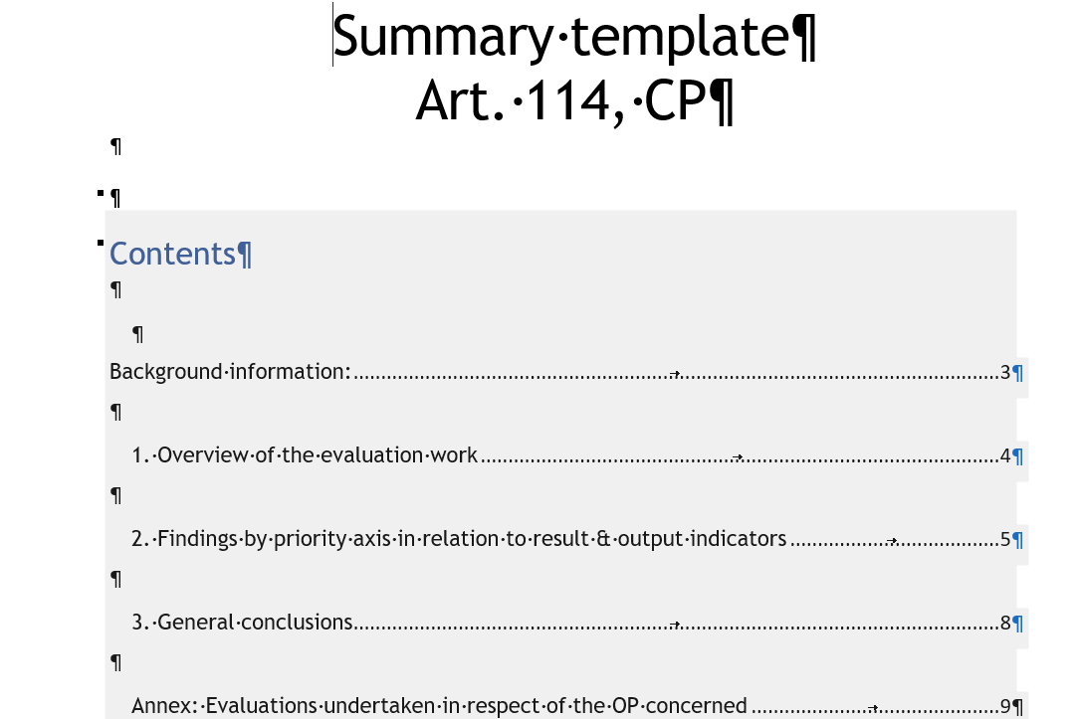
What part do you consider challenging? - Article 114
Put your dot

Slide 8
Questions raised during the registrations - Article 114
What elements need to be included in the summary report for evaluations?
Is there any template in SFC?
As to the Art. 114 (2) CPR the findings, not just a summary of what we carried out should be included. However, I would argue that we make use of the 2017 and the 2019 data, and explain that one data collection for 2022 is still outstanding, which will capture the level of achievement "at the end of the programme lifetime". There is no point in submitting data from before the programme was closed. It doesn't tell anyone anything in my / our opinion.

Slide 9

Comfort break

Slide 10
Evaluation Plan

Slide 11

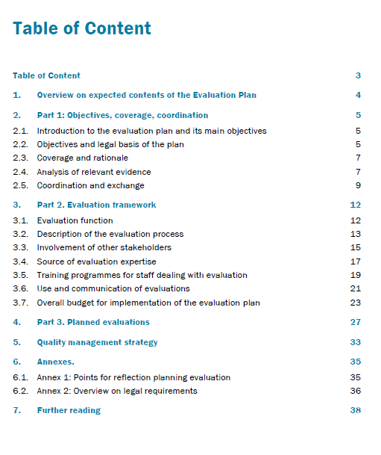
Notes:
Exemplary overview table on planned evaluations - mock example
Input from Evaluation Helpdesk: Elliot Stern: Evaluation Planning.pdf, DG Regio; Evaluation Summer School 2021
Annex 2: Overview on legal requirements
Annex 3: Further reading

Slide 12
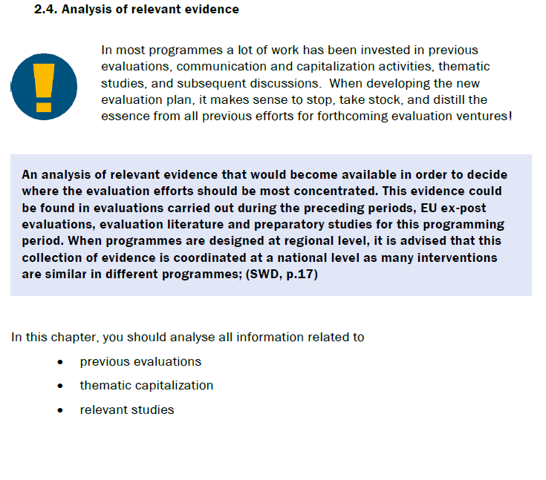
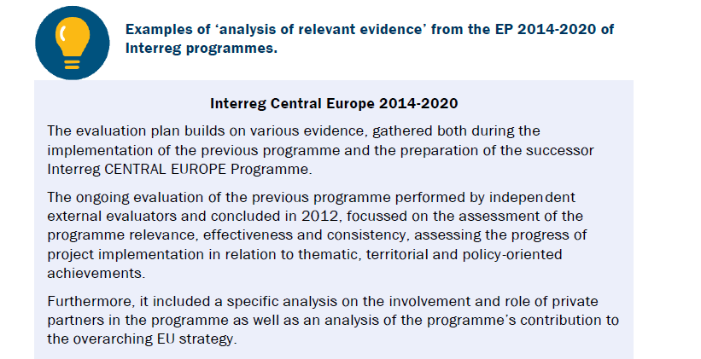
Briefing note evaluation plan 2021-2027

Slide 13
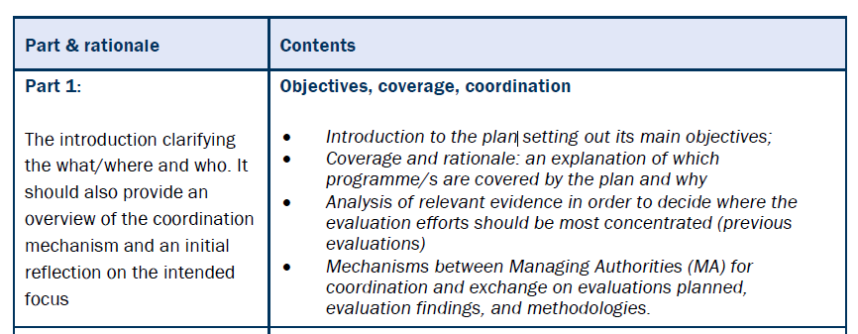
Overview on expected contents of the Evaluation Plan (1/3)

Slide 14
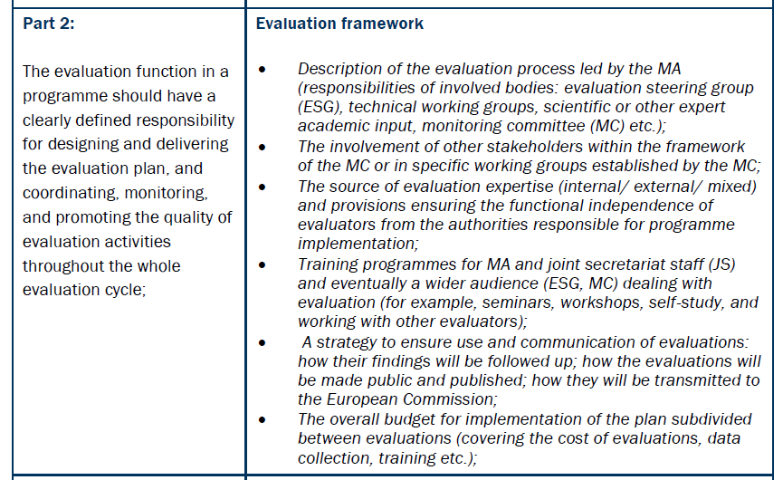
Overview on expected contents of the Evaluation Plan (2/3)

Slide 15
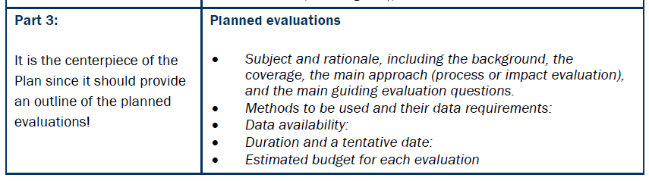
Overview on expected contents of the Evaluation Plan (3/3)

Slide 16

What part of the Plan do you consider challenging?
Put your dot

Slide 17
Interreg Evaluation & Evaluation Plans
REGIO B.2 – Evaluation and European Semester

Slide 18
Overview of SWD on Perf. Monitoring and Evaluation
SWD objective: to provide clarity on provisions on
Evaluation
Programming, monitoring using common and specific indicators
Categorisation system
Publication:
SWD + Annexes in PDF: https://ec.europa.eu/regional_policy/en/policy/evaluations/guidance/#1

Slide 19
Purpose of evaluation planning
Better quality of Evaluations:
  Adequate time allocated;
  Proper methods applied;
  Data available.
Ensure use for Management and Policy Making:
  Enable informed programme management and policy decisions on the basis of evaluation findings;
  Means;
  Evaluations should also be read not only written.
Knowledge sharing:
  Sharing of evidence in different policy fields between interreg programmes;
  Commission performs meta analysis of policy fields across member states.

Slide 20
Evaluation plan components
Objectives, coverage, coordination:
  What evidence available in different policy fields?
  Coordination between MA (evaluation coverage, findings, practice)
Evaluation framework:
  Responsibilities
  Evaluation process, Involvement of partners (working groups, multi-level governance), Source of evaluation expertise, independence
  Training programme, Strategy to ensure use and communication, Timetable (to feed reports)
  Budget, Quality management strategy

Slide 21
Evaluation plan components
Planned evaluations:
    Indicative list, ad hoc evaluations possible
    Impact evaluations should be planned early
For each evaluation:
    subject, rationale, evaluation questions
    Methods, data requirements!
    Duration and tentative date
    Estimated budget

Slide 22
Lessons learned
Design a feasible evaluation framework;
Body of policy evidence;
Clarify the objectives of evaluation;
Proper budget planning;
Ensure visibility;

Slide 23
Questions
What is the main lesson learnt in the period 14-20 that should be taken into account in 21-27 in order to improve evaluation process?
What is new in the field of evaluation? What are the expectations for the evaluation plan compared to the previous programming period? Time plan/activities for the evaluation in 2021-2027 and reporting of the indicators in 2021-2027,Required evaluations for the programming period 2014-2020 How to develop a good evaluation plan (concrete examples)?
Receive practical guide to draft the 21-27 evaluation plan in accordance with the indicators chosen, and understand better the intervention logic changes from 14-20 period to train the potential beneficiaries properly;
Should we evaluate the level of capitalization of the results of the projects implemented in 2014-2020 through newly implemented projects;
Integration of PO5 into the programme evaluation plan 2021-2027 considering the specific institutional set up for implementation, monitoring and evaluation of the Territorial Strategy.
Could the impact evaluation for 2021-2027 focus more on the contribution to cross-border/transnational territorial integration and less on performance, i.e. the contribution as regards each specific objective?

Slide 24



Keep in touch with Evaluation + #ESIFOpenData
ec.europa.eu/
#ESIFOpenData intro video
Inforegio website
ESIF Open Data Platform
#ESIFOpenData FAQ + User Guide
@EU_Commission
@EUinmyregion
@RegioEvaluation #ESIFOpenData
@EuropeanCommission
Notes:
Delete/update as appropriate

Slide 25

Thank you
© European Union 2020
Unless otherwise noted the reuse of this presentation is authorised under the CC BY 4.0 license. For any use or reproduction of elements that are not owned by the EU, permission may need to be sought directly from the respective right holders.
Notes:
Update/add/delete parts of the copy right notice where appropriate.
More information: https://myintracomm.ec.europa.eu/corp/intellectual-property/Documents/2019_Reuse-guidelines%28CC-BY%29.pdf

Slide 26
Questions raised during the registrations - EP
Learning more about practice
What is the main lesson learnt in the period 14-20 that should be taken into account in 21-27 in order to improve evaluation process?
What are the expectations for the evaluation plan compared to the previous programming period?
Time plan/activities for the evaluation in 2021-2027 and reporting of the indicators in 21-27
Required evaluations for the programming period 2014-2020
How to develop a good evaluation plan (concrete examples)?
Receive practical guide to draft the 21-27 evaluation plan in accordance with the indicators chosen, and understand better the intervention logic changes from 14-20 period to train the potential beneficiaries properly
Practicalities of the evaluation plan and activities (e.g how to reflect the MC more strategic role in 2021-2027 in the evaluation activities) and learning good examples (indicators, evaluation methodology on different themes)

Slide 27
Questions raised during the registrations - EP
More specific questions referring to the EP
Integration of PO5 into the programme evaluation plan 2021-2027 considering the specific institutional set up for implementation, monitoring and evaluation of the Territorial Strategy
Could the impact evaluation for 2021-2027 focus more on the contribution to cross-border/transnational territorial integration and less on performance, i.e. the contribution as regards each specific objective?
Should we evaluate the level of capitalization of the results of the projects implemented in 2014-2020 through newly implemented projects

Slide 28
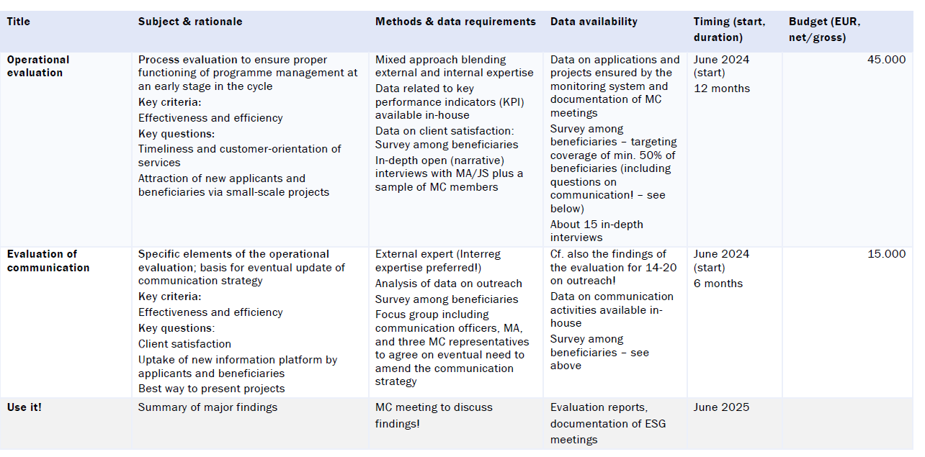
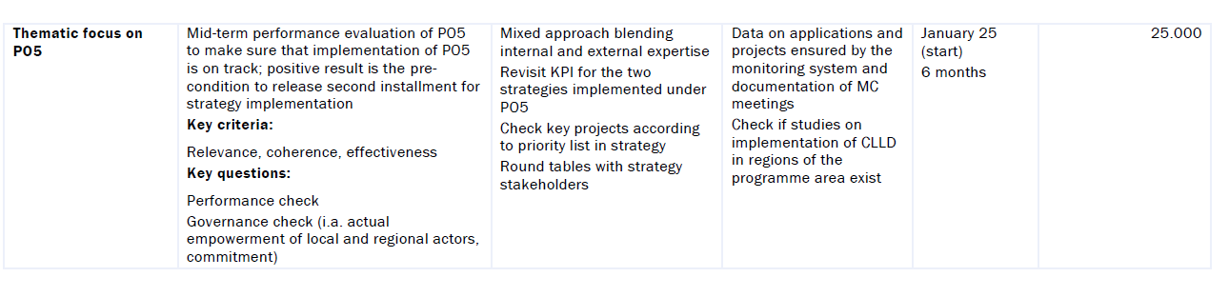
Overview table on planned evaluations - mock example

Slide 29

Discussion round
Evaluation Plan (EP)
What to evaluate?
When to evaluate?
What are good examples from 2014-2020, which could be repeated in 2021-2027?
What are bad examples from 2014-2020, which shouldn‘t be repeated in 2021-2027?

Slide 30

Lunch break (13:00-14:00)

Slide 31
Indicators
Notes:
Overview of the specific objectives and indicators selected by the approved Interreg programmes
Overall view of the methodology documents

Slide 32
What indicators do you find still challenging?
Put your dot
Put your dot

Slide 33
2021-2027
Indicators and intervention logic
REGIO B2 Evaluation and
European Semester Unit

Slide 34
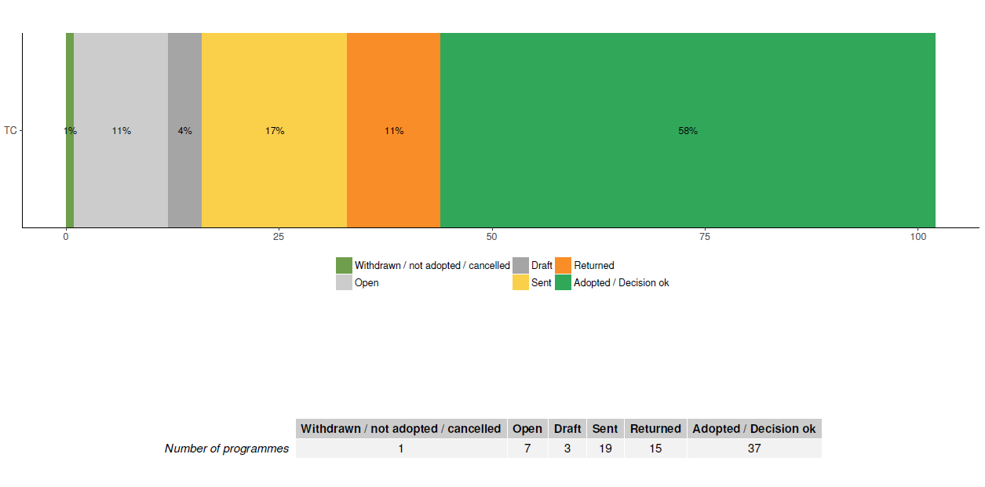
Points of discussion
1) The indicator system
2) Thematic allocations
3) What we have seen in the methodology documents
4) Open Data Platform
5) Final remarks
Overview of ETC programme status, September 2022

Slide 35
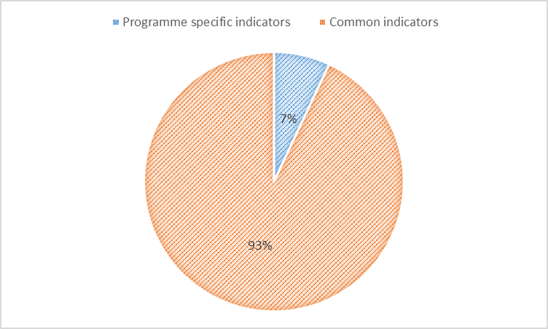
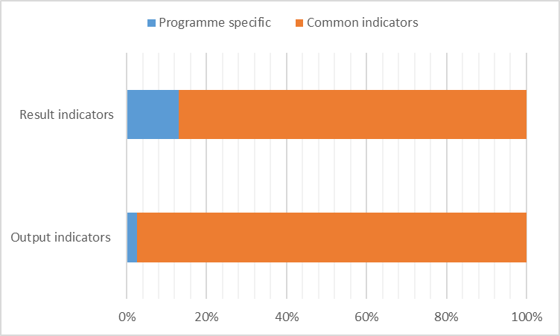
(1) Indicators
(adopted programmes, September 2022)
Aprox. 1500 indicators encoded:
1400 common
100 specific
Among the common indicators encoded:
1150 Interreg indicators
250 ERDF indicators

Slide 36
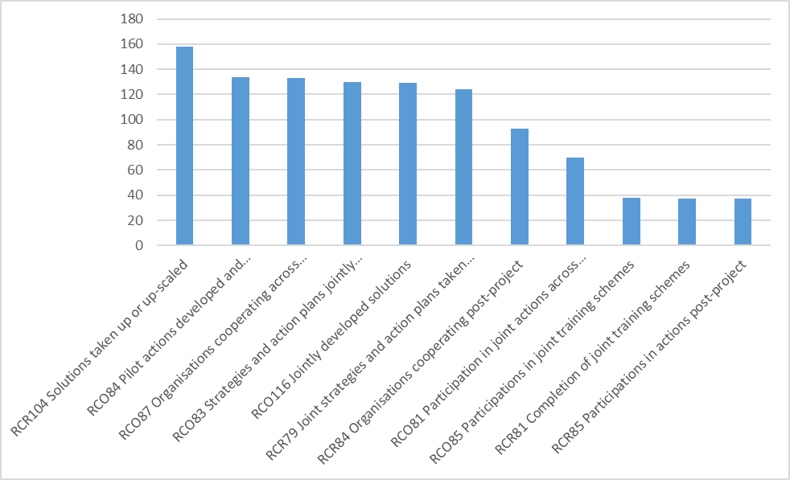
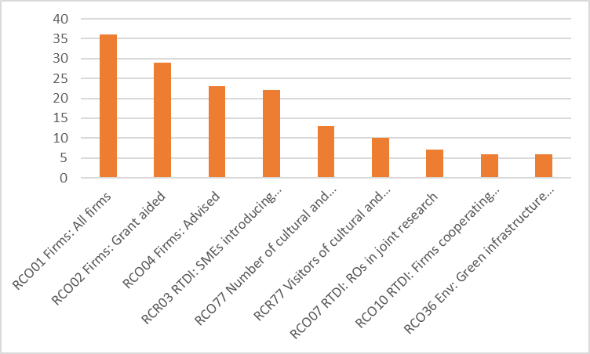
(1) Indicators

Slide 37
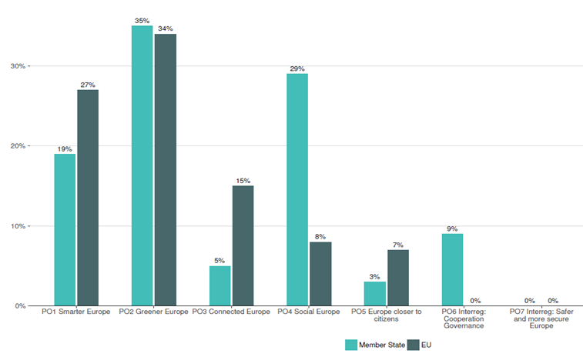
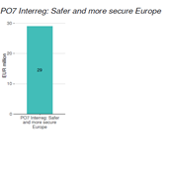
(2) Thematic allocations

Slide 38
(3) What we have seen in the methodology documents
A positive shift towards using the common indicators
A high coverage of the actions proposed through the selected indicators
Two main approaches for target calculation (unit cost, outputs/project)
Low values for milestones due to the need to report on finalised operations

Slide 39
(4) Open Data Platform
Chapter 3 of EU allocations datastory : https://cohesiondata.ec.europa.eu/stories/s/2021-2027-EU-allocations-available-for-programming/2w8s-ci3y
Interreg page in development: https://esif-development.azure-westeurope-prod.socrata.com/funds/2014-2020
In a few months we will have
  Programme pages for each programmes
  Refined charts on achievements (showing Interreg strands)

Slide 40
(5) Final remarks
The targets should be representative for the full budget of the programme
The use and definition of indicators to be explained to beneficiaries
Start reflecting on how to collect the data for the result indicators
Keep track of the changes in the assumptions used for setting targets
Finalise the adoption process for the remaining programmes as soon as possible

Slide 41
Thank you for you attention!
© European Union 2022
Unless otherwise noted the reuse of this presentation is authorised under the CC BY 4.0 license. For any use or reproduction of elements that are not owned by the EU, permission may need to be sought directly from the respective right holders.
Notes:
Update/add/delete parts of the copy right notice where appropriate.
More information: https://myintracomm.ec.europa.eu/corp/intellectual-property/Documents/2019_Reuse-guidelines%28CC-BY%29.pdf

Slide 42
Questions raised during the registrations - indicators
Methods for collecting data for direct result indicators (should be probably planned in advance and foreseen in subsidy contracts?)
Double counting, milestones, reporting indicators to the EU, consequences of underperformance on projects
Collection method as part of the closure of projects / Verification of the achievement of selected indicators
Information on the intervention logic and indicators. Also to exchange on the use of certain indicators and related challenges (e.g. RCO14/RCR11 and RCO77/RCR77).
How RCO 87 (organisations cooperating across borders) is going to be counted at Programme level? How should the MA choose on which SO to count the respective RCO?
How the alignment of indicators at programme level with those at project level will be ensured to make proper and meaningful evaluation
How to balance between indicators predefined by the Programme and indicators defined by the projects/beneficiaries? If/how other programmes put efforts to connect project activities to indicators?

Slide 43
Questions raised during the registrations - methodology
Methodology paper
We understand that the methodology paper is a working document for the programme so it can be reviewed without a programme modification as long as the indicators and targets do not change. Is our view correct? We would like confirmation on this.
How to set the baselines?

Slide 44
Discussion round: Indicators/Methodology paper
What indicators do you consider challenging? Why?
(Still) any interpretation questions when it comes to making it operational?
Data collection: Practices and good examples?
Need for exchange on practical handling of reporting requirements? (project to MA and then MA to EC)

Slide 45

Indicators corner in the ‘Results and Evaluation Network’
Share your …
Interpretation of common indicators, e.g. RCO 87, RCO 77, etc.
RCOs and RCRs in certain fields, e.g. Tourism
Questions and concerns

Slide 46

Please fill in the evaluation form for this event and share your view on potential follow-up evaluation activities for 2023!
Notes:
Evaluation form: https://connections.interact-eu.net/surveys/secure/org/app/8aad58df-9b5c-4e58-844c-624b73f8d5b9/launch/index.html?form=F_Form1

Slide 47
Cooperation works
All materials will be available on:
www.interact-eu.net

Slide 48

Cross-programme evaluation
Are you interested in participating in a cross-programme evaluation?
Which topics would you be interested?
Which geographical context would you prefer?

