Slide 1

Interprogramme Cooperation in the Mediterranean Templates.

Slide 2
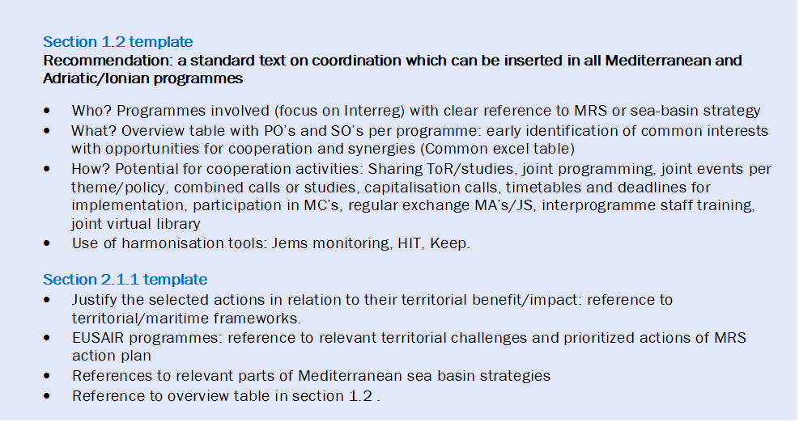
Interprogramme Cooperation in the Programming Phase.

Slide 3
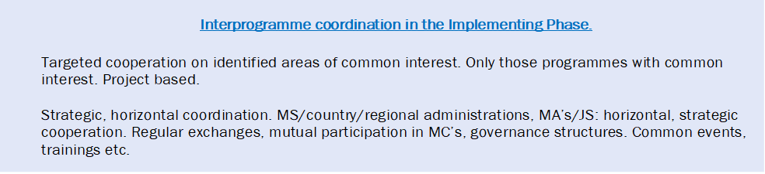
Interprogramme Coordination in the Implementing Phase.

Slide 4
Discussion with the Commission: Updates.
Pascal Boijmans. Head of Unit D2-DG REGIO EU Commission.
Jean Pierre Halkin. Head of Unit D1-DG REGIO. EU Commission.

Slide 5
Regulations: Coreper 16/12/2020 adopted a consolidated version “confirmation of the final compromise text” including the annex – programme template. The publication in official journal together with CPR, ERDF and ESF+ regulations is expected by June. Now Comission and MS still working in programmes‘ geography and budget.
Recommendations to Interreg CBC programmes (Strand A) by Court of Auditors. Audit will be published by the end of May.
        To avoid supporting the same kind of operations financed by the mainstream programmes. Also avoid mirror projects in both sides of the borders.
        Preserve the uniqueness of Interreg CBC projects and programmes. Interreg Projects should be characterized by joint planning, joint implementation and joint financing with a clear CBC or TN character.
An optimal coordination between TN CBC and mainstream programmes is needed within or not a MRS o SBS context.
How Interreg projects should strengthen the territorial dimension?. For this, there is a new concept “Functional areas”, looking beyond the administrative borders of our regions or MS but focusing on common challenges/topics. In one area, we could have several functional areas supported by different programmes and here we can speak about Coordination and synergies among programmes

Slide 6
Embedding of the Strategies in the Mediterranean. There are 2 in this area: EUSAIR (MRS for the Adriatic Ionian Region) and WestMed. The EU achieve its impact by designing policies. To implement such policies there are programmes and strategies.
What is the relation between Programmes and Strategies about?
    The strategies are open to programmes to ensure not only the EU policies but they have been adapted to the needs of an specific region.
    It is important the strategies knows and follows the programmes decisions and developments and vice versa.
    Strategies should use the competitive advantage of each EU fund TN, CBC and also the mainstream programmes (incl IPA fund and neighbourhood fund) to ensure the impact of such investment in the relevant territory.
    There should be a win win approach between programmes and strategies.
    Strategies can provide extra visibility to our programmes results and opportunity for capitalisation.
What is not about?
No relation of hierarchy about cooperation on equality
Not about diverting money from the programme to the strategy
Q&A: ISO 1 is focus on strengthen public administrations and legal obstacle preferably should be tackled directly and not in a cross cutting way

