Slide 1
Tourism and culture in Interreg 2021-2027
Interact event with DG REGIO D1/D2
15 December 2020

Slide 2
Introduction (1)
Interreg has always contributed to tourism and culture (and will continue to…)
Tourism and culture have high potential for transnational and interregional cooperation and local development
Interreg 2014-2020 | Sustainable Tourism | Cultural Heritage and Arts
Number of projects | 1,040 | 955
Partners | 4,833 | 4,114
Budget | EUR 1,280 B | EUR 1,039 B
From KEEP
Notes:
For the timeline of 2014-2020 more than 22% of the overall Interreg budget have been allocated in tourism and cultural projects further to the Keep data base analysis.
In fact, in the current programming period, 89 Interreg programmes generated more than 2000 projects in tourism and culture cooperation, while the bottom up approach of Interreg triggered 9000 partnerships.

Slide 3
Introduction (2)
Tourism and culture are highly relevant to Interreg
Linked to territories (mountains, rural areas, sparsely populated areas, seas, islands, etc)
Multidimensional (integrated)
Long-term (hence need to be framed in a strategy)
Require the involvement of local authorities/ stakeholders/ civil society
Tourism and culture can be well supported within a structured macro-regional approach (reflecting all strands of Interreg cooperation) because they can be:
Multidimensional and cross-cutting
With a short-term, as well as a long-term actions’ horizon
Multilevel governed - Require the involvement national, as well as of local authorities/ stakeholders/ civil society
Tourism and culture have also been separate priority areas in the MRS (relevant for all forms of funding: Interreg, mainstream, and through other funds)

Slide 4
Introduction (3)
For some programme areas, the best place to organise support to tourism and culture is PO5 (territorial and integrated)
New option with SO4.5 (when tourism or culture can be the specific activity for investments accompanied with a group of actions under this SO).
In short: Tourism and culture can be supported under any PO, where relevant, and when the intervention logic of the programme focuses on the specific policy objectives.
Notes:
The intervention logic of each programme will identify the appropriate PO to support tourism and culture, where relevant.
We would like here to stress that PO5 although able to invest in integrated territorial actions for tourism and culture, it is not pertinent for the Transnational programmes due to its heavy structure.

Slide 5
European Industrial Strategy Tourism ecosystem
Notes:
We can see, that Tourism reflect to a broad ecosystem which can be well supported by investments under PO1

Slide 6
Tourism – visitors economy
Source: World Travel & Tourism Council

Slide 7
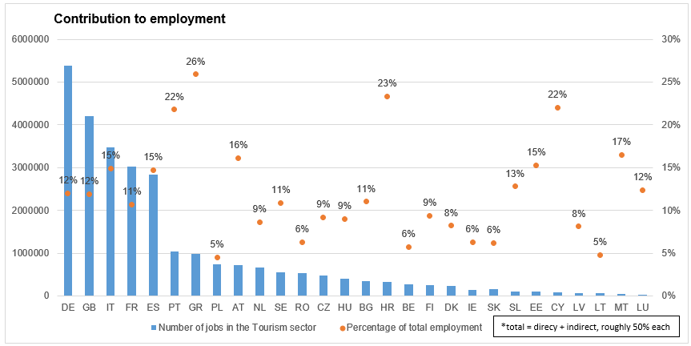
Tourism contribution to the EU economy and jobs

Slide 8
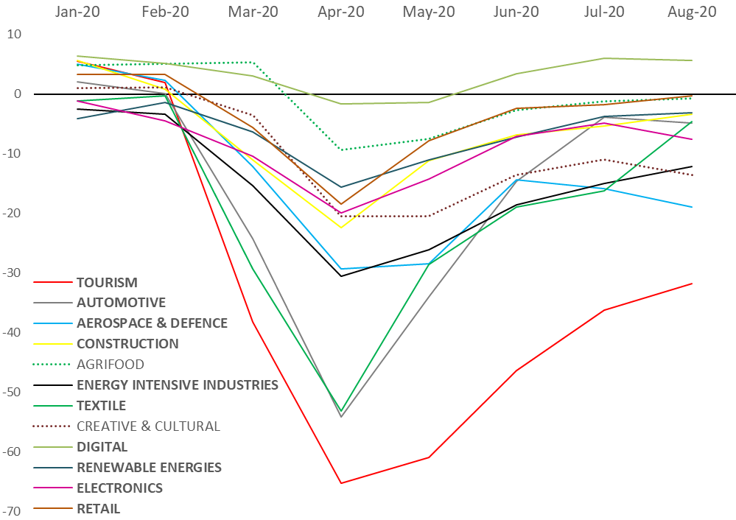
COVID-19 impacts. Tourism ecosystem outlook
Evolution of the Confidence Indicator by Ecosystem: January-November 2020
Source: GROW.A1 elaborations on data by the Joint Harmonised EU Programme of Business and Consumer Surveys.
Evolution of the Change in Turnover by Ecosystem: January-August 2020
Source: GROW.A1 elaborations on data by Eurostat

Slide 9
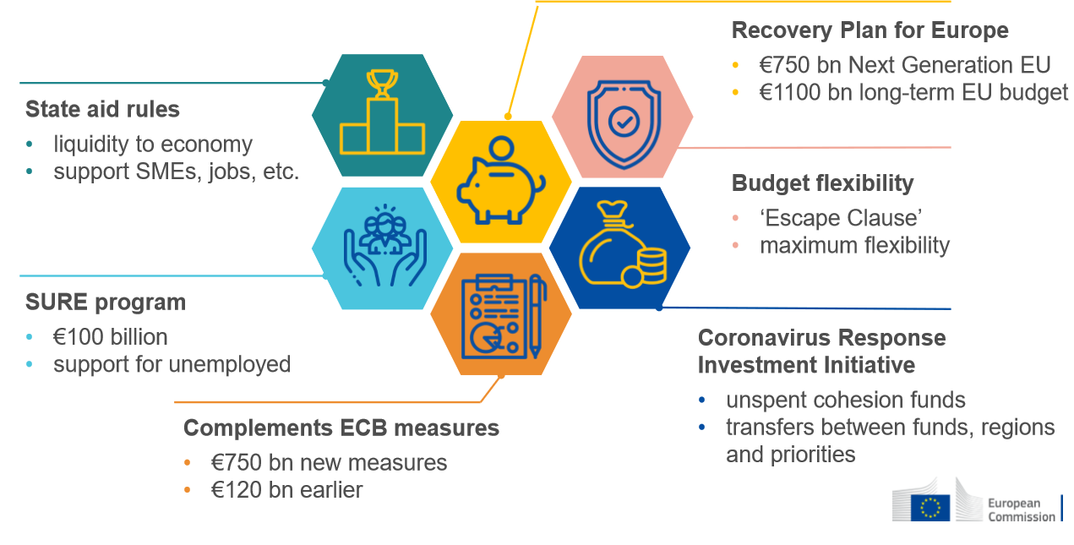
EU response to save and restart tourism – NEW SO 4.5 is part of a wider response…
Re-open EU: https://reopen.europa.eu/en/

Slide 10
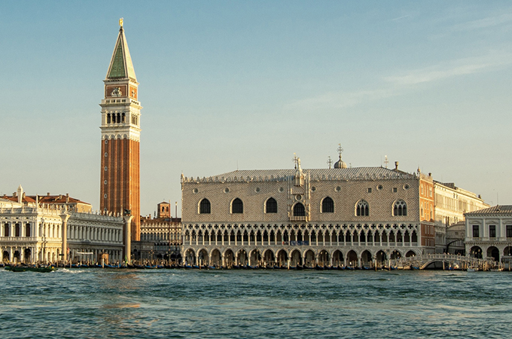
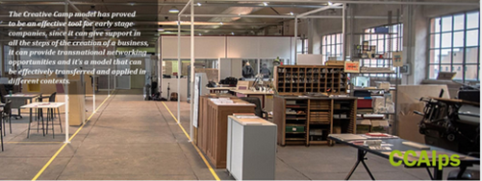
PO1
Link to intervention logic: actions that are innovative (for example because they use a new tool) and/ or contribute to the development of SMEs
CBC project:
Knowledge platform, skills and creative synergies for blue tourism ecosystem development (IT-HR)
TN project:
CCAlps invests in tourism, creative and cultural SMEs innovation and research through creative transnational camps and hubs (Alpine space)
Notes:
CBC project : BLUTOURSYSTEM provides tourism operators with tools and skills to develop new business ecosystems. Capitalizing the knowledge gained with TourMedAssets MED project, BLUTOURSYSTEM provides a new Market Intelligence designed to support tourism strategic planning and monitoring; it steers decision makers to rethink tourism, reduce gaps and design eco-innovative scenarios thus to promote sustainable growth.
Through Living Labs, operators are then engaged in a peer- learning mechanism that enables the co-design of new creative and eco-tourism scenarios. A Tourism Advice Point is then launched to support innovation in tourism: here stakeholders, decision makers and SMEs can find quality support and services to advance Tourism offer.
https://www.italy-croatia.eu/web/blutoursystem
_______________________________________________________________________________________________________________________
CCAlps could be a very relevant project for investments under PO1 because it aimed at liaising regional research and innovation actors to industrial stakeholders among various countries should stimulate interregional cooperation in new cultural and creative value chains across borders. Cooperation between higher education and business, in particular SMEs, training opportunities for staff, digitisation.
These are some of the actions that CCAlps camps and hubs have successfully set up among regions in France (Alsace, Rhone-Alpes, Province – Alpes – Cote d’Azur), Germany (Stuttgard), Austria (Salzburg), Slovenia (Zahodna Slovenija), Italy (Piemonte), Switzerland (Ticino) – 14 partners – “Interreg Alpine Space 2007-2013”
Total budget: 2,92 Million eur, EU budget: 2,14 million eur

Slide 11
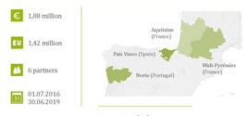
PO2
Link to intervention logic: actions that concern nature tourism with the goal to valorise biodiversity and/ or actions that address waste and energy impacts of tourism/culture sites and activities
CBC project:
The main aim of the project 3E-Morava Nature (SK-AT) is to manage the habitats in such a way that habitat networking, biodiversity and valuable ecosystem services are maintained on both sides of the River Morava. Activities include revitalization and management terrestrial and water biotopes, strengthening environmental education combined with nature tourism. In addition, 4 eco-centers will be established to strengthen the future CBC and conscious care for the natural heritage of the River Morava area.
TN project:
ENERPAT aims at providing solutions for renovation of old buildings in an energy efficiency manner. This approach improves heritage management, residents’ comfort and health, and has high circular economy standards. ENERPART undertakes eco-friendly pilot renovations of buildings in three cities: O Porto (PT), Vitoria (ES), and Cahors (FR) – Interreg SUDOE
Notes:
CBC project full title: Strengthening biodiversity and ecological network in the River Morava region through habitat management and environmental education (awareness raising) in eco-centers
________________________________________________________________________________________________________________________
Through PO2 one can expect investments in responsible tourism, green tourism and culture SMEs, energy efficiency, and circular economy, as well as environmental contingency plans and against fires and floods.
For instance: TN project: ENERPAT – undertook eco-friendly pilot renovation of buildings in three cities: O Porto (PT), Vitoria (ES), Cahors (FR) – total budget 1,88 million eur – EU budget 1,42 million eur – involving 6 partners – Interreg Sudoe
The scope was to use renovation technics combined with bio-based materials in order to minimize low carbon footprint.

Slide 12
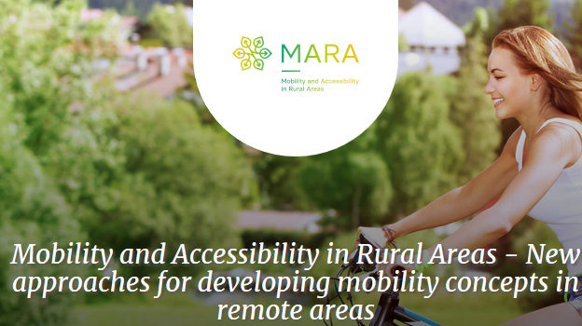
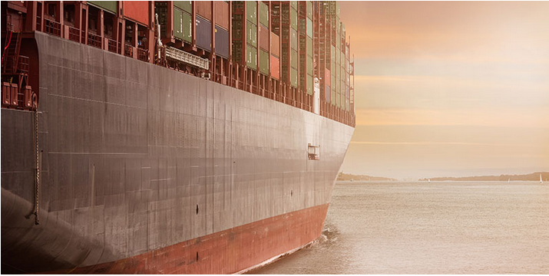
PO3
Link to intervention logic: actions that improve the accessibility of touristic and cultural sites/activities
CBC project:
PORTS (Partnership for the Observation and study of new Routes and Transnational Sea-highways) aims at strengthening the Apulian sea links with Montenegrin and Albanian coasts, in order to support socio-economic growth of the two main coastal area cross border systems. Joint actions to develop new sustainable solutions for maritime transport and sustainable mobility networks in order to improve internal links of tourist transport and pleasure cruises (IPA CBC Italy, Albania, Montenegro)
TN project:
MARA improves the accessibility and mobility in remote touristic areas of the Baltic Sea region. MARA examines and pilots different local mobility solutions including a Population Mobility Monitor based on mobile phone data, e-bike sharing, real-time information for call-a-bus systems, and waterways for transportation. New mobility approaches in remote areas are integrated into spatial or mobility development plans (Interreg Baltic Sea).
Notes:
Another CBC project (ES-PT _ POCTEP)
Sustainable tourism and electric mobility in natural spaces (https://keep.eu/programmes/92/).
Main aim: Fostering a sustainable and clean tourism model for visitors to border natural areas
Create a network of “green” tourist routes connecting natural and cultural value points in the border natural areas in electric vehicles.
Empower tourism entrepreneurs and wilderness entrepreneurs to offer an electric mobility tourism offer.
________________________________________________________________________________________________________________________
With PO3: we expect to develop physical and digital connectivity projects, which can result to better and cheaper IT solutions. Connectivity should not stop at the borders or at regions which face territorial challenges (islands, mountains, coastal and sparsely populated areas). Very often we can see a significant cultural and natural identity in those regions. Cooperation for developing accessibility measures could enable these regions to unlock their potential.
IPA CBC Italy- Albania-Montenegro programme has successfully invested into the PORTS project which is a partnership for the observation and study of new Routes and Transnational Sea-highways. The programme offered an opportunity to invest into the connectivity between the Apulian Sea and the coasts of Montenegro and Albania. A segregated target of the project PORTS was to improve links of tourist transport and pleasure cruises.
Total budget: 1,1 Million eur,
MARA project relevant for the Baltic Sea Region, to improve the accessibility and mobility in remote tourism areas with piloting various local mobility solutions and thus launching a new mobility approach in remote areas. This approach contributed to better integrate these areas into spatial and mobility development plans.
Total budget: 2.37 Million eur, EU budget: 1,53 Million eur., ENI-Russian participation: 0,15 Million eur, and Norway budget: 0.13 Million eur – Partners 12 (DE, PL, LV, NO, LT, SE, RU, FI, EE) – Interreg Baltic Sea Region 2014-2020

Slide 13
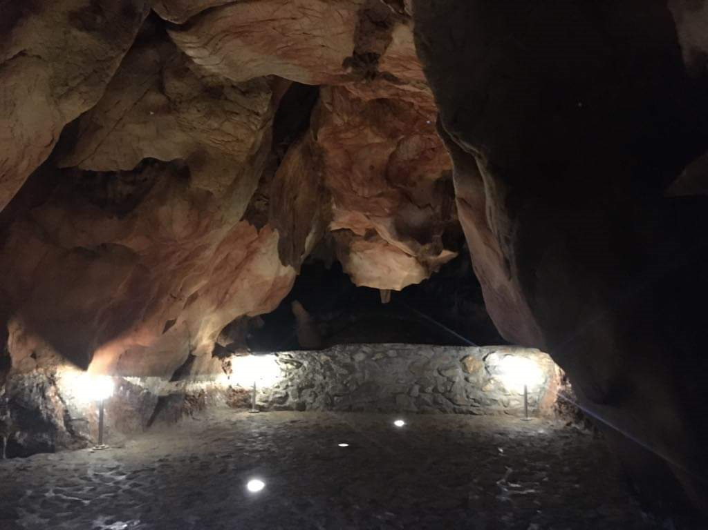
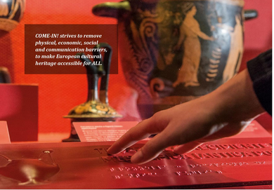
PO4
Link to intervention logic: actions related to a more ‘Social’ Europe [(i) employment, (ii) education, (iii) social inclusion, (iv) health, (v) culture/tourism]
CBC project:
The project “Aggtelek-Domica curative cave” aims to supports the certification of the caves of the cross-border cave system of the Aggtelek and Slovak Karst as therapeutic caves including the creation of the infrastructure necessary for the operation of the therapeutic caves. (SK-HU)
TN project:
“COME-IN!” smaller museums often lack the knowledge and financial means needed to improve accessibility for people with disabilities. The COME-IN! project creates a network of museums, disability associations, policy makers and other stakeholders who pool innovative ideas and provide training to support development of better accessibility. The project strives to remove physical, economic, social and communication barriers, to make European cultural heritage accessible for ALL. (Central Europe)
Notes:
Another CBC project (ES-PT _ POCTEP)
Sustainable tourism and electric mobility in natural spaces (https://keep.eu/programmes/92/).
Main aim: Fostering a sustainable and clean tourism model for visitors to border natural areas
Create a network of “green” tourist routes connecting natural and cultural value points in the border natural areas in electric vehicles.
Empower tourism entrepreneurs and wilderness entrepreneurs to offer an electric mobility tourism offer.
enhancing the effectiveness of labour markets and access to quality employment through developing social innovation and infrastructure
(ii) improving access to inclusive and quality services in education, training and life long developing infrastructure, including by fostering resilience for distance and on-line education and learning through training
(iii) increasing the socioeconomic integration of marginalised communities, migrants and disadvantaged groups, through integrated measures including housing and social services
(iv) ensuring equal access to health care and fostering resilience in health systems
(v) enhancing the role of culture and tourism in economic development, social inclusion and social innovation
and/or specific objectives (i) to (x) of Article 4(1) of Reg. ESF+
_______________________________________________________________________________________________________________________
TN project: COME-IN strives to remove physical, economic, social and communication barriers, to make European cultural heritage accessible to ALL – a particularly relevant project for people with disabilities. Total budget: 2,72 Million eur, EU budget: 2,21 Million eur, involved 14 partners from Germany (Thueringen), Poland (Malopolskie), Austria (Wien, Oberoesterreich), Italy(Friuli-Venezi-Giulia), Slovenia (Zahonda Slovenja), Croatia (Jadranska Hrvatska). Interreg Central Europe 2014-2020.
PO4, examples: promoting access to public services and healthcare facilities, support to labour mobility and education could be relevant for cooperation projects. Cooperation across borders or in a macro-regional context can create economies of scale and help policy-makers to reach solutions to the challenges they are facing through building on the experiences of others).

Slide 14
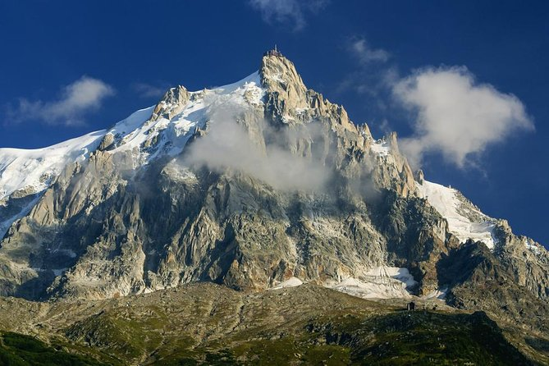
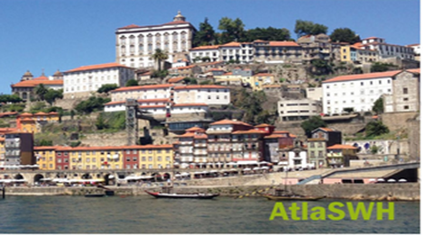
PO5
Please check training events organised already on PO5 (video, PPT and Q&A)
Link to intervention logic: a territory taken holistically, with integrated actions required and deep involvement of stakeholders
CBC example: PARCOURS (PITER in Alcotra programme). CBC strategy to coordinate actions around the Mont-Blanc area, including on tourism. It cover 71 towns and 200 000 inhabitants, with a clearly defined natural heritage (1 natural park, 9 natural reserves, 13 protected areas).
TN example: AtlaSWH, Urban World Heritage Sites have an important cultural value across the Atlantic Area (over half of Europe’s coastline and two of its seas). AtlaSWH is creating a network of such sites to address the challenges related to the protection of their identity, while enhancing their cultural assets. The goal is to stimulate heritage-led economic and cutlural development (Atlantic Area)
Notes:
PO5: A Europe closer to citizens (sustainable development of urban, rural and coastal areas and local initiatives)
SO1: fostering the integrated social, economic and environmental development, cultural heritage and security in urban areas
SO2: fostering the integrated social, economic and environmental local development, cultural heritage and security, including for rural and coastal areas also through community-led local development
Although the PO5 is not very relevant for the Transnational and Interregional programmes because of its heavy structure, when it comes that the programme has established a territorial integration strategy (which identifies tourism and culture as part of the main economic drivers of a specific territory), it has incorporated a local lead network in its structure in order to implement this strategy (for instance a cities network corresponding to the specific territory), and it has identified a territorial tool to conduct the strategy through adequate projects and actions, then a project such as AtlaSWH could be relevant for PO5. To note that the project is here as a theoretic example!
AtlaSWH aimed at creating a network of Urban World Heritage cultural sites, along the Atlantic Area for the protection of their identity and the enhancement of their cultural assets. The scope was to stimulate a heritage-led economic and cultural development in the Atlantic Area.
Total budget: 1,82 M eur, EU budget: 1,37 Million eur, 5 partners: Italy (Tuscany), France (Aquitaine), UK (Lothian), Spain, (Galicia), Portugal (Norte) – Interreg Atlantic Area 2014-2020

Slide 15
Recent developments = NEW S.O.
Following the Covid-19 crisis, the political intention is to support the tourism and culture socio-economic sectors (to recover and to develop further)
Therefore, SO4.5 was introduced (even if it is under PO4, the overall political intention is broader and is clearly linked primarily to recovery)
SO4.5: « enhancing the role of culture and sustainable tourism in economic development, social inclusion and social innovation »
SO4.5 makes it possible to bundle all the actions on tourism and culture under the same objective
EC will assess SO4.5 on the ‘intervention logic’ (there should be a clear narrative in line with the political intention (e.g. socio-economic development))

Slide 16
Possible areas of support under SO 4.5
Support for both public and private organisations to reinforce the resilience of these sectors through training and employment support, digitalisation, social innovation and transition to circular business models.
Support for SMEs, including social enterprises (such as social cooperatives) and social innovation in tourism and culture - development of existing or new tourism and culture businesses.
Development of innovative solutions and new business models in culture and tourism.
Support to diversification of the tourism by investing in lesser-known destinations and diverse forms of tourism (cultural, rural, agro-tourism, sport, health/medical tourism); consequently contributing to the livelihoods of local and regional communities.
Support for cultural clusters that contribute to the development of creative industries.
Support capacity building both for public and private tourism and cultural organizations at national, regional and local level.

Slide 17
Horizontal elements (please check the training event already organised on the intervention logic (video, PPT, Q&A)
Intervention logic: drives the choice of Policy Objectives and Specific Objectives
Indicators:
ERDF indicators PO1-PO5 should be used only for the respective POs (not for ISOs).
ERDF generic indicators (those with an *) can be used inter-changeably for POs 1 to 5
Interreg-specific indicators included under Annex I (table 2) of the ERDF Regulation can be used across POs 1 to 5 and ISO 1 and 2
Intervention codes: all intervention codes can be used inter-changeably between POs/ISOs
Under PO4, ESF+ type of activities are allowed for Interreg. Please use primarily the Interreg common indicators and secondarily as deemed relevant for the intervention logic the ERDF indicators marked with * from Annex I (table 1) of the ERDF Regulation.
Possible types of indicators for SO4.5 (from PO5 with *): RCO77: Capacity of cultural and tourism infrastructure supported and RCR77: Tourists/ visits to supported sites
At this stage a change to Annex I is not envisaged

Slide 18
Promoting sustainable tourism actions
Special focus : the role of MRS (1), projects generated from the MRS embedding exercise
Preserving cultural heritage – Routes 4U
EUSBSR: Culture and Tourism are two Policy Areas
Alvar Aalto and modern architecture & Maritime and Ice age Heritage route
EUSDR:
PA "To promote culture and tourism, people to people contacts“
Cyril and Methodius Route & Iron Age Route
EUSALP: TPA 1: “Economic Growth and Innovation”, TPA 2”Environment and Energy “
Via Alpina (5 hiking routes) &Via Claudia Augusta
EUSAIR: Pillar 4 “Sustainable tourism”
Diversified tourism offer,
Sustainable and responsible tourism management
Olive trees route, & Roman Heritage route
MRS
Green mobility
Scaling up skills - digitalisation
Recovery plans from COVID19
Health tourism
Build on common EU values

Slide 19
Special focus : the role of MRS (2), projects
related to regional innovation (CCIs)
“AI-NURECC Initiative - CCRE-S3 (Cultural and Creative Regional Ecosystems) CCRE-S3 (Cultural and Creative Regional Ecosystems) is now an official interregional partnership under RIS3 “industrial transformation platform”.
The main objectives are: (i) to support increased investments, sustainable and inclusive growth driven by culture and creativity, (ii) to identify job opportunities and innovation for developing regional ecosystems, (iii) activation of interregional partnerships for SMEs recovery, (iv) to define value chains among CCIs and other sectors (eg tourism and high end industries), (v) to enhance innovation and accessibility of CCI related services.
To be continued via the AI-NURECC II initiative and through mobilising ERDF regional and IPA funds.

Slide 20
Special focus : the role of MRS (3)
“Tourism recovery through cooperation”
To activate existing macro-regional networks for the Tourism and the Cultural industries of tomorrow, and to mobilise macro-regional cross cutting approach, and the multilevel governance structures, for:
Establishment of PPP;
New MRS tourism products and models based on the social distancing (incl. quality tourism and remote micro destinations – mountains, islands, sparsely and rural areas);
Activating chambers of commerce networks to promote digital transition for small and very small tourism businesses (incl. in remote areas);
Education for new value added jobs for smart and integrated management of safe destinations (incl. hybrid knowledge empowerment – remote working models);
Crisis management platform (incl. contingency plans on energy and hygiene, crisis management tools).

Slide 21
Q&A

