Slide 1
Inventory of cross-border and transnational data
Evaluation Plan Event
Frank Holstein, Spatial Foresight GmbH
24 February 2015| Paris, France

Slide 2
Inventory of cross-border and transnational data
Stocktaking of result indicators
377 Result indicators from draft OPs 2014-2020
36 of 60 Cross-border Programmes
4 of 12 IPA Programmes
9 of 15 Transnational Programmes
2 of 4 Interregional Programmes
Groups of indicators defined based on the related IP and related TO and unit of measurement.
Notes:
database
Looking at all result indicators defined by programmes 2014-2020
Aim of the study; compiling the result indicators, looking for similarities and differences in the result indicators and especially focus on data sources, to see whether there is room for efficiency gains and cooperation between programmes
Grouped thematically to highligth the most frequent used result indicators and assess data avalability and highlight data challenges for those indicators

Slide 3
Inventory of cross-border and transnational data
What do the result indicators measure?
Result indicators in the draft OPs reflect expected results
Only 28 result indicators in the database reflect flows (8%). These result indicators are relatively more observed related to TO1, TO3 and TO7.
Most indicators address Thematic Objective 6 addressing the environment (including natural and cultural heritage) and resource efficiency.
Notes:
In order to assess the data sources it is wothwhile looking at what the result indicators actually measure.
Flows of goods, people, services, information. Special feature of INTERREG Programmes. However only very limited observed in the result indicators included in our study. Most result ind
ETC programmes traditionally focus on process related result, learning and exhange and flows of good, people services and information. This latter makes them different from other ERDF programmes.
Result indicators put forward in the draft OPs

Slide 4
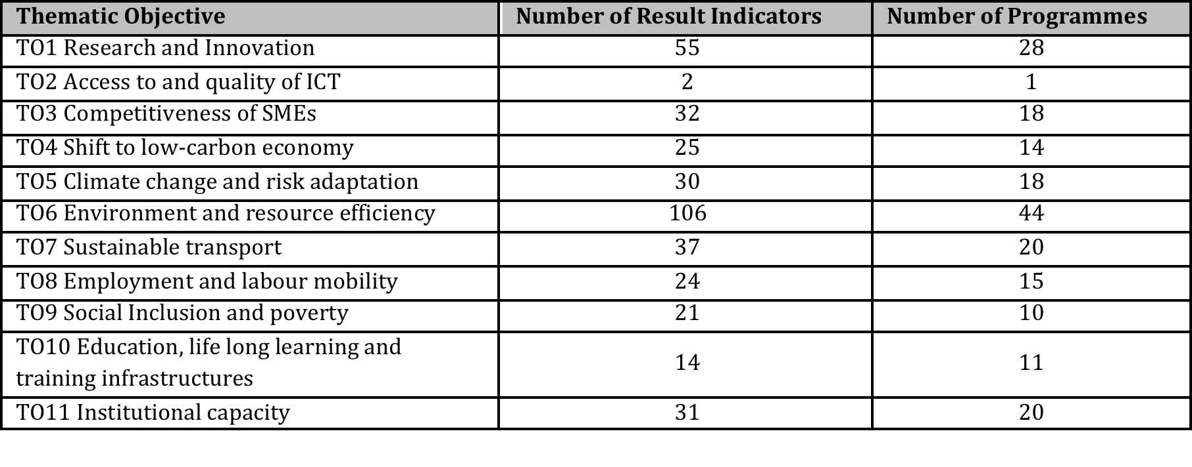
Inventory of cross-border and transnational data
Result indicators per TO and number of Programmes
Notes:
We structured the result indicators per TO and how many programmes it concerns
Tell something about highest ranked indicators and make link to data sources

Slide 5
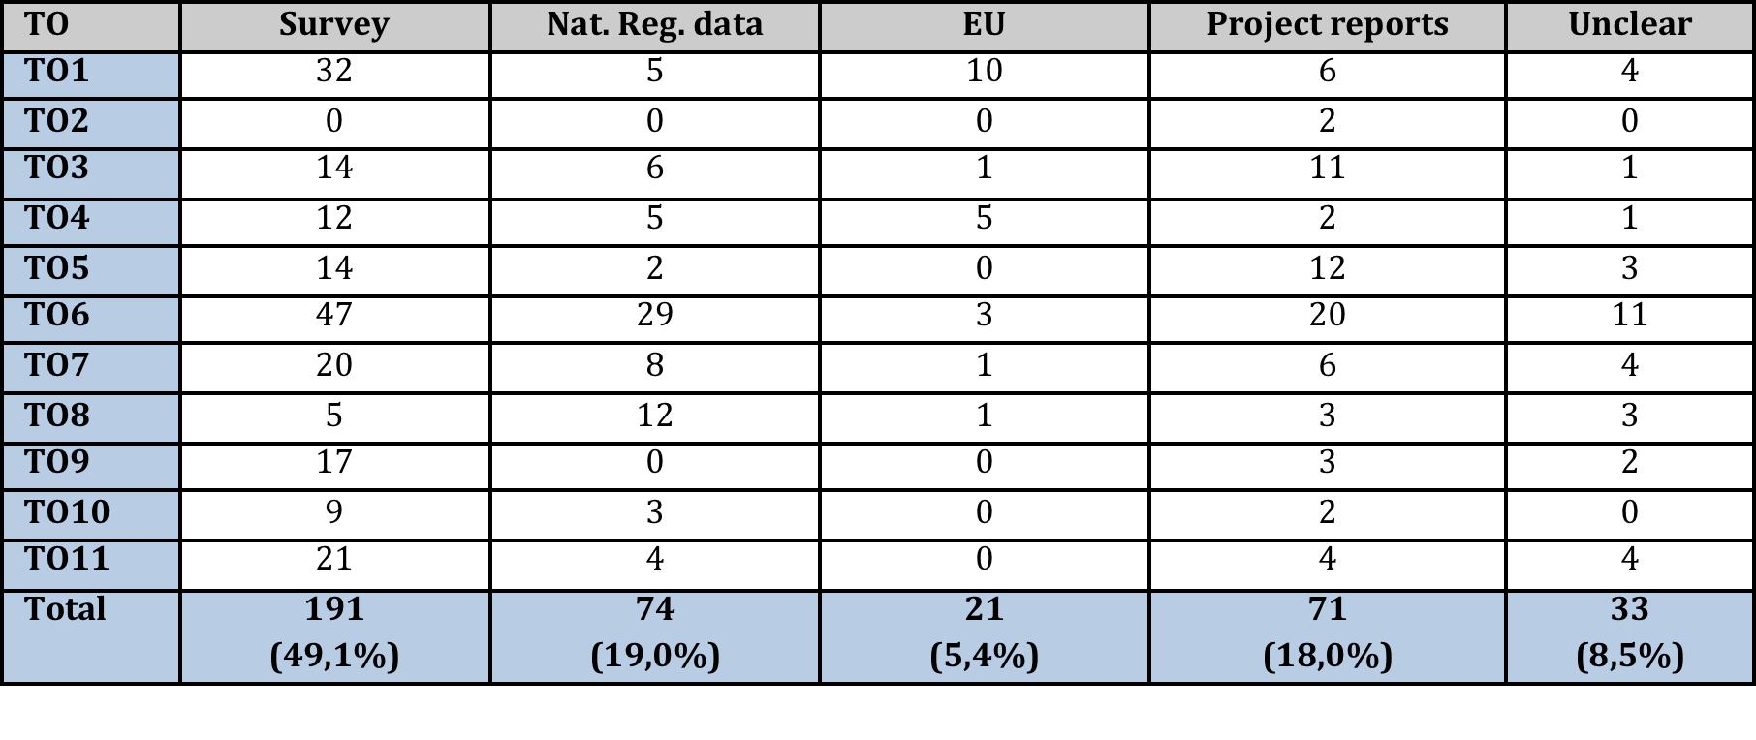
Inventory of cross-border and transnational data
Frequency of data sources indicated in the draft OPs per TO

Slide 6
Inventory of cross-border and transnational data
Proposed data sources
Surveys will be used for almost half of the result indicators.
Pro: can deliver very specific information
Con: require capacity in terms of time and money
EU wide available data (e.g. Eurostat data) will be used for only 5% of the result indicators.
Pro: harmonised data
Con: not always available at right geographical scale and with the exactly right focus
Data from national or regional statistic offices will be used for 20% of the result indicators.
Pro: often available at low geographical scales
Con: risk of no harmonised methods and definitions
…
Notes:
Challenges homogeneous and comparable data, on general two major challenges: not on low levels and not comparable across borders due different defintions. Methods of collections etc. not harmonised. Restrictions national and regional statistics.

Slide 7
Inventory of cross-border and transnational data
Use of surveys and questionnaires
There might be room for efficiency gains by developing and designing surveys jointly.
At the same time coordinating surveys from different programmes might limit a risk of survey “fatigue”.
Similarities of indicators across Europe limited to a few examples, no critical mass for a European wide survey development due to large differences in result indicators.
Notes:
Large share of result indicators where surveys are indicated as source of data effciency gains; joint development sharing experience definitions etc. second; timing and frequence of the same stakeholders targeted by different ETC Programmes. -> they overlap

Slide 8
Inventory of cross-border and transnational data
Cooperation possibilities for data collection via surveys and questionnaires per transnational area
The database has been used to identify geographically overlapping ETC-Programmes to identify regions where surveys are anticipated by several ETC-Programmes addressing the same TO.
In these regions stakeholders are at risk of being approached by several ETC-surveys – which might lead to survey “fatigue” and where programmes might want the harmonise the surveys regarding topics addressed or regarding the period when the publish the surveys.
Notes:
Overlap interregional – transnational- cbc, but also between transnationals

Slide 9
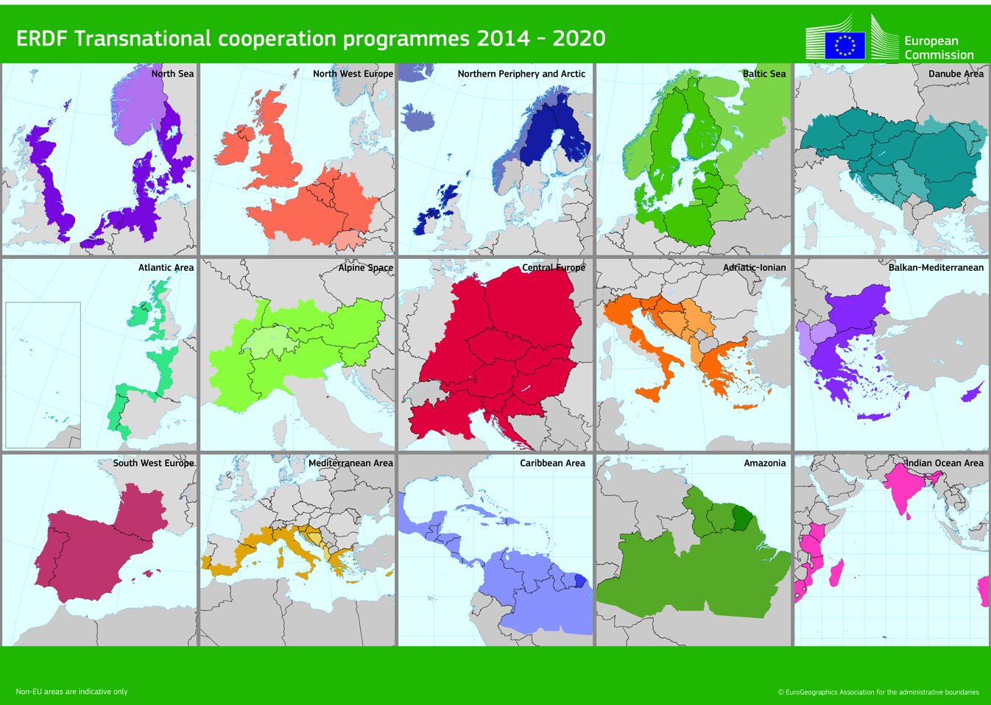
Inventory of cross-border and transnational data
Cooperation possibilities for data collection via surveys and questionnaires per transnational area

Slide 10
Inventory of cross-border and transnational data
Concluding remarks
SOs from ETC programmes make it difficult to find suitable EU datasets.
Data is not always available at the right geographical level and cross-border data systems might be elaborated or stimulated in particular for flow data.
Similarities of themes addressed by survey-based result indicators can serve as starting point for discussions between ETC programmes.
Programmes might benefit from joint survey development, reducing costs and limiting survey faigue among stakeholders.

Slide 11
Concluding remarks
Inventory of transnational and cross-border data
Where do I get the data from? Is there EU wide data available or other harmonised data available?
In case of surveys, which partners could I involve?
(whom to carry out the survey? Target group? Similar as other programmes?)
Are there synergies with other programmes with shared areas? (reducing costs)
Is it possible harmonise the timing of different surveys to limit survey fatigue for respondents?

Slide 12
Thank you for your attention
Please do not hesitate to contact us for any further information
or visit www.interact-eu.net
Frank Holstein
Spatial Foresight GmbH
www.spatialforesight.eu

