Slide 1

DWELL
Diabetes & WELLbeing
Ruben Vanbosseghem
DWELL Programme Lead
Artevelde University of Applied Sciences
Interact – Inclusive Growth On the Road. Health & Ageing
Antwerp, 6th December 2019

Slide 2
DWELL is a cross-border 4 year project with partners in the UK, France, Belgium and the Netherlands.
The project has a budget of €3,169,849.95 (EFRO + co-funding) and will run until 2020

Slide 3
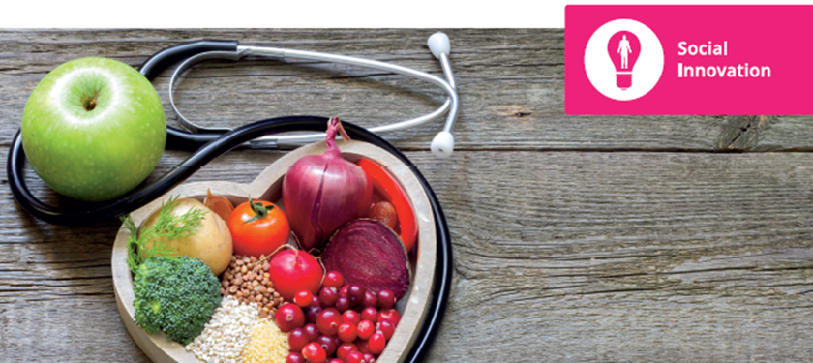


Diabetes & Wellbeing - Overview
DWELL will improve the lives of people with type 2 diabetes, dramatically reducing their risk of developing long-term complications.
A holistic 12 week programme will provide individual, tailored support, motivating each person to make long-term lifestyle changes necessary to manage their condition successfully.

Slide 4
DWELL will:
Change the way people with type 2 diabetes are supported
Improve their health and wellbeing
Reduce the cost of type 2 diabetes to the public purse
Empower patients to take control of their own lives
Potential for cost effective commissionable service at end of project.

Slide 5
DWELL will deliver:
12 week patient support programme for people with type 2 diabetes delivered to 1000 patients across 4 countries
Training programme for staff to successfully deliver to patients
New tools to support patients
Comprehensive evaluation report

Slide 6
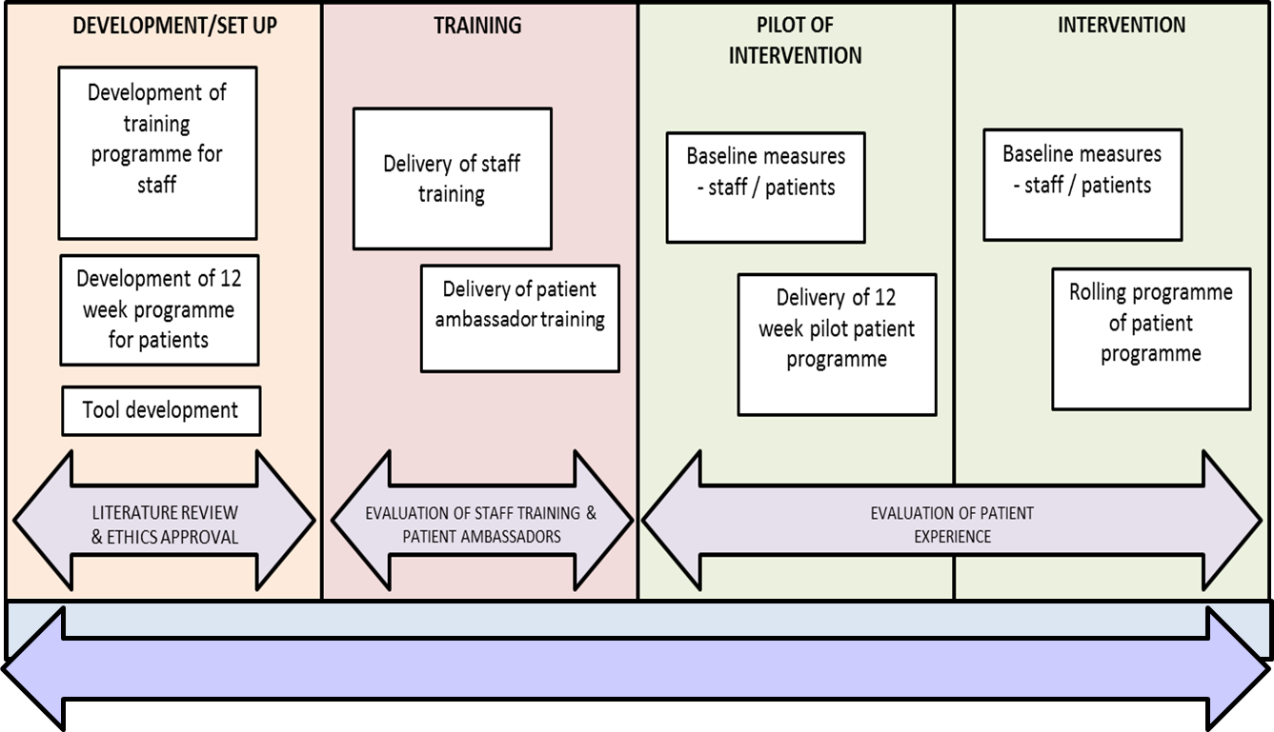
Methods

Slide 7







DWELL – 12 week programme
nutrition
physical activity
well-being
education
peer support
motivational interviewing
Self-management

Slide 8
Evaluation
Mixed methods approach
Repeated measures design:
Pre-post and post-follow up comparisons
Comparison within and between sites
Process evaluation of intervention
Cost effectiveness analysis of patient outcomes
Baseline
(T0)
End of programme (T1)
1st Follow up - 6 months post-programme (T2)
2nd Follow up - 12 months post-programme (T3)

Slide 9
Implementation is ongoing
In the 4 participating countries
Promising preliminary results
  People are changing their lives
  Improved health outcomes

Slide 10
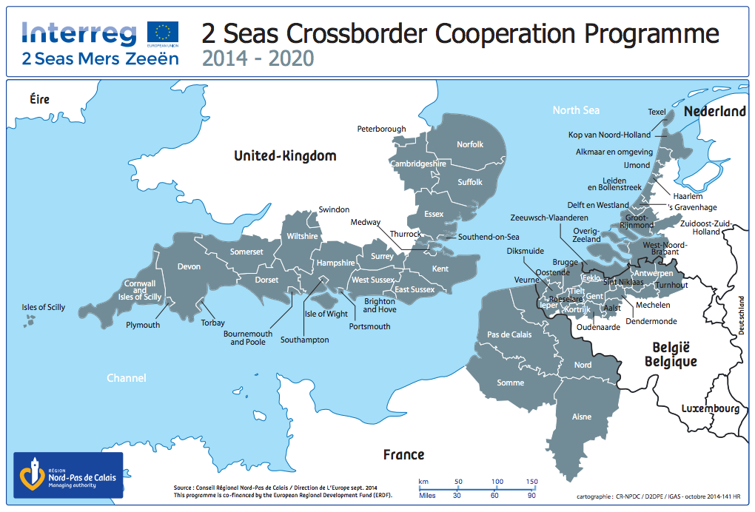

Cross border cooperation
Different countries
Different health care systems
Different organizations
Same challenges

Slide 11
Cross border cooperation
Development of the DWELL programme
Implementation of the DWELL programme
DWELL (patient) ambassadors
end users
academic
industry
government

Slide 12
The story of … Patrick

Slide 13
69 years old
Living together with his wife
Recently diagnosed with type 2 diabetes

Slide 14
My GP told me that I have diabetes type 2
Prescribed some medication
I couldn’t believe that taking a pill was the only thing I could do…

Slide 15
I followed the DWELL programme. It became a habit to go to the sessions for 12 weeks every Friday morning
I’ve learned a lot about diabetes. When I started, I actually didn’t know what the difference was between type 1 and type 2 diabetes
Now I have more knowledge and insights in nutrition, portion control, physical activity,…

Slide 16
I feel like I am able to read food labels when I go to the supermarket
I eat less carbs and fats, more fruits and vegetables
I take the stairs more often
I drink less alcohol
I even started drinking water in stead of soda and diet coke - my wife doesn’t know what she sees!

Slide 17
I lost weight and my HbA1c improved
I have more confidence to make my own decisions
I have more knowledge now, but it was very interesting to share tips and tricks with peers in our group
This programme has changed my life, it is up to me now to stay motivated

Slide 18



ruben.vanbosseghem@arteveldehs.be
@rubenvanbo
dwelldiabetes.eu – arteveldehogeschool.be
verpleegkundearteveldehogeschool
verpleegkunde.arteveldehs

