Slide 1

“Inclusive Growth On the Road: Health & Ageing”
Antwerpen, 6 December 2019
Valentina Polylas, Director, EUREGHA
VALENTINA POLYLAS
October 2018

Slide 2

What is EUREGHA?
ADVOCACY
CROSS-BORDER HEALTHCARE
POLICY MONITORING
HEALTH EQUITY
PROFILE PROMOTION
e-HEALTH
PARTNERSHIP BUILDING
INTEGRATED CARE
PROJECT DEVELOPMENT
HEALTH PROMOTION & PREVENTION
SECRETARIAT of the CoR IRGHW
VALUE-BASED APPROACH
15 FULL MEMBERS
Notes:
Established on 30 January 2006 as an informal network
In January 2012 it was formalised as a non-profit organisation under Belgian law (ASBL).
EUREGHA is the network of reference for regional and local health .authorities in health related issues..
Our mission is to promote collaboration among regional and local health authorities in Europe, within the framework of policies relating to public health and health care, as well as to establish focused collaboration with the institutions of the EU and other relevant stakeholders.
Today it counts 15 Member authorities, 1 Observers and multiple partner organisations.
supports and facilitates its members to approach European institutions and initiatives s
is a platform for mutual learning and knowledge exchange between the members and other relevant actors to strengthen regional development
contributes to bringing the members’ agendas to the European level.
gives our members the opportunity to stay updated on and to
collaborate in new European initiatives and financing opportunities

Slide 3
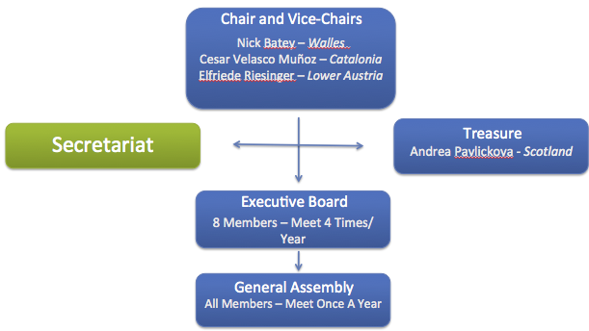
EUREGHA’s structure
EUREGHA is the network of reference for regional and local health authorities in health related issues...
Mission
Our mission is to promote collaboration among regional and local health authorities in Europe, within the framework of policies relating to public health and health care, as well as to establish focused collaboration with the institutions of the EU and other relevant stakeholders.

Slide 4
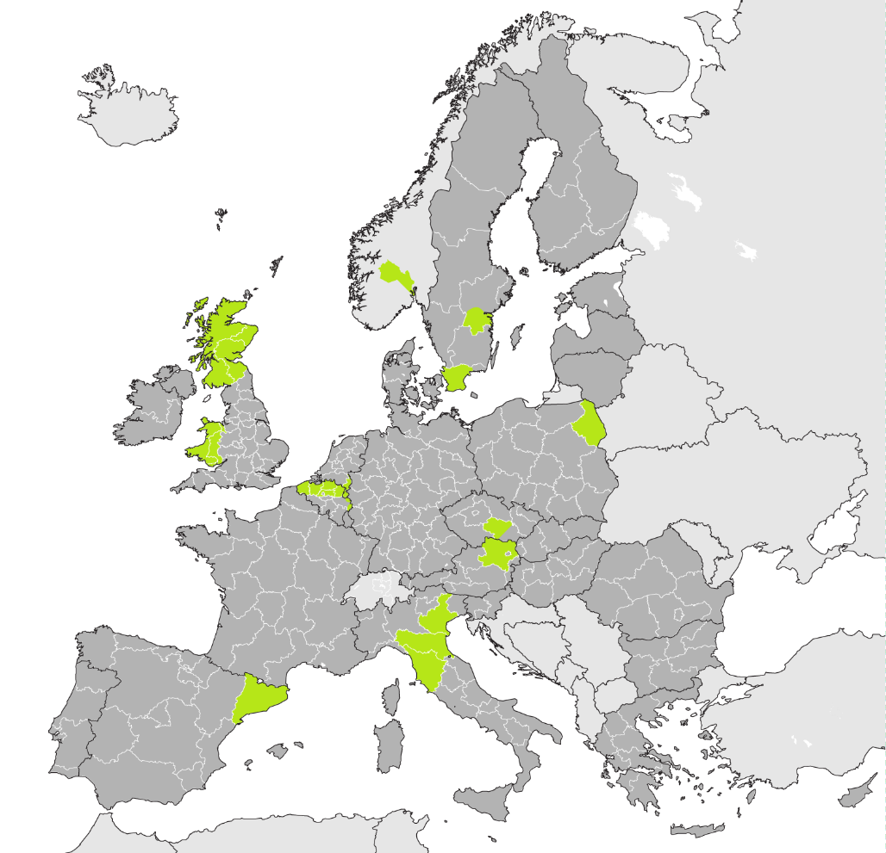
Our Members
  Skåne (SE)
  Scotland (UK)
  Catalonia (ES)
  Flanders (BE)
  German-speaking Community of Belgium (BE)
  South Limburg (NL)
  Lower Austria (AT)
  Wales (UK)
  Region Östergötland (SE)
  Podlaskie (PL)
  Veneto (IT)
  Emilia Romagna (IT)
  Tuscany (IT)
  Vysočina (CZ)
  Buskerud (NO)
  Northern Ireland observer

Slide 5
EUREGHA’s Activities and Tools
Advocacy
Making the voice of regional and local health authorities heard at EU level
Liaising with the EU institutions and international stakeholders
Reinforcing the partnership between EUREGHA member regions
and the EU institutions.
Policy monitoring
Providing access to tailored monitoring of information on health-related legislation and funding through reports, e-mails, weekly InfoFlashes and bimonthly newsletters.
Profile promotion
Disseminating booklets and publications of EUREGHA
members’ best-practices
Organising high-level events in Brussels
Organising exclusive policy briefings and annual conferences
Partnership building
Providing opportunities for cooperation and exchange of experiences
with other European regions
Project development
Monitoring calls for proposals and tenders
Disseminating partner searches
Providing participation opportunities, through EUREGHA, in EU projects,
Joint Actions and initiatives

Slide 6

Secretariat on the Interregional Group on Health and Wellbeing
EUREGHA carries out the tasks for the Interregional Group for Health and Wellbeing of the European Committee of the regions, organizing its 5 annual meetings.
2019 Sessions
CoR Interregional Group on Health and Wellbeing: “Active and Healthy Ageing” (17/06/19)
CoR Interregional Group on Health and Wellbeing: Value-Based healthcare in Europe: challenges and opportunities (18/04/19)
CoR Interregional Group on Health and Wellbeing (IRGHW) – Constitutive meeting (07/02/19)
CoR Interregional Group on Health and Wellbeing: “Healthcare in Cross-Border Regions” (26/06/19)
CoR Interregional Group on health and Wellbeing – Meeting on “Integrated Care in Europe: The Way Ahead” (06/12/19)
One of the 2018 Sessions
Global Challenges, Territorial Answers: The Future of Health in Europe (09/10/18) with Commissioner Vytenis Andriukaitis

Slide 7

Approach
In order to guarantee health in all regions, it is important to strengthen the multilevel governance approach in the area of health by:
  Creating new strategic partnerships between the EU and regional and local authorities
  Reinforcing the multi-stakeholder partnerships with the civil society academia and the industry
Objectives
Invest in innovative health policy making: shifting to a value-based approach
Tackle health inequalities
Ensure health promotion and prevention: shifting from drug approach to behavioral changes
Foster integrated care to offer a service that is closer to the citizen
Innovate health in order to take full advantage of the opportunities provided by the digital revolution and technological innovation
Invest in border regions

Slide 8

Tools
The Signatories
Investments and exchange of practices at EU level in the health and well-being sector are key and must be done through:
  Cohesion policy
  European Social Funds Plus
  Horizon Europe
  European Innovation Partnership on Active and Healthy Ageing (EIP-AHA)
  Increased synergies with EU programs and new tools
  A permanent physical forum of consultation
Cristian-Silviu Buşoi, Member of the European Parliament – ENVI Committee
Biljana Borzan, Member of the European Parliament – ENVI Committee
Alojz PETERLE, Member of the European Parliament – ENVI Committee
Institutions

Slide 9























Associations and Organizations
European Regions

Slide 10
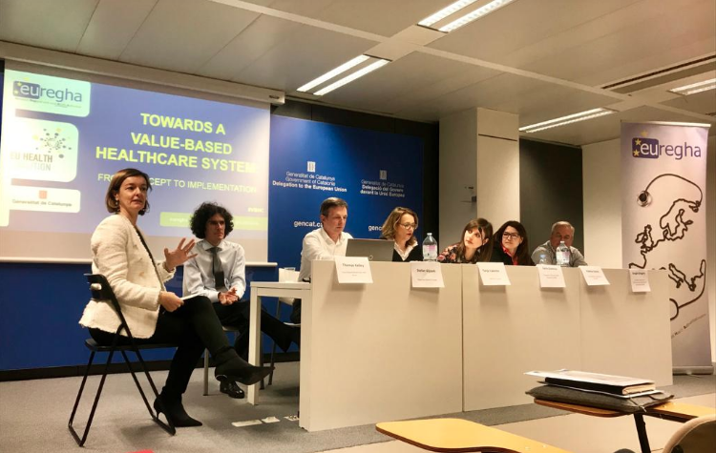
Policy Cycles for 2019
January - June
Value-based healthcare
Implementation of the EURIPHI project
Organization of an event on VBHC and outcomes
July - December
eHealth
Collection of best practices publication of a booklet of regional good-practices (on going)
Specific focus in the newsletters
Specific focus in the newsletters
Main Outputs
Main Outputs
Conference “Towards a Value-Based Healthcare system: from concept to implementation”. (April 4, 2019)

Slide 11





BUILDING SOCIAL AND EMOTIONAL SKILLS TO BOOST MENTAL HEALTH RESILIENCE IN CHILDREN AND YOUNG PEOPLE IN EUROPE
BOOST is the result of a cooperative effort between different stakeholders in the field of health and education research, dissemination, educational sector and policy making.
BOOST aims to create an innovative approach in order to strengthen social and emotional skills among children and young people in school, thus promoting mental health and well-being.
General objective:
Many school-based Social and Emotional Learning (SEL) programs have proven effective in increasing social well-being and academic achievement in children and have positive long-term effects, such as increased success in the labour market and in life in general.
However, a number of shortcomings have been identified:
  SEL activities are usually implemented by outside experts and not integrated into general teaching activities
  Teachers perceive SEL as time-consuming and often do not engage in this kind of interventions
Background:
@BOOST_MHealth
BOOST project
www.boostproject.eu

Slide 12
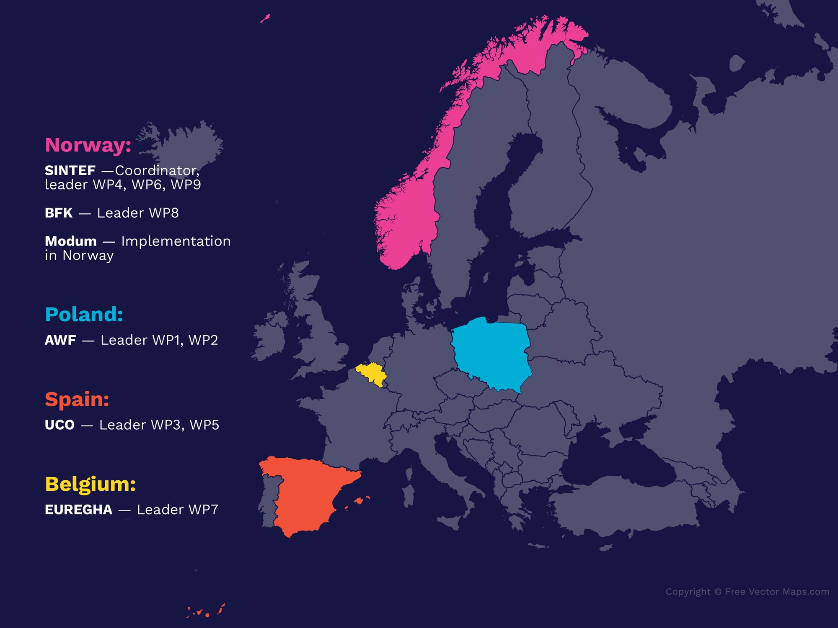

BOOST Consortium
The BOOST consortium brings together:
1 County Municipality
1 Municipality
2 Universities
1 Research Organisation
1 European Regional and Local Health Authorities Network
The consortium partners have complementary expertise and represent the whole chain necessary for acquiring, spreading, ensuring uptake and using new knowledge.

Slide 13
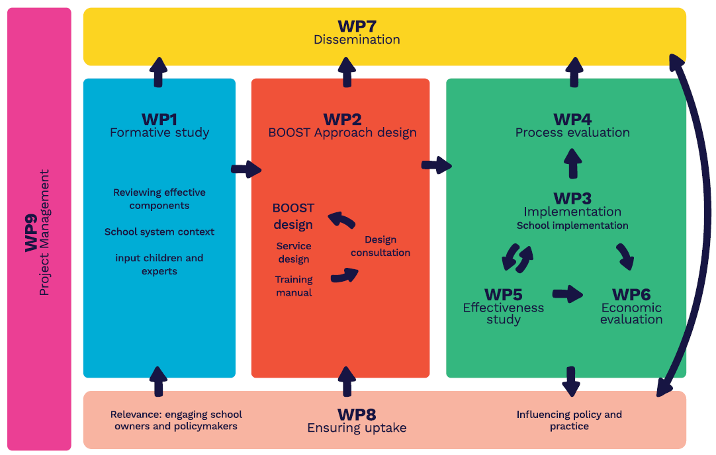
Work and Methodology
The BOOST project will develop, implement, and test a new school-based population approach for social and emotional learning, which will involve teachers' skills development, organisational development, and classroom implementation.
The approach will be tested in mainstream school environments by regular class teachers in three diverse European contexts in Norway, Spain and Poland.

Slide 14
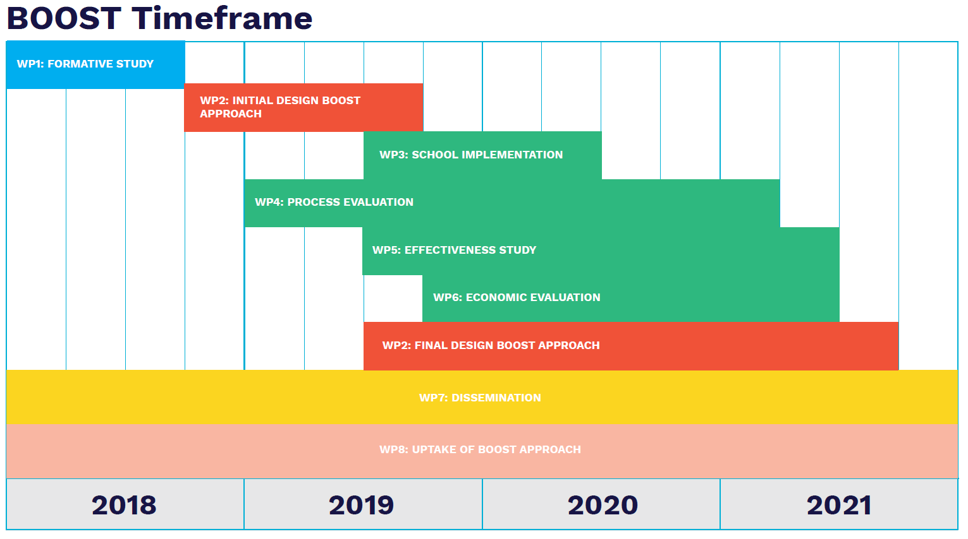
The project, launched in January 2018, has a duration of 4 years
and is financed by the HORIZON 2020 programme

Slide 15



Through the EURIPHI project, Public Procurement Organisations (PPOs) involved in different Public Procurement Innovation (PPI) and/or Pre-Commercial Procurement (PCP) are teaming up around a novel approach of Value-Based Procurement (VBP) joined by national/regional procurement organisations and service providers with a common vision: developing a Value-Based Procurement of innovative solutions to enable the transformation of health and social care delivery.
  www.euriphi.eu
  @Euriphi_eu

Slide 16

The Call – A Coordinating and Support Action (CSA)
To address common unmet care – health need, authorities can act together…
Introducing innovation through joint public procurement
Application:
Respond to the need to change health and care organizations and support the transition towards a patient-centered integrated model with triple aim:
  Better care experience
  Better care outcomes
  More efficient care
Ensure the use of rapid diagnostics in care pathway to manage infectious diseases and foster appropriate antimicrobial drug use reducing unnecessary prescriptions and AMR
  Facilitate uptake of rapid diagnostics tests (Point of Care) through Europe

Slide 17
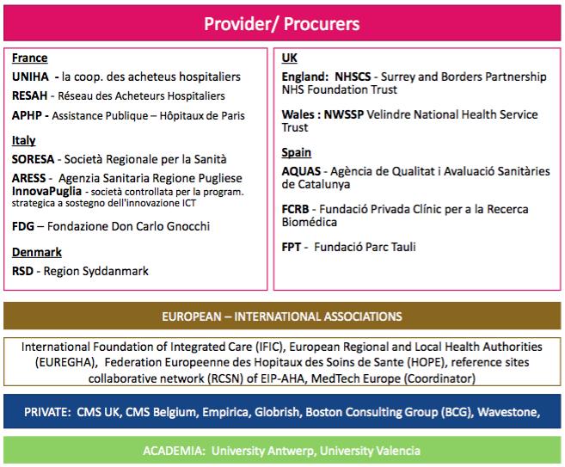
EURIPHI Partners

Slide 18
EURIPHI Regional Health Authority Network
Collaborative network
Representatives of (regional) health (and social care) authorities, chief financial and innovation officers;
Ability to impact decisions to foster sound investment to introduce innovation/innovative solutions in health and integrated care;
Willing to prioritize areas of interest to invest in and foster a cross-border approach of Value Based PPI/PCP to introduce innovative solutions
EURIPHI Network – benefits
Be informed of the latest innovation partnerships in procurement
Opportunity to exchange the latest insights in policies development and initiatives by regions/institutions and the European Commission and guide development of a framework of cooperation
Discuss concrete cross-border collaborative cooperation, indentify possible clusters of common shortcomings/unmet needs and apply future PPI/PCP Calls incl. EU Calls

Slide 19
EURIPHI Deliverables
Build and ecosystem
  EURIPHI sustainable Community of Practice – “Value based PPI (Procurement Innovative Solutions) and advisory board
  EURIPHI Network of (Regional) Health Authorities Representation - Payers
Develop a common vision, understanding, tools and guidance
  Develop value based procurement of innovative solutions method (“Value Based PPI/PCP”)
  Develop a legal basis for Value drive cross-border procurement with local decision making and contracting fostering innovation partnership
  Application
    Patient centered integrated care innovation solution
    Use rapid diagnostic in clinical pathways of hospital acquired at ICU and ventilator acquires infection diagnosis and antibiotic stewardship

Slide 20
EURIPHI Deliverables
Development of cross-border PPI – learning experiences
  Use Value Based Procurement processes (from pre-tender dialogue to contracting) and deploy Value Based PPI for learnings and informing future EU PPI/PCP calls on
    Rapid diagnostics for hospital acquire infectious respiratory diseases
    Patient-centered integrated care
Dissemination and exploitation
  www.euriphi.eu
  @Euriphi_eu
The project was launched in January 2019.

Slide 21

Thank you for your attention!
EUREGHA Secretariat
Rond-point Robert Schuman, 11
1040 – Bruxelles, Belgium
Contact
Valentina Polylas, Operations Manager
valentina.polylas@euregha.net
www.euregha.net
EUREGHA
#HealthinAllRegions

