Slide 1
Inclusive Growth On the Road. Health & Ageing
6 December 2019

Slide 2
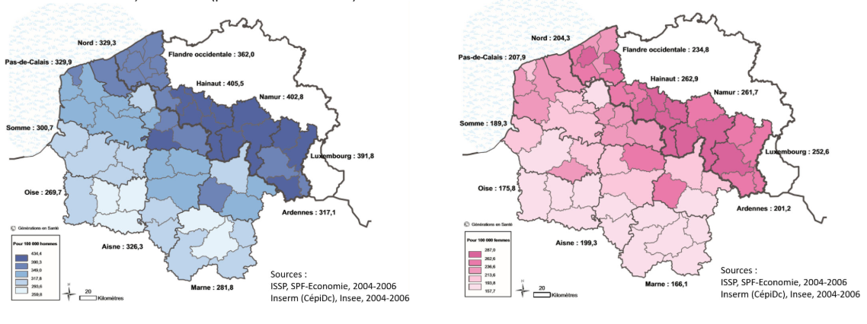
Nanocardio
Context : cardiovascular diseases
Previous Interreg project : ICAPROS (Interreg IV)
Standardized mortality rate due to cardiovascular diseases in the Wallonia-France-Vlaanderen cross-border zone :
Coordinator : UMons– Pr S. Laurent
NMR and Molecular Imaging Lab.
Interreg FWVl 2015
Prevalency of cardiovascular diseases in the Wallonia-France-Vlaanderen cross-border zone
Principal factor causing cardiovascular diseases : Atherosclerosis
2

Slide 3
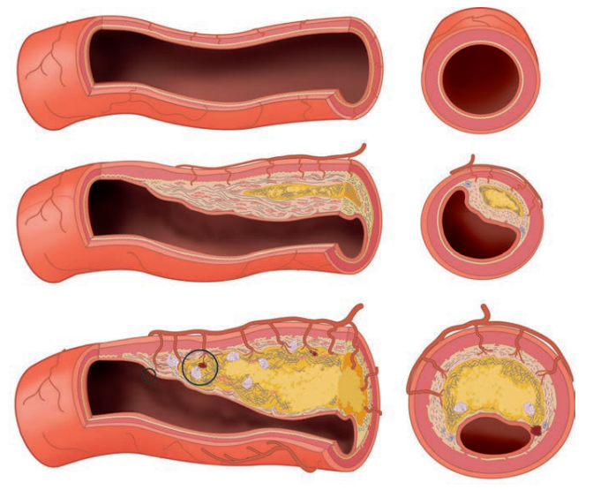
Nanocardio
Context : Atherosclerosis
Cardiovascular diseases
• Principal cause of morbidity and mortality throughout the world
• Risk factors: ageing, overweight,…
Nowadays diagnostic methods
• Angiography (catheter, allergy)
• Doppler (non invasive but lack of specificity)
Coordinator : UMons– Pr S. Laurent
NMR and Molecular Imaging Lab.
Interreg FWVl 2015
NanoCardio → Prevention of these cardiovascular diseases
Need of new techniques to detect atherosclerosis precociously
How ? By developing a new molecule…
3

Slide 4
A new nanoplateform to detect atherosclerosis
Optical probe
Optical imaging
Paramagnetic dendritic nanoplatform
Magnetic resonance imaging
R832 peptide
Targeting system

Slide 5
Nanocardio
Magnetic resonance imaging (MRI) probe
Coordinator : UMons– Pr S. Laurent
NMR and Molecular Imaging Lab.
Interreg FWVl 2015
5

Slide 6
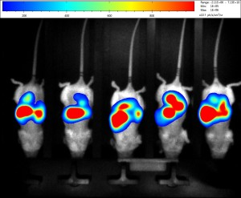
Optical probe
Optical probe
Optical imaging
Paramagnetic dendritic nanoplatform
Magnetic resonance imaging (MRI)
R832 peptide
Targeting system
https://www.cmmi.be/?page_id=28

Slide 7
Targeting atherosclerosis…
Nanoplateform
Optical probe
MRI probe
Targeting system
Atherosclerotic plaque
Aims of the NanoCardio project :
Development of diagnosis systems enabling the detection of atherosclerosis by means of two imaging techniques used simultaneously
Precocious detection → Appropriate healthcare for patients
Strong development perspectives in the health sector for the cross-border area and beyond (preclinical development)

Slide 8
A cross-border project : Consortium
Nanoplatform synthesis
In vitro and in vivo studies
MRI and optical imaging
Toxicological study
Nanoplatforms safety
Associated operators :

Slide 9
Thank you for your attention

