Slide 1
INTERACT Workshop inclusive growth
Cross-Border Cooperation
European Commission - DG REGIO
Valeria.Cenacchi@ec.europa.eu

Slide 2
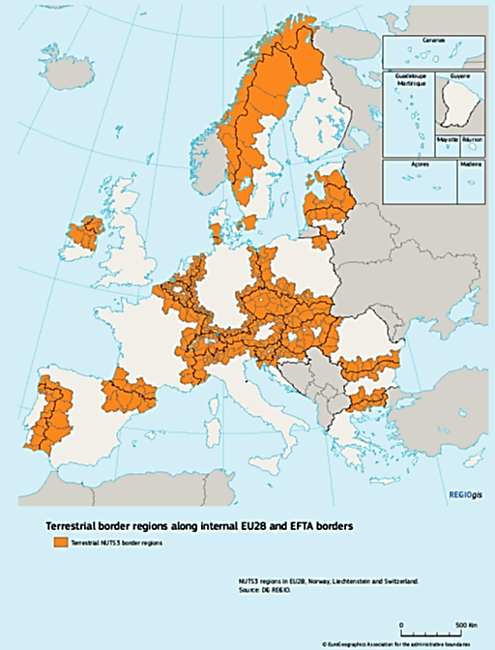
Border Regions matter
40% EU territory
30% EU population (150m)
30% EU GDP
BUT navigating different legal and administrative systems is still complex, long and costly

Slide 3
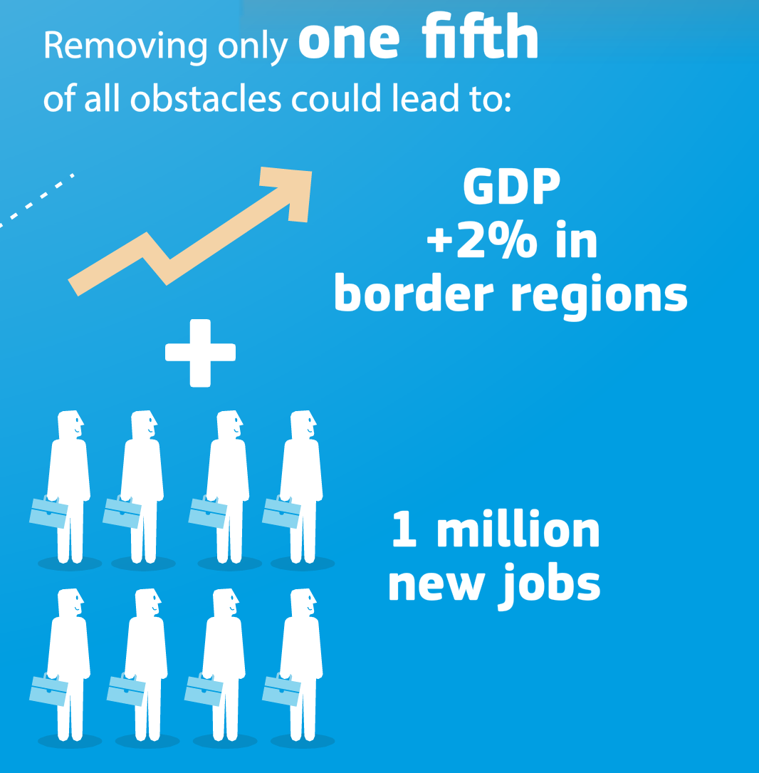
A huge untapped potential
+
support beyond funding!
With only 20% of obstacles lifted, EU Border Regions could gain 2% in GDP…

Slide 4
BORDER FOCAL POINT Action Plan

Slide 5
Boosting EU border regions platform
https://ec.europa.eu/futurium/en/border-regions
Health Policy Platform
http://www.euregha.net/crossborderhealthcare/

Slide 6
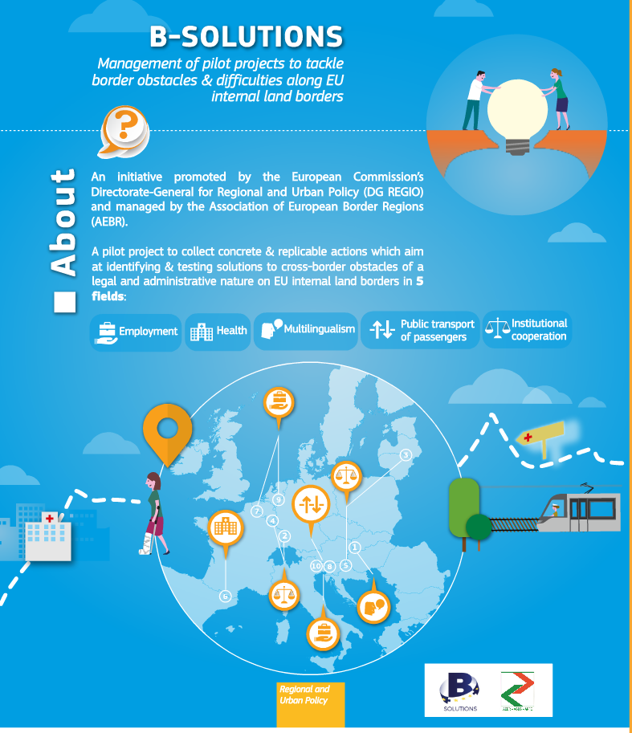
B-SOLUTIONS
Addressing border obstacles
https://www.b-solutionsproject.com/pilot-actions

Slide 7
B-solutions - Pilot projects - Healthcare
Cross-border health care (Euroregion Nisa, CZ-DE)
CB Emergency Medical Services (EMS) (FR-BE)
Ambulances without Borders (NL-BE)
CB health care acess Valga and Valka (EE-LV)
Recognition of qualifications healthcare professional (FR-ES -Hospital de Cerdanya)

Slide 8
Policy Objectives 2021-2027
+ 2 horizontal objectives:
Administrative capacity building (CBC governance)
Co-operation between regions and across borders (embedding co-operation in mainstream)
A smarter Europe (innovative & smart economic transformation)
A greener, low-carbon Europe (including energy transition, the circular economy, climate adaptation and risk management)
A more connected Europe (mobility and ICT connectivity)
A more social Europe (the European Pillar of Social Rights)
A Europe closer to citizens (sustainable development of urban, rural and coastal areas and local initiatives)
+ ECBM
European Cross Border Mechanism

Slide 9
Synergies and cumulative effect
Enabling condition: strategic policy framework for health, including mapping infrastructure needs
Investments in health may be envisaged both under PO1 (leverage for regional economic development – 3S) and PO4 (better access, marginalised categories)
Combine other funding sources (R&D, digitization)
Non-funding tools !
Post 2020 provisions provide high potential for more complex cross border investments in health which can combine different strands (mainstream, Interreg, ECBM, ERDF/ESF) and address different needs (framework conditions, infrastructure, research, innovation, digitization, services accessibility, human resources capacity, legal harmonization) for more impact!

Slide 10
More Information
Boosting Border Regions
https://ec.europa.eu/futurium/en/border-regions
@RegioInterreg #EUBorderRegions

