Slide 1
EU tools to support
Member States cooperation and investments in health
5 December 2019
Unit "Performance of national health systems"
Directorate-General for Health and Food Safety
European Commission

Slide 2
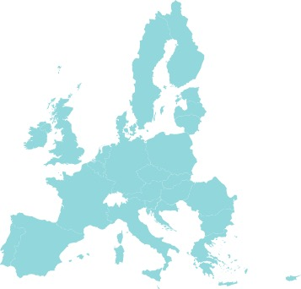
Supporting the transformation
of national health systems
Similar challenges
Shared values
Common policy objectives
Same investment needs

Slide 3
What role for the EU level ?
Policy framework
Coordination of economic policy – the European Semester
Knowledge brokering – State of Health in the EU
Co-operation, mutual learning, technical and financial support

Slide 4
What is available?
Support
mechanisms
Country-specific knowledge
Good Practices
Guidance material
Tools
Dedicated events
Twinning schemes
Technical support
Financing instruments

Slide 5
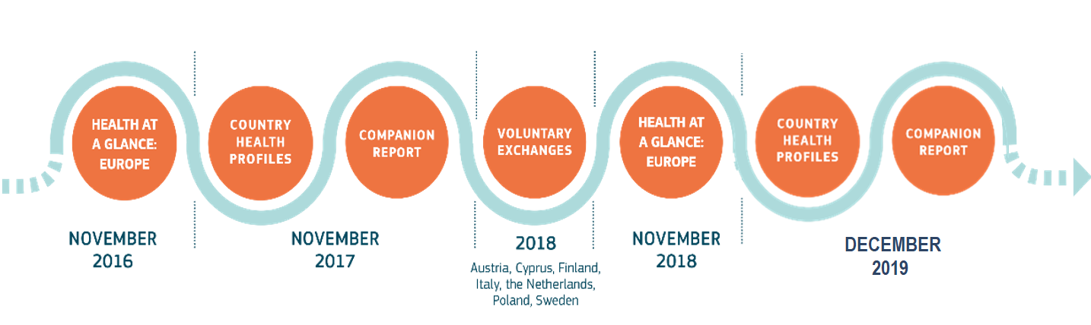
STATE OF HEALTH IN THE EU
Knowledge
Brokering

Slide 6

Non-communicable
Diseases
Best Practice Portal
https://webgate.ec.europa.eu/dyna/bp-portal/

Slide 7
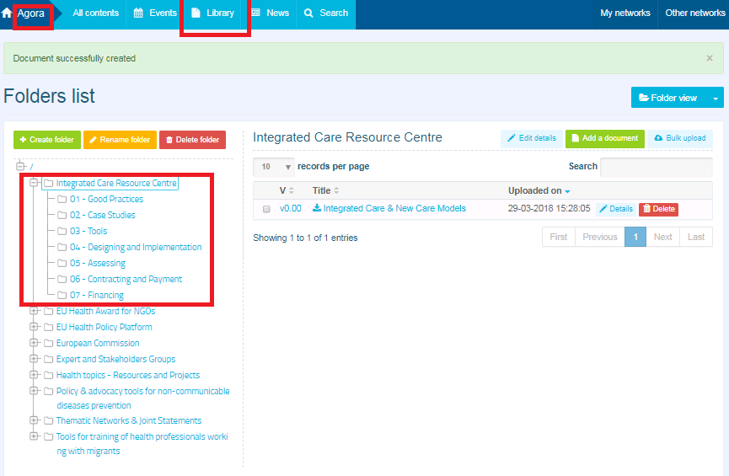
Collection of knowledge resources – support implementation
Integrated
Care
Resource Centre
EU Health Policy Platform
https://webgate.ec.europa.eu/hpf/

Slide 8
Knowledge transfer
“Implementation Rooms”
How to design and implement integrated care:
Lessons from early adopters in Europe
@ ICIC17 in Dublin & ICIC18 in Utrecht
Focusing on successful examples from European regions and transferring knowledge in relation to aspects important for deployment
Change management
Political engagement
Patient engagement
ICT infrastructure and solutions
Workforce/patients education and training
Incentives

Slide 9
“Twinning” projects
  Support from EU Programmes
SCIROCCO Exchange and VIGOUR projects launched in 2019 – Health Programme
DigitalHealthEurope launched in 2019 – Horizon 2020
Bring together “early adopters” of integrated care with “new adopters”
“Early adopters” assist the “new adopters”
    prepare the local environment for implementation
    transfer of knowledge and good practice
    dedicated seminars and workshops
    study visits, mentoring, etc.

Slide 10
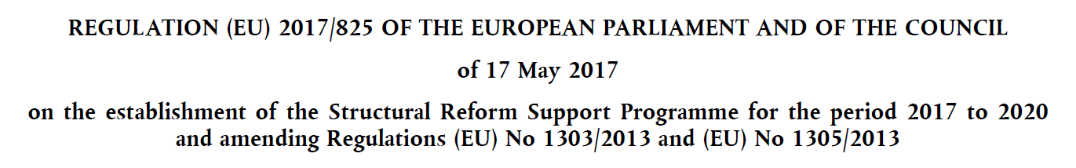
The structural reform support programme (SRSP)
Key takeaways:
Technical support is demand-driven, based on request from Member States;
It is available to all Member States;
Technical support covers the entire process of reform: from design to completion;
No co-financing is required;
The SRSS engages in dialogue with Member States to discuss technical support needs and to agree on cooperation and support plans.

Slide 11
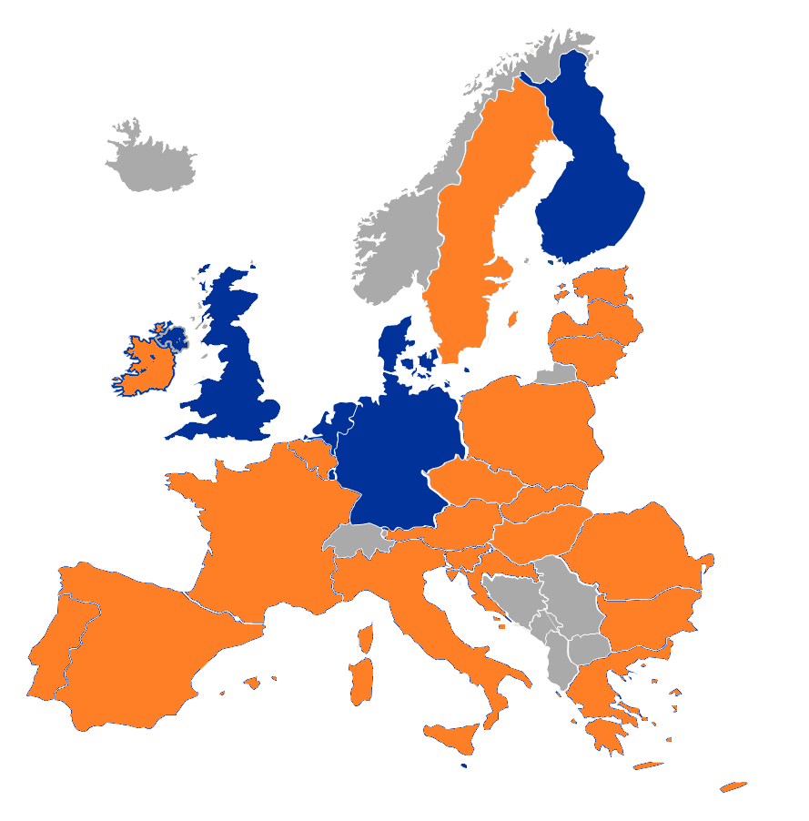

TECHNICAL SUPPORT PROJECTS ON HEALTH in 21 countries
(on-going and under
preparation)
Some examples:
• INTEGRATED SERVICE PROVISION
• National e-health centre
• Capacity building for infrastructure projects
• Functional Integration of Hospitals
• Primary Health care reform
• cancer Screening programmes
• DRG system
• SPENDING REVIEW ON MEDICINES
• centralised procurement
• Health system performance assessment

Slide 12
Technical assistance
Current schemes in ESIF 2014-2020
TAIEX-REGIO PEER 2 PEER scheme
  Related to the European Regional Development Fund (ERDF) and the Cohesion Fund
  Helps public officials exchange knowledge, good practice and practical solutions to concrete problems --> better results
  from EU Structural Funds investments
    Expert missions
    Study visits
    Single or multi-country workshops
    https://ec.europa.eu/regional_policy/index.cfm/en/policy/how/improving-investment/taiex-regio-peer-2-peer/

Slide 13
2014 - 2020
EU level financing possibilities
Supporting
Integrated Care
EC proposals for 2021 - 2027
Horizon 2020
Health Programme
Structural Funds
(ERDF/ESF)
Investment Plan for Europe
EIB financing
Horizon Europe
Digital Europe Programme
Structural Funds
  ERDF
  ESF+ with Health strand
InvestEU Programme
(Implementation + Advisory Services)
Reform Support Programme
(Implementation + Technical Support)
EIB financing

Slide 14

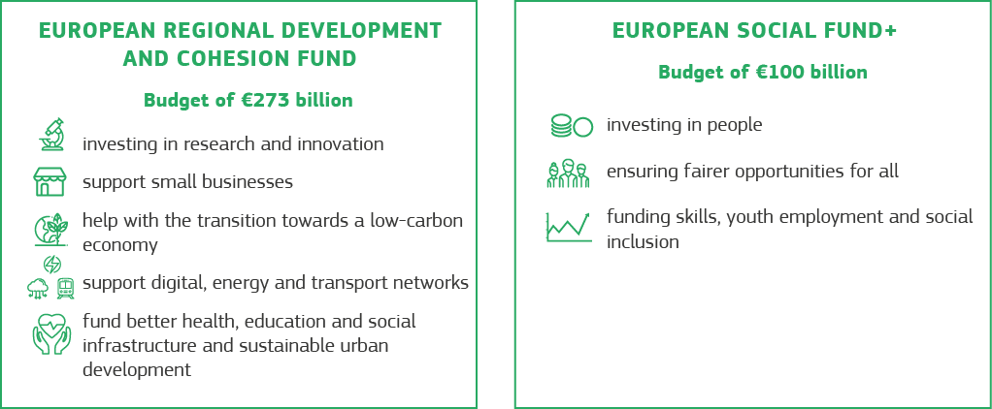
REGIONAL DEVELOPMENT AND COHESION
A strengthened link with the European Semester
A simplified framework and less red tape for the beneficiaries of the funds
A more tailored approach to regional development
Source: European Commission

Slide 15
Cohesion Policy Objectives in 2021-2027
  PO 1: a smarter Europe…
  PO 2: a greener Europe…
  PO 3: a more connected Europe...
  PO 4: a more social Europe…
  PO 5: a Europe closer to citizens…
All ESF+ specific objectives fall under PO 4 : “a more social Europe, implementing the European Pillar of Social Rights”
Investments in health and long-term care may be envisaged both under PO1 and PO4.

Slide 16
Structural funds in 2021-2027 to support:
Important health needs in a number of areas, in line with health reforms
Improve accessibility, effectiveness and resilience of healthcare systems
Enhance access to affordable, sustainable and high-quality healthcare
with a view to reducing health inequalities
Examples:
  stronger primary care
  health promotion and disease prevention
  active and healthy ageing
  integration of care
  health workforce training
  eHealth

Slide 17

Now…
Investments in
healthcare
New care models
& services
Infrastructure
(hospitals)
Medical innovations
(medicines, imaging,
diagnostics, devices…)

Slide 18
Seminar on "Strategic investments for the future of healthcare"
February 2017
  Main messages
Long-term investment strategies that meet the reform needs of health systems
Integrated approach to investments: consider together the investment needs for
    infrastructure
    technology
    service models

Slide 19
The investment triangle in health
The future
New care models & services
(prevention programmes, integrated care,
patient pathways; workforce skills and roles;
system re-organisation and governance, …)
investment
triangle
Infrastructure
(hospitals, primary care & community care centres)
Medical innovations
(diagnostics, data analytics,
decision support systems,
eHealth/mHealth)

Slide 20
Seminar on "Strategic investments for the future of healthcare"
February 2017
  Main messages
Combine financing instruments and blend financing from various sources
Look beyond national budgets and EU grants - develop partnerships with new stakeholders and learn to manage new financing instruments
Contracting and payments models to be considered in conjunction with the planned investments
  as these will determine whether the investments will turn into successful service provision or not

