Slide 2
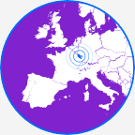
Moselle unlimited!
1 DEPARTMENT WITH A VOCATION TO OPEN UP TO THE WORLD, EUROPE, THE GREATER REGION
THE POLITICAL WILL TO BECOME A EURODEPARTMENT
MANY CROSS-BORDER SUCCESSES TO ITS NAME, SUCH AS SESAM’GR (German language learning)
A STRATEGY FOR ATTRACTIVENESS AND TERRITORIAL MARKETING (6,000 Ambassadors)
LEADERS IN SOLIDARITY POLICY
“EUROPEAN REFERENCE SITE” EIP on AHA

Slide 3
SENIOR ACTIV’ PRESENTATION PARTNERSHIP
LEADER
FINANCIAL PARTNERS
METHODOLOGY PARTNERS

Slide 4
SENIOR ACTIV’ PRESENTATION Promoting ageing well at home for seniors and frail elderly people
PROJECT OBJECTIVES
Improve the image and place of ageing in our societies,
act in a preventive and personalised way on loss
of autonomy,
respond to requirements of
proximity,
optimise support for
individual life pathways.

Slide 5
SENIOR ACTIV’ PRESENTATION
TARGET GROUP
seniors
frail elderly people
caregivers and professionals involved
The “quadruple helix” approach (institutions, businesses, academic resources and users)

Slide 6
SENIOR ACTIV’ PRESENTATION
PROJECT STRUCTURE
AXIS 3 - Cutting edge of the Silver Development in the Greater Region
AXIS 1 - Co-ordination
AXIS 5
Support for seniors and carers
AXIS 6
Adaptable and evolving home space
AXIS 7
Active citizen participation of older people
AXIS 2 - Communication
AXIS 4 - Create and animate a “Silver Development”
e-community

Slide 7
Axis 3 - Cutting edge of the Silver Development - Moselle Department
Diagnosis to optimise the development of the territories according to demographic ageing
Identify:
- good practices and their capacity to be reproduced,
- the triggers of loss of autonomy,
- use cases that could serve as a basis for experiments
Tools available: indicators, cross-border glossary, regulatory frameworks
Method: qualitative interviews

Slide 8
Axis 4 - Create and animate a Senior Activ’ - Well e-community
Creation of a network of experts and professionals in the Greater Region, to stimulate thinking around innovation to help ageing well, health and well-being prevention methods for seniors, frail elderly people and their carers
Activities: monitoring / sharing experiences / identifying unmet needs for solutions
Two types of tools: the creation and animation of a collaborative platform and the organisation of territory-based workshops across the Greater Region.

Slide 9
Axis 5 - Improve support for seniors in the Moselle Department
Objectives: access to information / individualised support / coordination of professionals
Feed and nourish the concept of training modules to prepare cross-border workers in the Greater Region for retirement
Creation of a common digital tool to guide the elderly as well as caregivers and professionals in a personalised way, towards the right person and the right service
SENIOR ACADEMY TO PROMOTE AGEING WELL THROUGH PREVENTION
- Seminars for discussion between trainers preparing people for retirement, creation of training modules
Development of “life-long learning” in the Greater Region
Networking the structures and institutions from different sides so that the professionals involved can discuss their practices (geriatrics, social and medico-social sector, home help services)

Slide 10
Axis 6 - Anticipate and guarantee an adaptable and evolving home space AVIQ
Objectives:
Adapt accommodation to avoid falls
Improve access to technical help
Facilitate returning home after hospitalisation
Actions:
Dematerialised technical help showroom
Seminars for discussion between occupational therapists
Feasibility study for a “recyclotheque” to sort and reuse technical aids
“Adaptable and evolving home space” working group

Slide 11
Axis 7 - Support social citizen participation of older people
Objectives:
prevent progressive isolation as well as the breaking of social ties
develop and enhance charity in favour of active ageing
encourage and professionalise the charitable commitment of seniors.
Actions:
1 - Development of charity training modules aimed at seniors (MOOC)
2 - Networking of seniors’ associations
3 - Encouraging citizen involvement by seniors in the management of neighbourhoods and municipalities in order to prefigure a Council of Seniors in the Greater Region.
4 - Creation of a cross-border newsletter that shares seniors’ initiatives from different sides

Slide 12
SENIOR ACTIV’ PRESENTATION
Public Innovation Laboratory which has three missions
➔ a role as Observatory to develop a shared diagnosis…
➔ a “Senior Academy” to learn collectively….
➔ a Lab to experiment/innovate…

Slide 13
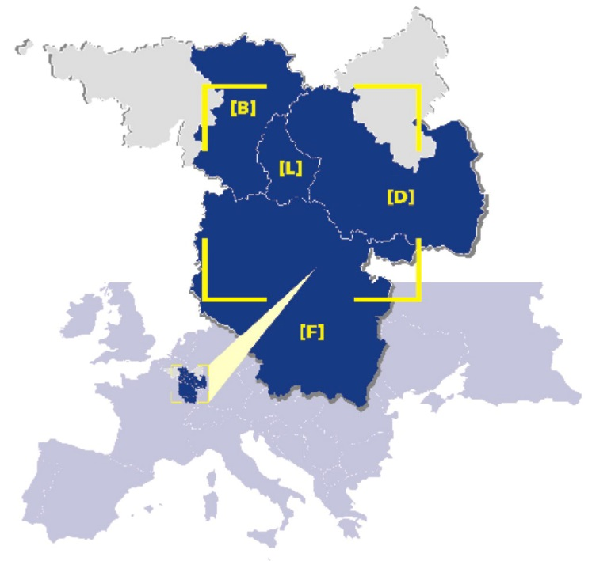
SENIOR ACTIV’ PRESENTATION
Support: INTERREG V A Greater Region 2014-2020 Programme
2018 - 2022 budget: 3.7m€
of which, 2.1m€ from FEDER

