Slide 1
Financial instruments under IGJ and ETC
Cooperating for investment
28 November 2018 I Brussels, Belgium
Iuliia Kauk, Interact

Slide 2
‘Does your programme consider providing support to financial instrument(s) (i.e. loans, guarantees, equity) in current or the next programming period?’
Repository of Interreg programme management practices
45 Interreg programmes:
19 answers – not known yet
2 answers - YES

Slide 3
FIs in ESIF
Financial instruments vs. Grants
Benefits of FIs
Types of FIs
Ex-ante assessment
Implementation options
FIs in 2014-2020 and beyond
FIs and ETC: is there any future?
Case study

Slide 4
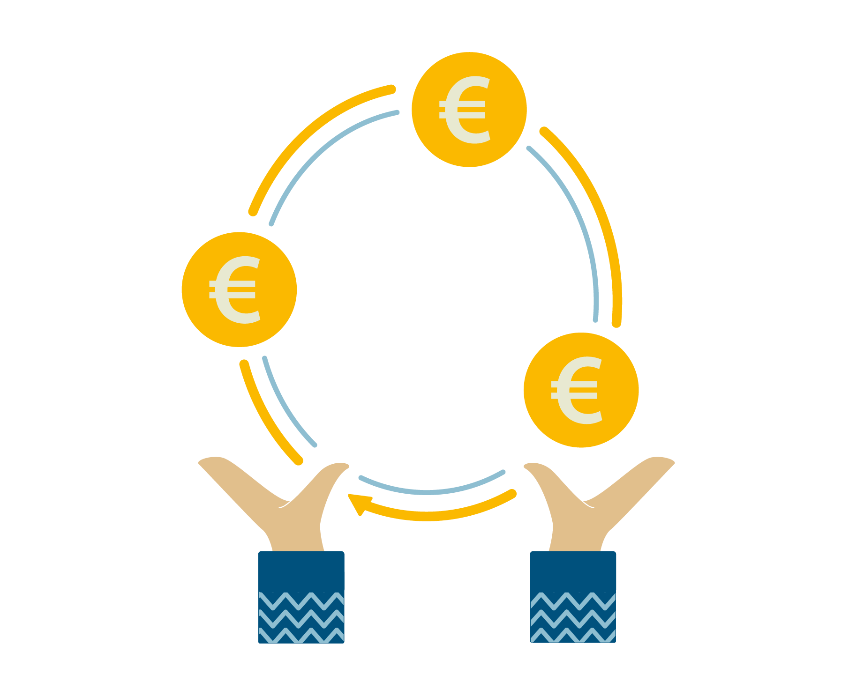
Financial instruments vs. Grants
WHAT

Slide 5
Definition
Financial engineering instruments/ revolving funds
Guidance for Member States on financial instruments (2015):
… Union measures of financial support provided on a complementary basis from the budget to address one or more specific policy objectives of the Union.
Revolving
Additionality
Leverage

Slide 6
Grant
ESIF programme/Grant
Project 4
Project 2
Project 1
Project 3
Can be spent once
Reimbur-sement
Co-financing
TO/ SO

Slide 7
Financial instruments
ESIF programme/ MA
Financial instrument
Final recipient
Final recipient
Final recipient
Revolving: stay in cycle
Frontloading/ advance
Market failure/ suboptimal investment
Lengthy set-up

Slide 8
Benefits of financial instruments
WHY

Slide 9
Benefits of FIs
Leverage/ multiplier effect
Increased impact of ESIF programmes
Revolving nature of funds
Efficiency and effectiveness of gains
Repaid investments
Better quality of projects
Private sector involvement and expertise
Wider spectrum of financial tools for policy delivery

Slide 10
FIs in 2014-2020
Wider scope – all TOs and IPs
Set-up – compulsory ex-ante assessment
Various implementation options
Legal provisions set out from outset
Compulsory reporting on a range of indicators

Slide 11
Types of financial instruments
WHAT

Slide 12
Choice of financial products
Type of final recipient
Micro-enterprises, start-ups, innovative SMEs, high-risk investments
Type of project
Interest rate, collateral conditions, credit risk protection
Financial context
Market failure, suboptimal investment situation, investment needs

Slide 13
Financial products in ESIF
Loans
Guarantees
Equity
Quasi-equity

Slide 14
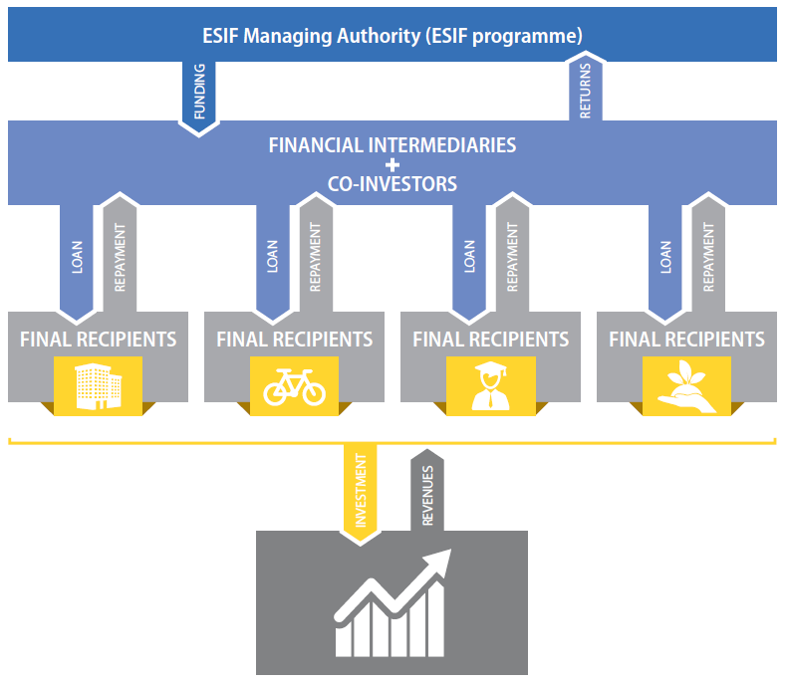
Loans
*Factsheet on FIs products – fi-compass.eu
Notes:
2:13

Slide 15
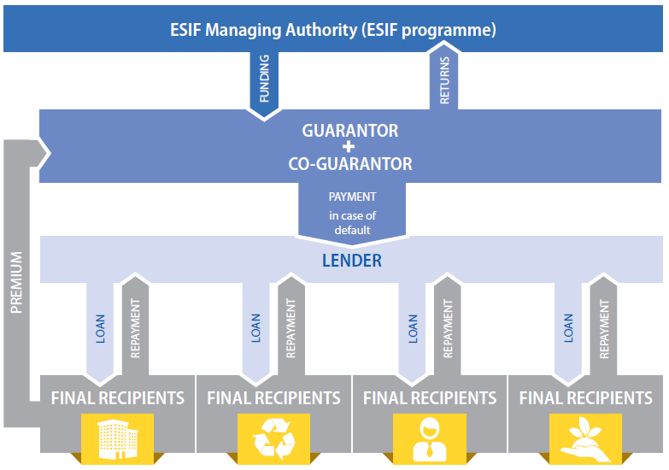
Guarantees
*Factsheet on FIs products – fi-compass.eu
Notes:
2:13

Slide 16
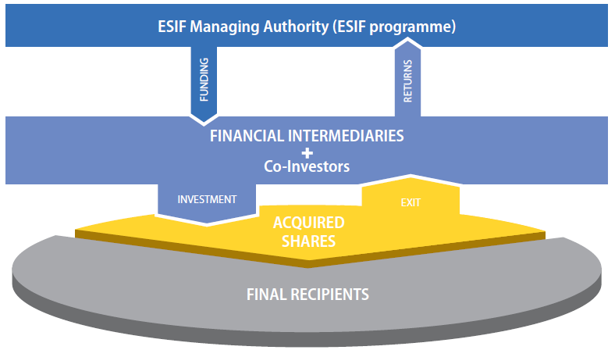
Equity
*Factsheet on FIs products – fi-compass.eu
Notes:
2:13

Slide 17
Quasi-equity
Mezzanine capital or mezzanine finance
Closer to equity or debt capital according to the level of ownership acquired and the exposure to loss in the event of insolvency.
For instance, subordinated loan
Equity
Debt

Slide 18
Pros of financial products for MAs
Financial products | Benefits
Loans | Address specific risk capacity constraints in a given segment Large scale investment, high number of FRs Limited management costs Defined repayment scheme Money can quickly be reinvested
Guarantees | High leverage effect Can be part of a broader investment strategy Disbursement only in the event of default Large scale instrument
Equity | High level of returns is possible Stimulates investment by local private equity, external investors
Quasi-equity | Addresses specific liquidity and risk capacity constraints Higher level of returns (compared to normal loans) Stimulates investment by local private equity industry also in riskier areas

Slide 19
Cons of financial products for MAs
Financial products | Benefits
Loans | Expected return is lower than other FIs (equity) Funded products require more initial resources than unfunded (guarantees) Investment risk and management costs are higher (guarantees)
Guarantees | Does not provide liquidity but represents a risk reserve for the lender Revolving effect is slower than for loans (until repayment is ensured) Estimating the appropriate cap (max limit) can be difficult
Equity & Quasi-equity | Time-consuming; cost-intensive investment Short-term financing is not possible Full insolvency risk High set-up and operational costs Typically low number of investors and FRs Addresses only a few selected FRs Fundraising of private resources can be challenging

Slide 20
EC off-the-shelf financial instruments
LOAN
Risk-sharing loans
LOAN
Urban development product
LOAN
Renovation loan
GUARANTEE
Capped guarantees for SMEs
EQUITY
Co-investment facility
Notes:
2:13

Slide 21
Ex-ante assessment
WHERE

Slide 22
Ex-ante assessment (Article 37(2) CPR)
Market failure
Additional resources
Lessons learnt
Value added
Market assessment
Delivery and Management
Proposed investment strategy
Expected
results
Provisions for the update and review

Slide 23
Implementation options for MAs
HOW

Slide 24
CPR Article 38(1)
MA ESIF
programme
EU level instrument (Art. 38(1)(a))
FI set up at national, regional, transnational or cross-border level, managed by or under the responsibility of MA (Art. 38(1)(b))
MA invests in a legal entity (Art. 38(4)(a))
MA entrusts implementation tasks to certain entities (Art. 38(4)(b)): EIB, IFI, NFI, ot.
MA implements directly loans or guarantees (Art. 38(4)(c))

Slide 25
NEW implementation option – FI implemented directly by the MA
MA is a ‘beneficiary’
Selection of final recipients – advantage
Relatively easy to set up (no establishment of FoF/ no financial intermediaries)
No management costs
No risk of ‘parking money’ – no frontloading
Capacity of MA – investment decision (ex-ante assessment)
MA/ IB
Final recipients
Financial products (loan/ guarantee)

Slide 26
Implementation options
Managing Authority ESIF programme
Fund of Funds (FoF)
Financial intermediaries
Financial intermediaries
Financial products
Financial products
Financial products
Final recipients
Final recipients
Final recipients

Slide 27
Financial instruments in 2014-2020 and beyond

Slide 28
Legal framework
Article 66 (CPR 2014-2020)
Forms of support
The ESI Funds shall be used to provide support in the form of grants, prizes, repayable assistance and financial instruments, or a combination of thereof.
Article 47 (draft CPR 2021-2027)
Forms of support
Member States shall use the contribution from the Funds to provide support to beneficiaries in the form of grants, financial instruments or prizes or a combination thereof

Slide 29
Financial instruments in 2014-2020 EUR 20 billion planned allocations to FI for ERDF, ESF and CF by Thematic Objective – ca 4.4% of ESIF

Slide 30
24 MS implementing FI Total OP contribution committed to FIs: EUR 12.8 bln (of which 9.9 bln – ERDF and CF) Payments into FIs: EUR 3 bln Payments to final recipients: EUR 1 bln Expected leverage: 7.5 for loans, 25 for guarantees, 9.6 – equity 36 500 enterprises receiving support + 1444 jobs created Thematic areas: TO3 SMEs (52%); TO1 R&D (20%), TO4 LCE
Main findings (end of 2016) –
MAs on progress in setting up FIs (24 MS)

Slide 31
Financial instruments will be a key delivery mechanism for 2021-2027 investments generating revenue or cost savings; the provisions for their use have been streamlined and updated to ensure better and easier implementation as well as quicker set-up.
FIs in draft CPR 2021-2027:

Slide 32
Simplification in regards to FIs
FIs better integrated into the programming and implementation process;
Flexible implementation options for MAs (under the responsibility of MA or direct management);
Combination of EU resources under one set of rules;
Flexibility on combination of grants and FIs;
Eligibility rules simplified;
Reflows and fund recycling have been simply codified.

Slide 33
Combination of FIs with other forms of support – Article 37 CPR
Combination of FI and grant within a FI operation
(single operation)
Combination of FI and grant at the level of final recipient – 2 operations
MA
4 scenarios:
I – FI ESIF + G ESIF (2 separate projects: FI and grant)
II – FI ESIF + FI ESIF (2 separate FI projects)
III – FI ESIF + G non-ESIF (part of a separate project + separate intervention)
IV – FI ESIF + FI non-ESIF (part of a separate project + separate intervention)
Financial instrument
Risk sharing loan
Interest rate subsidy, guarantee fee subsidy, technical support
Final recipients
Final recipients
Final recipients
Final recipients

Slide 34
Financial instruments and ETC

Slide 35
Financial Instruments in ETC? Reality or Wishful thinking?
Favourable conditions:
Governance structures
Scope, across borders
Network of stakeholders at different levels and sectors
To be resolved:
Demand for FIs in ETC
Potential to deliver profit
Governance models
Audit and control

Slide 36
Financial Instruments and ETC
Does it fit with the agreed priority axis?
What about CB/ TN cooperation?
What is the value added or additionality?
Who decides on the final beneficiary/ recipient/ project?
How to deal with reflows/ returns of investment?
How to monitor financial instruments?
What about state aid?
What is the definition of eligibility?

Slide 37
Implementation of FIs in ETC
Critical mass
Setting the ‘Investment strategy’
Ensuring cross-border/ transnational cooperation
Setting OP indicators
Governance process and delegation principles
State aid compliance
Repayment and reinvestment schemes
Upward reporting and downward monitoring at all levels

Slide 38
Barriers to implementation of FIs in ETC
State aid (de-minimis and GBER)
Selection of FoF managers and financial intermediaries
National regulation adds further complexity (e.g. no para-banking)
Insufficient capacity on the side of Mas
Competition with grants
others

Slide 39
Programme of FIs for SMEs, Slovenia
Case study by fi-compass.eu

Slide 40
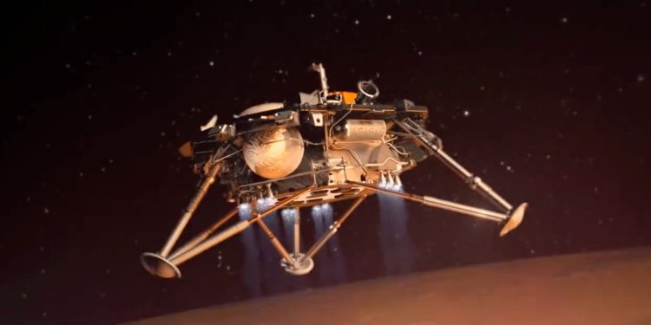
Is it better to colonise Mars OR is it better to prevent climate change?

Slide 41
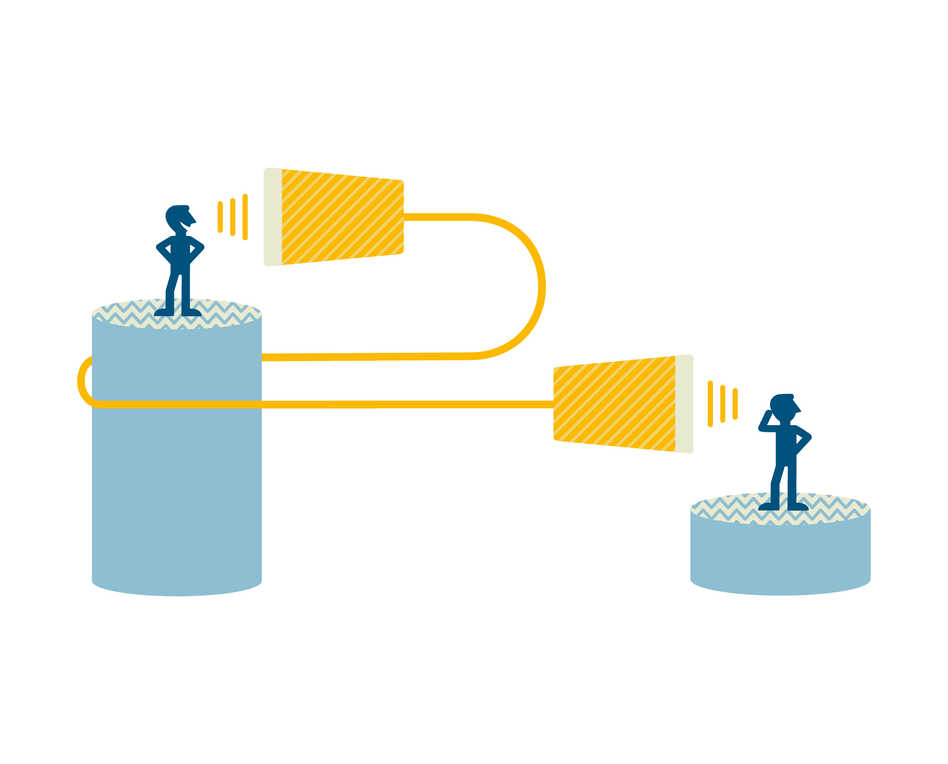
Financial products: Loans, guarantees with interest rate subsidies, equity, quasi-equity
Financial size: Total PFEI – EUR 218.8 mln
Thematic focus: SMEs support
Timing: 2009-2013
Achievements
Absorption rate: all absorbed by the end of 2016
EU leverage: 5.8
Leverage of public resources: 3
Re-investment: from 2016 on
Main outputs: 2294 SMEs supported with EUR 387 mln of financial support unlocked EUR 708 mln in total SME investment as of end of 2015.

Slide 42
Cooperation works
All materials will be available on:
www.interact-eu.net

