Slide 1
Insights in Interreg Europe: An accelerator for regional development
Magda Anagnostou
Policy Learning Platform Coordinator | Interreg Europe
info@interregeurope.eu
28 NovemberInteract - Brussels

Slide 2
Summary
Introduction – what is the programme about
How interregional cooperation benefits regional policies – examples from IR-E projects
Role of SF MAs in Interreg Europe
Conclusion – lessons learnt

Slide 3
1. What is the programme about?
Sharing solutions for better regional policies
Interreg Europe aims to improve the implementation of regional development policies and programmes, in particular Investment for Growth and Jobs and ETC through exchange of experience and policy learning.

Slide 4
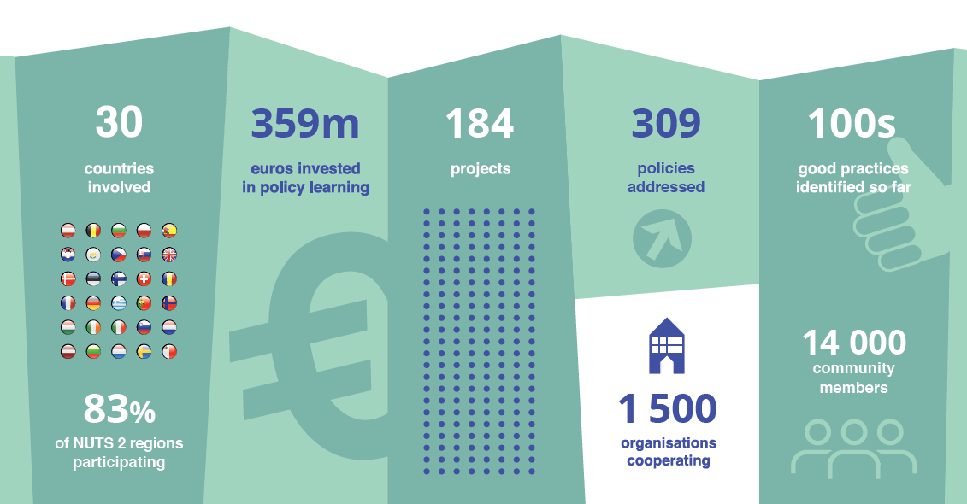
A pan-European programme

Slide 5
A programme
for policymakers
Learn from
each other
to improve
policies
Managing
authorities of
SF programmes
Regional/ national and local authorities
Agencies,
business support organisations

Slide 6
What the programme does?
Projects
1st phase: Policy exchange of experience (2 to 3 years) on a shared regional policy issue ending with one action plan per region
2nd phase: Monitoring of action plan implementation
(1 year) + possible pilot actions
Policy Learning Platform
Improve exploitation of project’s results
Open up the programme’s benefits
Notes:
Objectives of the platform: 1) Spread good practices further; 2) Boost programme results; 3) Increase impact of policy learning.

Slide 7
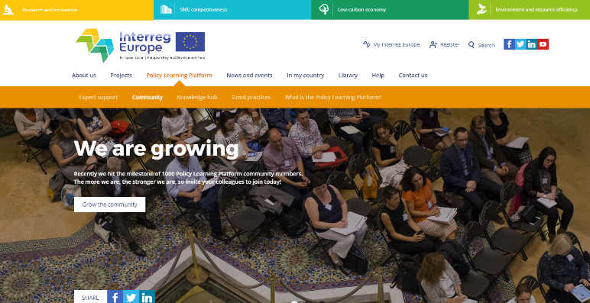
Policy Learning Platform
4 services for interregional learning
Join our community of 14.000 members!

Slide 8
2. How interregional cooperation benefits regional policies/SF?
Particularity: Exclusively dedicated to mainstreaming
Objective: Improving the implementation of SF programmes
Interreg Europe result = mainstreaming

Slide 9
Core benefits
How to improve the implementation of SF programmes?
Level 1: support new projects
Level 2: change programme management
Level 3: change programme content
may not require funding!

Slide 10
Example of mainstreaming
EkoSMART, telemedicine practice developped in Slovenia
Transfered to Cyprus ERDF OP – Priority axis 2 – Investment priority 2c (CIT & e-health) for EUR 400,000 : telemedicine tool for dependent persons follow-up

Slide 11
Example of mainstreaming
Practice developped in Piedmonte region:
Transfered in the ERDF OP of the Basque country, TO1:
introduction of new selection criteria in the calls for projects to favour clusters involvement
Ex: 2018 call for projects on SMEs internationalisation: bonus points when SMEs are accompanied by their cluster

Slide 12
Example of mainstreaming
Telemedicine practice developed in Liverpool
Transfered in the ERDF OP of Malopoloska: ‘Tele-Angel’ project financing (8.9 million euro): telemedicine tool for dependent persons follow-up

Slide 13
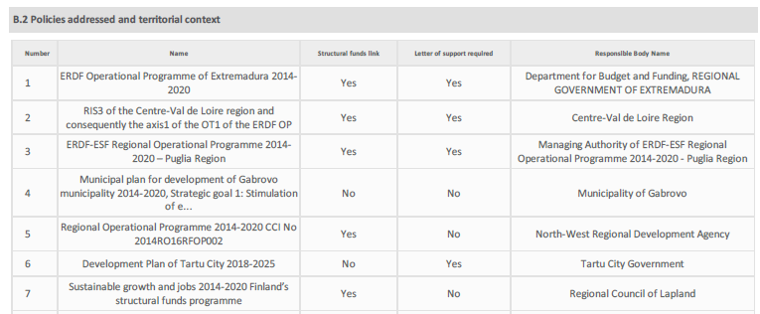
In practice: Prerequisites for mainstreaming
In the application, for each region:
Identify the need (territorial context)
Identify the policy adressed (i.e. OP) and envisaged improvements for this policy
Involve the policy maker
Define the stakeholders group
Notes:
Diving into programme details: how do we ensure the mainstreaming ?

Slide 14
Result-based approach
Progress reports focusing on results
Mandatory action plans
Introduction of a phase 2: mainstreaming follow-up
Notes:
It is also important the result based approach which is implemented through

Slide 15
3. Role of SF MAs in Interreg Europe
Active participation as project partners
Political endorsement as providers of letter(s) of support
Active involvement in phase 2 of projects (roll-out of the action plan)
Strategic communication to relevant stakeholders
Active use of the Policy Learning Platform (main beneficiaries of Peer Reviews: pilot Région Hauts-de-France – energy efficiency in social housing)

Slide 16
State of play - 2018
184 projects (1,268 targeted policies) – 4th call under assessment – last call
80% of targeted policies are structural funds programmes
For 40% of those policies, policy makers are direct partners (33% for structural funds programmes)

Slide 17
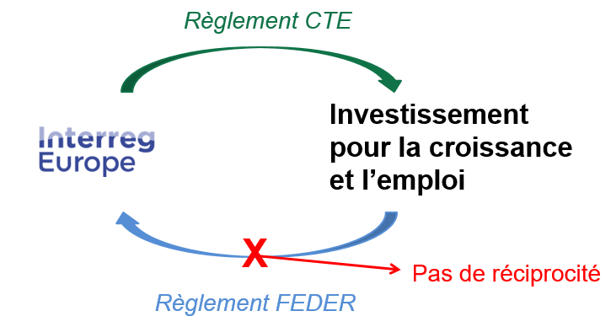
4. Lessons learnt
For all Structural Funds programmes, MA mobilisation is sometimes complicated e.g. political context, funds availability, timing..
ETC regulation
Investment for growth and jobs
No reciprocity
ERDF regulation
Importance of better integrating cooperation in regional strategies

Slide 18
Thank you for your attention
Questions welcome

Slide 19
Interreg Europe secretariat Les Arcuriales, Entrée D, 5e étage 45 rue de Tournai, 59000 Lille, France info@interregeurope.eu www.interregeurope.eu

