Slide 1
EU Budget for the future Regional partnerships 28 November 2018 – INTERACT seminar Brussels
#CohesionPolicy #EUinmyRegion

Slide 2
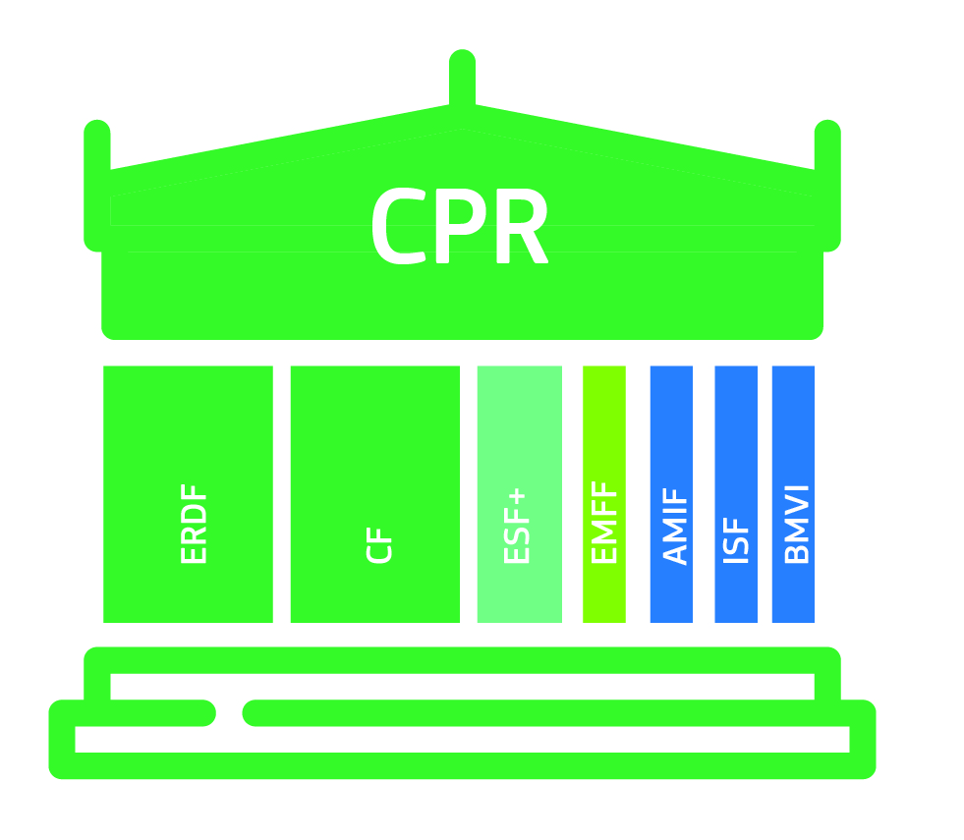
Legal architecture 7 funds, 1 Regulation
CPR covers delivery. 1 set of rules is:
More coherent
Simpler to learn
Simpler to combine

Slide 3
2 (+3) key legal instruments
Common Provisions Regulation (CPR)
Delivery elements are here
OP content
ERDF/CF Regulation
Cohesion policy priorities are here (e.g. specific objectives and thematic concentration requirements)
Specific objectives
ESF+ Regulation
ETC Regulation
New interregional innovation investments??
ECBM Regulation
Only if cross-border projects!

Slide 4
CPR
2014-2020
CPR (Article 96(3))
An OP shall describe the integrated approach to territ. development,(..), specifying, where appropriate, the following:
(b) the arrangements for interregional [and transnational] actions, within the OPs, with beneficiaries located in at least one other Member State
Article 70
Annex I, point 7.1.5:
implementation of relevant R&I measures emanating from their SSS
post-2020
CPR (Article 17)
(3) Each OP shall set out:
(d) for each specific objective:
(v) the interregional [and transnational] actions with beneficiaries located in at least one other Member State
Article 57(4): "implemented outside of a Member State, including outside the Union, provided that the operation contributes to the objectives of the programme"

Slide 5
CLLD
post-2020
Article 25 Community-led local development
(2) The Member State shall ensure that community-led local development is:
(d) supportive of networking, innovative features in the local context and, where appropriate, cooperation with other territorial actors.
Article 28 Support from Funds for community-led local development
(1) The Member State shall ensure that support from the Funds for community-led local development covers:
(b) the implementation of operations, including cooperation activities and their preparation, selected under the local development strategy;

Slide 6
ERDF: Shorter & modern menu of priorities 5 Policy + 2 Interreg-specific objectives
A smarter Europe (innovative & smart economic transformation)
A greener, low-carbon Europe (including energy transition, the circular economy, climate adaptation and risk management)
A more connected Europe (mobility and ICT connectivity)
A more social Europe (the European Pillar of Social Rights)
A Europe closer to citizens (sustainable development of urban, rural and coastal areas and local initiatives)
"enhance cooperation with partners both within and outside a given Member State" (point (b) of Article 2(3) ERDF)
cross-border regions, non-contiguous regions, MRS/SBS regions
Third countries??
Notes:
(13) In order to encourage and boost cooperation measures, within programmes implemented under the Investment for jobs and growth goal, it is necessary to enhance cooperation measures with partners within a given Member State or between different Member States in relation to support provided under all of the specific objectives. Such enhanced cooperation is additional to the cooperation under ETC/Interreg and should in particular support cooperation among structured partnerships with a view to implementing regional strategies as referred to in the Communication from the Commission ‘Strengthening Innovation in Europe's Regions: Strategies for resilient, inclusive and sustainable growth’ 17 . Partners may therefore come from any region in the Union, but may also include cross-border regions and regions which are all covered by a macro-regional or sea-basin strategy or a combination of the two.

Slide 7
Aspects to be covered
A. Who? - Partners to be identified
B. How much? Allocation; co-funding
C. What? – Policy objectives/specific objectives to be defined
D. How? – Project selection criteria and procedures; project implementation; financial control and audit
E. Where? – Expenditure outside own programme area
F. When? - Duration

Slide 8
A) Who? – Partners to be identified
Is there "unilateral cooperation"? Any form of cooperation is about partners coming from regions in at least TWO Member States!
Political will and commitment of all partners is necessary, but not sufficient!
No partner identified in OP → Art. 17 (-)
Partner identified in 1 OP, but not reflected in OP of "partner region" → "Unilateral cooperation with certain interregional scope"

Slide 9
B) How much? – Allocation; co-funding
Absolute amount in EUR or percentage (%) → specifically set aside
on OP level or on level of priority axis → Art. 17 (+)
Amount under Code 133 (interregional cooperation) additional argument → Art. 17 (+)
No amount or % specified → Art. 17 (-) → "Unilateral cooperation with certain interregional scope"
Co-funding rate according the co-funding OP; Article 13 ETC (Interreg) Reg of 70% does NOT apply
ANNEX I
Dimensions and codes for the types of intervention for the ERDF, the ESF+ and the Cohesion Fund - Article 17(5)
TABLE 1: CODES FOR THE INTERVENTION FIELD DIMENSION
133 Enhancing cooperation with partners both within and outside the Member State

Slide 10
C) What? – Priorities/measures/ activities to be defined (1/2)
"Unilateral cooperation with certain interregional scope"
Only own OP fixes content → Art. 17(-)
Articles 4(1) and 6 ERDF apply, NOT Article 4(2)!
-----
Partner regions identified in 2 OP’s + in both OP’ amounts or % are identified →
"Mirror cooperation" (1st degree of interregional cooperation)
Content different, identified in each OP independently (especially in cases of cooperation between different categories)
or content identified in both OP’s with +/-same text
but still separate selection criteria/ procedures

Slide 11
C) What? – Priorities/measures/ activities to be defined (2/2)
"Common cooperation" (2nd degree of interregional cooperation)
Partners identified; amounts or % set aside!
Content identical in all OP’s
Common project selection criteria (but still formally separate selection procedures)
Common rules on project implementation
Inspiration for partnerships:
COM(2017) 376 of 18.7.2017 on Innovation in Europe's regions → SWD (Section 3.2.6: 18 thematic platforms)
Structured Partnerships for EWRC

Slide 12
D) How? – Project selection criteria and procedures; project implementation; financial control and audit (1/3)
"Joint informal cooperation" (3rd degree of interregional cooperation)
Partners identified; amounts or % set aside!
Content identical in all OP’s
Common project selection criteria
Joint informal committee for project selection (to be validated by individual programmes)

Slide 13
D) How? – Project selection criteria and procedures; project implementation; financial control and audit (2/3)
"Joint formal cooperation" (4th degree of interregional cooperation)
Partners identified
Content identical in all OP’s
Amounts pooled together on joint account (possibly as a global grant?)
Common project selection criteria
Joint legal body (EGTC?) to implement joint allocation

Slide 14
D) How? – Project selection criteria and procedures; project implementation; financial control and audit (3/3)
Financial control and audit: Draw inspiration from Articles 45 and 47 of ETC (Interreg) Regulation
Joint body (EGTC!) to do management verifications in all regions
In each region own auditors audit, but all programme audit authorities recognize findings of the others

Slide 15
E) Where? – Expenditure outside own programme area
Article 70 CPR discontinued Article 57(3) new CPR:
"All or part of an operation may be implemented outside of a MSt, including outside the Union,
provided that the operation contributes to the objectives of the programme."
Authorities of co-funding OP bear ultimate responsibility for legality and regularity of expenditure off-shore
Commission will only communicate with authorities of co-funding OP
Robust agreements between authorities of co-funding OP and of the region where ERDF is spent

Slide 16
F) When? – Duration
Final date for eligibility of expenditure: 31/12/2029
OP’s free to work with (joint) calls or with an on-going system for project submission
NEW Article 67: selection of operations by MA
Long-standing cooperation between regions (4 Motors for Europe) → EGTC?!

Slide 17
References; Questions & Answers
References:
INTERACT (pilot activity on cooperation in Objective 1 and 2, September 2011)
INTERACT (Handbook how to set up an EGTC)
Contact:
Dirk Peters REGIO B.4 (1/12/2018: REGIO D.2) Tel. +32/2/296.6199 dirk.peters@ec.europa.eu

Slide 18
Setting up of an EGTC (1/2)
Partners set up an EGTC to implement mainstream interregional cooperation
Defined regions are partners (Quid new partners?)
Assembly defines themes, selection criteria and procedures
Director signs grants with lead beneficiary
Region 1 accepts that expenditure of « its » beneficiaries in Region 2 are controlled by Region 2 and accepts the results (inside EU)

Slide 19
Setting up of an EGTC (1/2)
Global grant CPR post-2020: o/o
Article 123 CPR 2014-2020:
(7) The Member State or the managing authority may entrust the management of part of an operational programme to an intermediate body by way of an agreement in writing between the intermediate body and the Member State or managing authority (a 'global grant'). The intermediate body shall provide guarantees of its solvency and competence in the domain concerned, as well as of its administrative and financial management capacity.
NOT as Global grant
Each OP just refers for the management of interregional cooperation to an intermediate body in the form of an EGTC WITHOUT agreement between MA and EGTC; definition of all aspects listed left over to the EGTC; EGTC is the beneficiary (national/regional co-funding managed by EGTC as well?)
Once an EGTC is set up, it can be used for other types of interregional cooperation OUTSIDE Structural Funds

