Slide 1


THE SPANISH ACTIONS TO IMPLEMENT THE ATLANTIC STRATEY:
THE BLUE ITI FOR THE ESI FUNDS
Brussels, 28th november 2018
General Directorate of EU Funds
Ministry of Finance
Spain

Slide 2
ESI FUNDS IN SPAIN
THE BLUE GROWTH AND THE ATLANTIC STRATEGY
THE «BLUE iti»
GOVERNANCE
IMPLEMENTATION

Slide 3
ESI FUNDS IN SPAIN.
    2014-2020 PERIOD

Slide 4
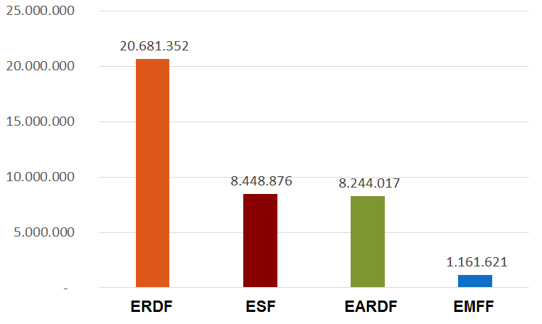
FINANCIAL ALLOCATION BY FUND
TOTAL = 38,5 bN eur
(without yei and etc)

Slide 5

PROGRAMMING STRUCTURE
OF OPS
Objectives of the
Atlantic Strategy
2. Thematic Objectives
3.
Investment Priorities
4.
Specific objectives
1.
Priority Axis
MS
Regulations
MS

Slide 6

THE BLUE GROWTH, THE ATLANTIC STRATEGY and the blue iti

Slide 7

THE BLUE ECONOMY IN SPAIN
In Spain→ the maritime sectors are of great importance in our economy
4.872 km of coasts in the Iberian Peninsula
Two archipelagos: The Balearic and the Canary Islands
80% of the Spanish perimeter is surrounded by the sea.
The blue economy represents > 2,7% of the Spanish GDP.
Generates > 480.000 employments
Indirect effects make these figures higher (around 9% of GDP)

Slide 8

THE INTEGRATED TERRITORIAL INVESTMENTS
Article 36 of CPR, for territorial development
ITI is a tool to implement territorial strategies in an integrated way
It is not an operation, nor a priority of an Operational Programme.
Instead, ITI allows Member States to implement OPs in a cross-cutting way and to draw on funding from several priority axes of one or more OPs.

Slide 9
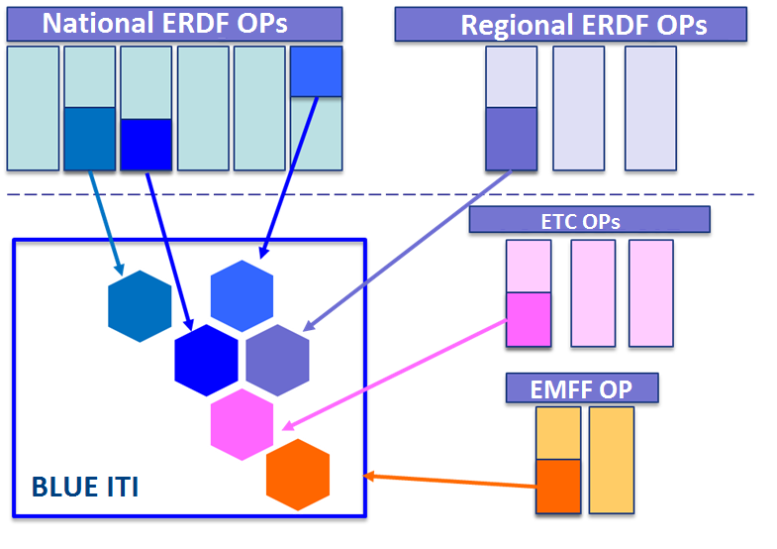

Slide 10
OBJECTIVES
Develop the blue economy in the Atlantic regions of Spain through the ESI Funds (mainly ERDF and EMFF), in line with what it is defined in the Atlantic Strategy and its Action Plan
And additionally:
Foster blue growth in Spain applying a cross-cutting approach, combining Funds and efforts from different Administrations and Programs.
To increase the visibility of the Atlantic Strategy, supported with the ESI Funds.
To allow monitoring of progress and results achieved.
Contribute to leverage private investment towards the blue economy and revitalize the coastal regions of the Atlantic Ocean.

Slide 11
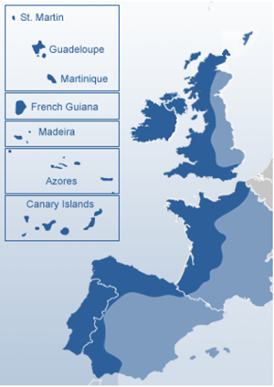
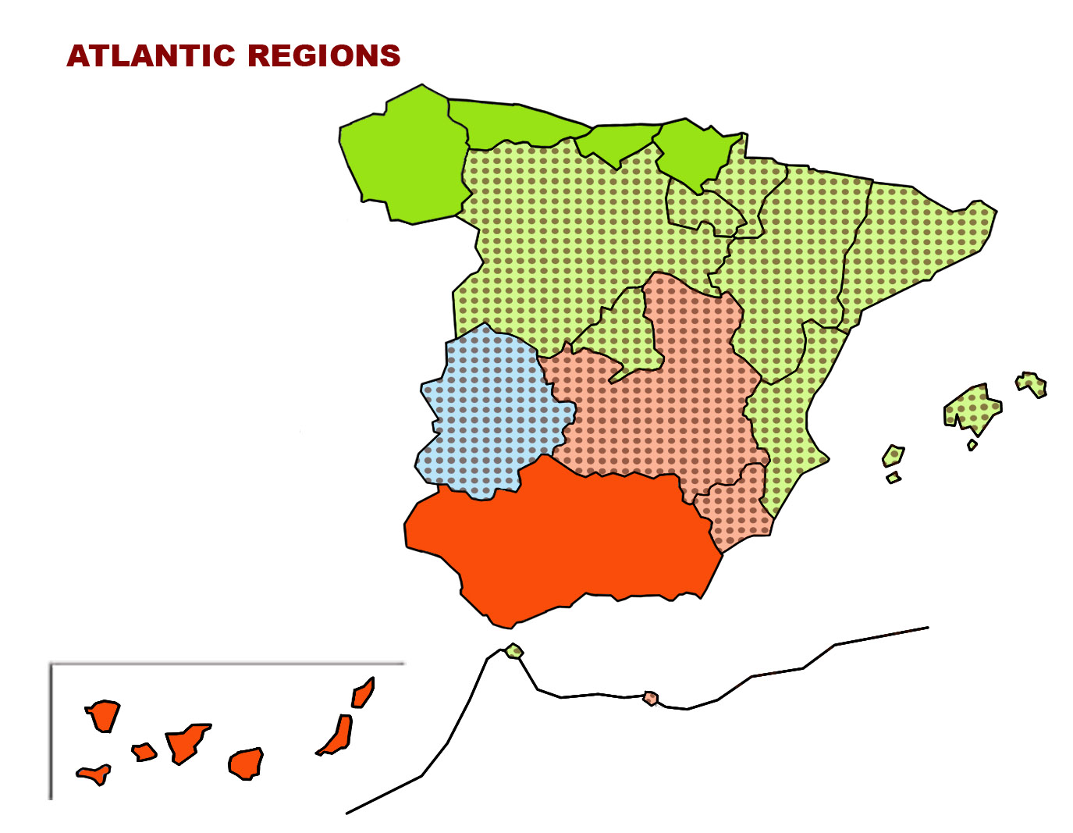
TERRITORIAL SCOPE
11
11
Notes:
11

Slide 12
FUNDS AND OPS
FUND | OPERATIONAL PROGRAM
ERDF | Regional OPs: Galicia, Asturias, Cantabria, País Vasco, Canarias, Andalucía National OPs: Smart Growth, Sustainable Growth
ERDF-ETC | All
EMFF | National OP

Slide 13
PRIORITIES AND OBJECTIVES IN THE ACTION PLAN
Priority 1: Promote entrepreneurship and innovation
OEA0101: sharing knowledge between higher education organisations, companies and research centres
OEA0102: enhancement of competitiveness and innovation capacities in the maritime economy of the Atlantic area
OEA0103: fostering adaptation and diversification of economic activities by promoting the potential of the Atlantic area
Priority 2: Protect, secure and develop the potential of the Atlantic marine and coastal environment
OEA0201: improving maritime safety and security
OEA0202: exploring and protecting marine waters and coastal zones
OEA0203: sustainable management of marine resources
OEA0204: exploitation of the renewable energy potential of the Atlantic area's marine and coastal environment
Priority 3: Improve accessibility and connectivity
OEA0301: promoting cooperation between ports
Priority 4: Create a socially inclusive and sustainable model of regional development
OEA0401: fostering better knowledge of social challenges in the Atlantic area
OEA0402: preserving and promoting the Atlantic’s cultural heritage

Slide 14
CROSS CHECK
ERDF SPECIFIC OBECTIVES – ATLANTIC OBJECTIVES

Slide 15
GOVERNANCE

Slide 16
GOVERNANCE STRUCTURE
Monitoring Group
Secretariat
  Presidency: MA ERDF
  Members:
    MA of ERDF
    MA of EMFF
    MA of ETC programs
    IB of ERDF regional OPs
    Others
    DG Regio
MANAGEMENT
AUTHORITY
OF ERDF FUND

Slide 17
IT SYSTEM
Each Managing Authority has to ensure that the system allows:
Identification of interventions→ the interventions co-financed with the ESIF can be identified in the management system as «Blue ITI operations»
To add new operations → that may be programmed and implemented during the programming period.
To monitor and evaluate outputs and results → gathering information on output, financial and result indicators
Provides the information → needed to draft the ITI Annual Report

Slide 18
SOFTWARE: FONDOS 2020. INTERVENTIONS
Does the intervention contribute to the Blue ITI …?
To which Atlantic Objective?
Check if the intervention takes place → in an Atlantic Region
Check if the Specific Objective has correspondence with Atlantic Objectives
YES
YES
YES

Slide 19
PROGRAMMING & IMPLEMENTATION

Slide 20
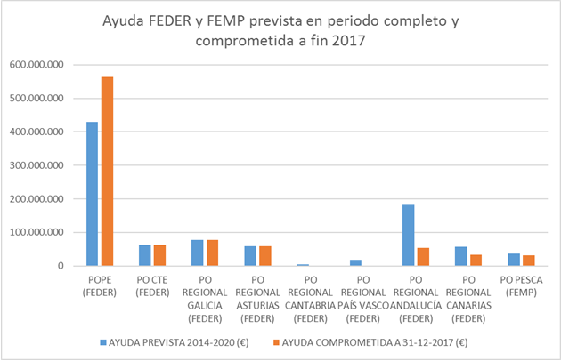
PROGRAMMING & IMPLEMENTATION
Programmed (2014-2020): 934 millions EUR (ERDF/EMFF aid)
Committed* (at 31/12/2017): 885 millions EUR (89% ERDF, 6% ETC, 5% EMFF)
Paid, not certified (at 31/12/2017): 130 millions EUR
ERDF/EMFF programmed (2014-2020) and
committed (31/12/2017)

Slide 21
INTERVENTIONS
R&D&innovation: R&D infrastructures in Atlantic regions. R&D projects in marine or maritime fields.
SMEs: projects to support SMEs in the following sectors:
  marine sport, marinas and nautical leisure activities;
  port services, cruise passengers;
  Tourist, cultural and natural attractions of the Atlantic seaboard;
Low carbon economy:
  Renewables in the Canary Islands.
  R&D in the field of renewable energies.
Risk management and climate change: risk management projects, actions to address climate change
Natural resources and environment: natural, cultural and touristic heritage projects. Urban projects. Water treatment projects.
Sustainable transport: projects on ports

Slide 22
CONCLUSIONS
The Funds and the Programs are sectoral… but problems/challenges aren’t.
An ITI allows MAs to implement actions from an integrated perspective.
Spain has already programmed more than 900 Million EUR of the ESI Funds in projects related to the Blue Growth and the Atlantic Strategy
The Blue ITI will allow us to to deliver on its full potential.

Slide 23

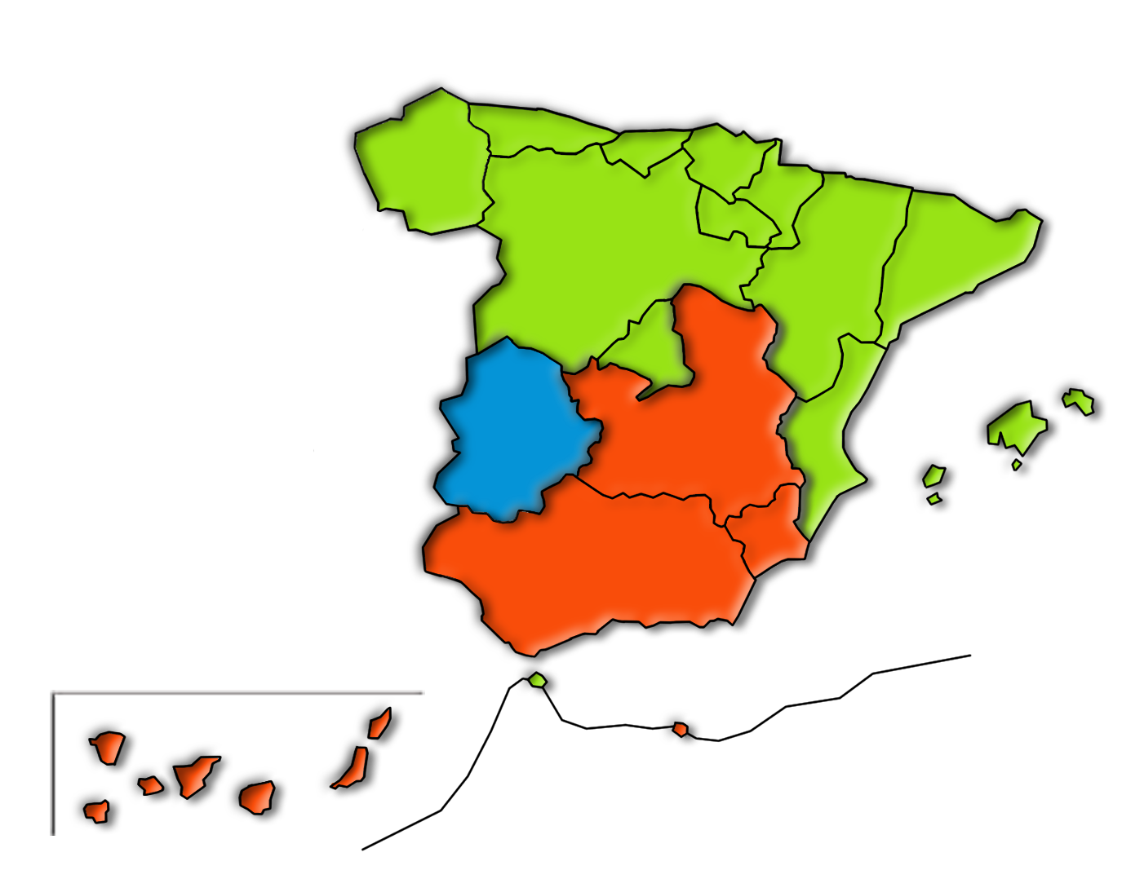
Thank you
programacionterritorial@sepg.hacienda.gob.es
www.dgfc.sepg.hacienda.gob.es
Notes:
23

