Slide 1

STATE OF PLAY, EXPERIENCES, RATIONALE AND EXPECTATIONS FOR THE (SIMPLIFIED) USE OF NEW TOOLS FOR COOPERATION AND DEVELOPMENT
THE CASE OF EGTC GO, WITH CB ITI AND SB PRINCIPLE
Interact
Brussels, November 28th, 2018

Slide 2

Interact
Brussels, November 28th, 2018
BACKGROUND – contex of EU
„185 million EU citizens, or 37% of the population, live in border areas. These are often peripheral, underdeveloped or marginalised areas: sometimes the borders are historical scars. The main aim of cross-border cooperation is to reduce the effect of borders as administrative, legal and physical barriers, tackle common problems and exploit untapped potential.“ (EC, 2011).

Slide 3
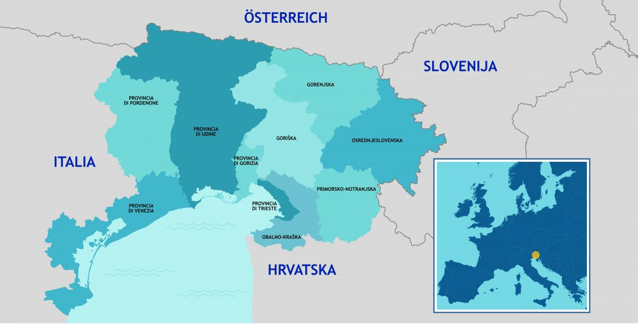

Interact
Brussels, November 28th, 2018
BACKGROUND - geography

Slide 4
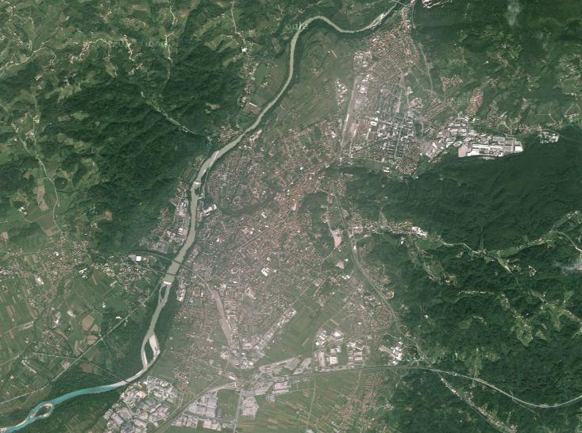

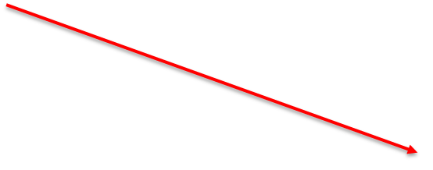


Interact
Brussels, November 28th, 2018
BACKGROUND - geography

Slide 5
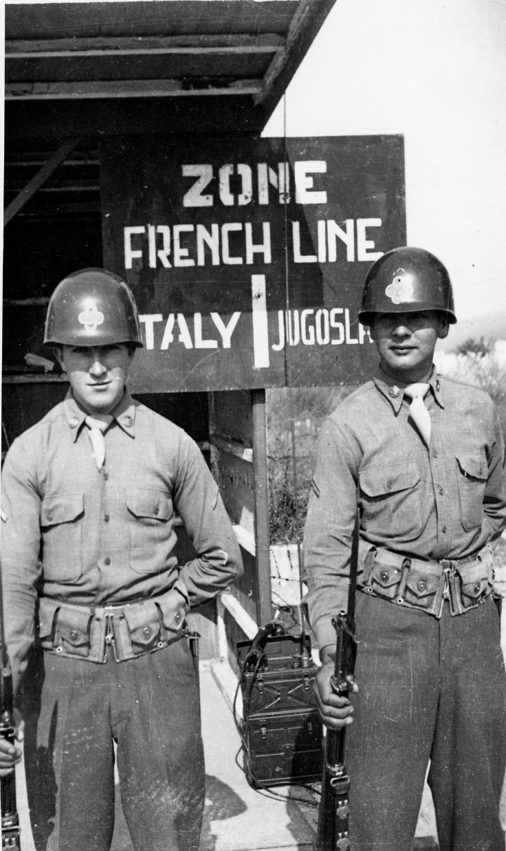
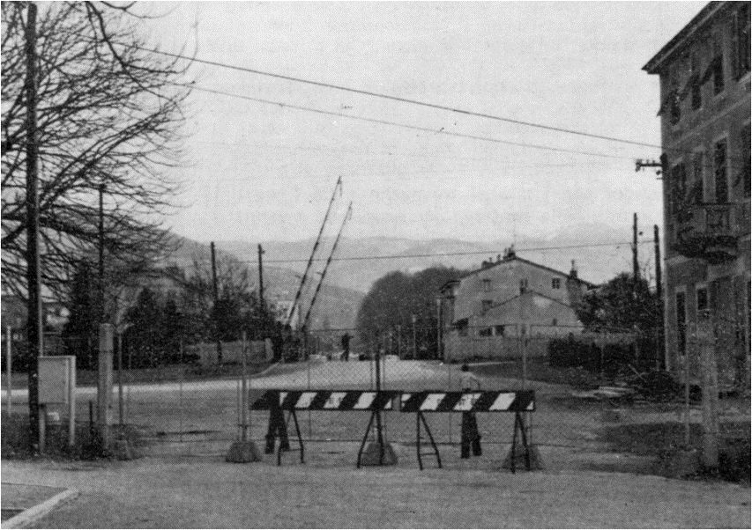
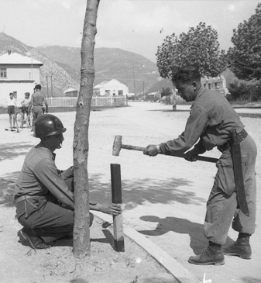
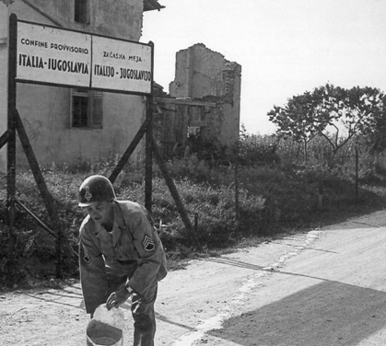
Interact
Brussels, November 28th, 2018
BACKGROUND – cold war times

Slide 6
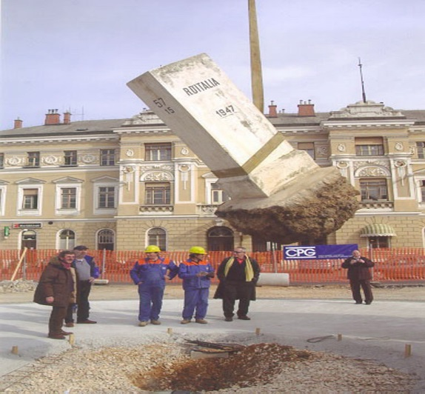
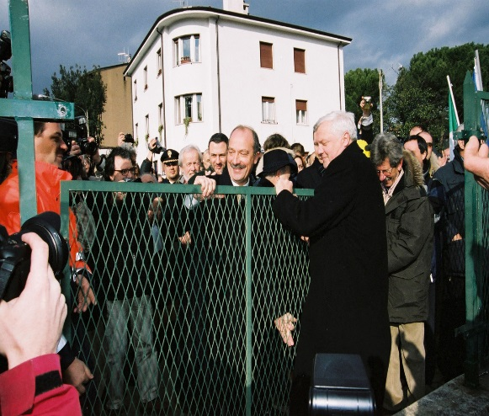
Interact
Brussels, November 28th, 2018
BACKGROUND – near past
An economy based on the border (logistics, armies, custom services, retail trade)
Cultural, social and health services doubled in two „facing“ cities
Integration process
Border-based economy to be reinvented

Slide 7
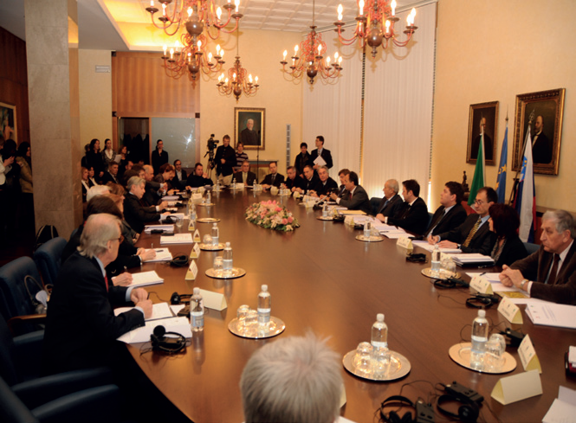
Interact
Brussels, November 28th, 2018
BACKGROUND – CHALLANGES/NEW PATH
New EU Regulatory framework (1082/2006)
Institutionalization of cooperation
EGTC GO

Slide 8
Interact
Brussels, November 28th, 2018
EGTC GO – MISSION/ASSETS
Strengthens consultation and dialogue
Promote policy debate and jointly developed strategy
Facilitate the daily lives of the people of the cross-border
Ownership on an equal basis; guarantee of shared decision making process
People,
Day to day work,
Up to date knowledge
Faith

Slide 9
Interact
Brussels, November 28th, 2018
From EGTC GO to I-SLO ITA and CBC ITI
Capitalization of two programming periods (Interreg ITA SLO)
A new cultural approach to the border
(from point of weakness to point of strength)
A strong communication/
cultural campaign
Participatory approach towards citizenship and institutions
Identification of a common challenge

Slide 10
Interact
Brussels, November 28th, 2018
PROGRAM 2014-2020
NEW REGULATION PACKAGE
Regulation (EU) 1303/2013, art. 36, 123, Reg. 1299/2013, art. 11,12.
CB ITI
INTERMEDIATE BODY
SOLE BENEFICIARY principle

Slide 11
Interact
Brussels, November 28th, 2018
INTEGRATED TERRITORIAL INVESTMENT
CB ITI
1303/2017; art. 36
1299/2017; art. 11
Integrated territorial approach to addressing territorial challenges, going beyond national borders
Address the full complexity of CB area as joint and unique
Laveraging complementaries and sinergies
Stronger focus on the territorial IMPACT of EU policies
Comprehensive approach to programm, design and implement CB project.

Slide 12
Interact
Brussels, November 28th, 2018
INTERMEDIATE BODY
1303/2017; art. 123
1299/2017; art. 11, 12
IB
with MA delegated functions
Easy and fast access to data
More info/time to go in depth analisys
More effective
monitoring
Closer to the territory
Clearer focus (geographically, thematically, procedure)
More effective/justified
selection
„One“ case/approach
Less risk of missunderstanding/ missinterpretation
Quick reply/effective relations
Solid and responsive management
Regular comm./work with MA
Rapp. in MC/regular reports
Perfect relations with AA/sistem approved
Have EC as mentor
Great structure
relations

Slide 13
Interact
Brussels, November 28th, 2018
SOLE BENEFICIARY
SB
1299/2017; art. 12
Closer to all key policymakers
Player in joint policy, plans, actions
Solid, longlasting results
Stronger CB commitment
More efficient
Implementation
Better coordination of activities, costs, results, stakeholders
„Up to date“ monitoring
Openess to innovative tools/instruments
More effective
approach
Fewer administrative steps in reporting
„One“ case/approach
Less risk of missunderstanding/ missinterpretation and loss of funds
Faster
reinbursment

Slide 14
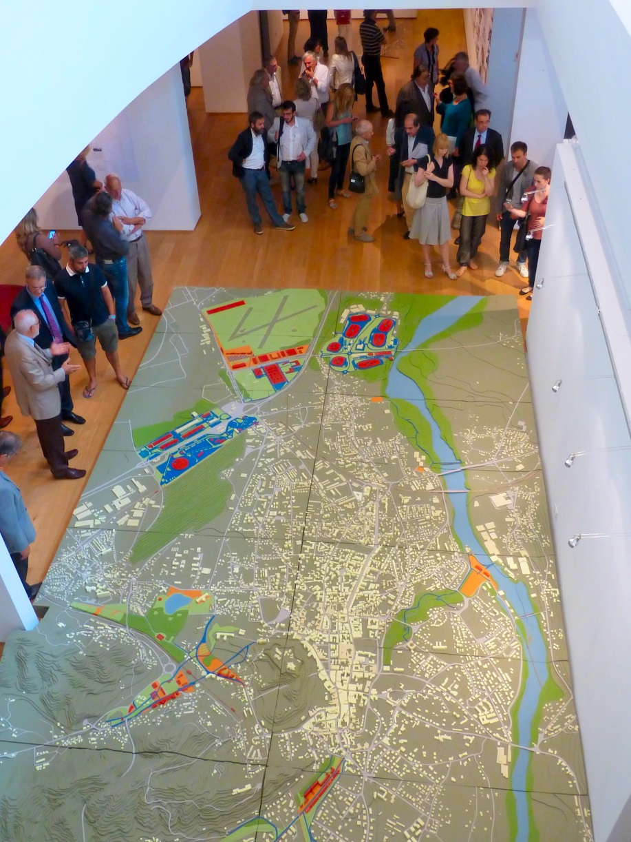
Interact
Brussels, November 28th, 2018
COMBINED THE 3 TOOLS WE GET…
A designated territory and an integrated development strategy
Three Municipalities: Gorizia - Nova Gorica – Šempeter-Vrtojba
EGTC GO Strategic Plan
A package of actions to be implemented
Cross border natural park Isonzo-Soča
Network of crossborder health services
A governance to manage ITI
EGTC GO as
INTERMEDIATE BODY (IB)
Implementation of the ITI
EGTC GO as
SOLE BENEFICIARY (SB)

Slide 15
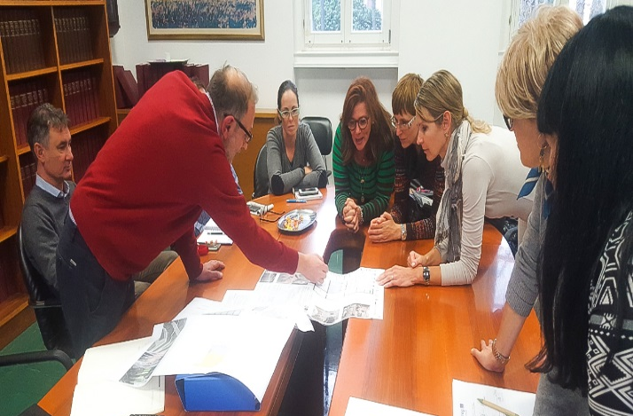
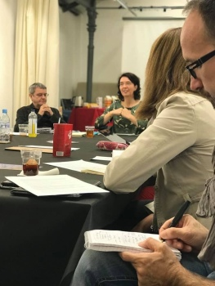
Interact
Brussels, November 28th, 2018
CBC ITI KEY BENEFITS
In 2014, the Programme I-SLO ITA decided to allocate 10 Meuro for the ITI managed by EGTC GO
TRUST!
SUSTAINABILITY of the actions and results
CB ITI coordinated and COMPLEMENTARY TO URBAN AGENDAS of two cities

Slide 16
Interact
Brussels, November 28th, 2018
CBC ITI key benefits

Slide 17
Interact
Brussels, November 28th, 2018
CBC ITI CHALANGES/BENEFITS/UPGRADE
DIRECTIVE 2014/24/EU On public procurement;
Article 38Occasional joint procurement,
Article 39 Procurement involving contracting authorities from different Member States
Joint entity (EGTC) + agreement on the applicable national procurement rules (Public call made by GECT GO (ITA) in Slovenija, by SLO law, for investment in Slovenija
Joint procurement; CBC funds (EGTC) as additional - laverage effect
Joint planning, joint implementation, joint management
Follow procedures, habits on national level (institutions involved)
Cooperation between structures of programme (!FLC) is essential

Slide 18

Interact
Brussels, November 28th, 2018
CBC ITI BENEFITS
Followers will never know how hard is and how hard the leader tries to create the path.
Closer to beneficiaries, users.
Shorter reinbursment times.
Solid and longlasting results.
Stronger commitment!
Take CBC as a laboratory of EU programmes!

Slide 19

Thank you for your attention!
Standard projects
State of the art
Tomaž Konrad
Office of Intermediate Body
EGTC GO
Interact
Brussels, November 28th, 2018
UDINE/VIDEM, 9.06.2016

