Slide 1

Cooperation under fisheries CLLD
Brussels, 28 November 2018

Slide 2
What is Community-Led Local Development (CLLD)?

Slide 3

Seven key principles of CLLD:
Bottom-up, strategy in the hands of the local community
Area-based (not project-based)
Integrated and multisectoral
Partnership-based (public-private-NGO)
Innovation
Decentralisation of decision-making
Cooperation, networking and learning from each other

Slide 4

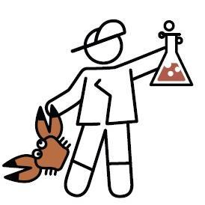



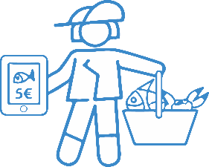




Basic components of CLLD
Strategy
(F)LAG
Area
Partnership
LAG = Local Action Group
in the EMFF: FLAG (Fisheries Local Action Group)

Slide 5
Traditional funding approaches vs. Community-Led Local Development (CLLD)
Government
(national / regional)
Government
(national / regional)
Managing
Authorities
Paying
Agencies
Managing
Authorities
Paying Agencies
Partnership
(F)LAG
Local
Development
Strategy
Area
Project
Project
Project
Project
Project
Project
Project
Project

Slide 6
Local Action Groups funded by ESI Funds:

Slide 7
CLLD funding can be used for:
Preparing the Local Development Strategy (LDS)
Implementing the LDS (projects prepared by beneficiaries and selected & funded by the (F)LAG)
Community animation and running costs
Cooperation projects
- Implemented by:
LAGs or FLAGs
involving other relevant organisations in the (F)LAG area
- Partners can be:
  other LAGs or FLAGs from the same or different MS
  local public-private partnerships implementing CLLD strategies within or outside the EU
Art. 35 of the Common Provisions Regulation 1303/2013

Slide 8
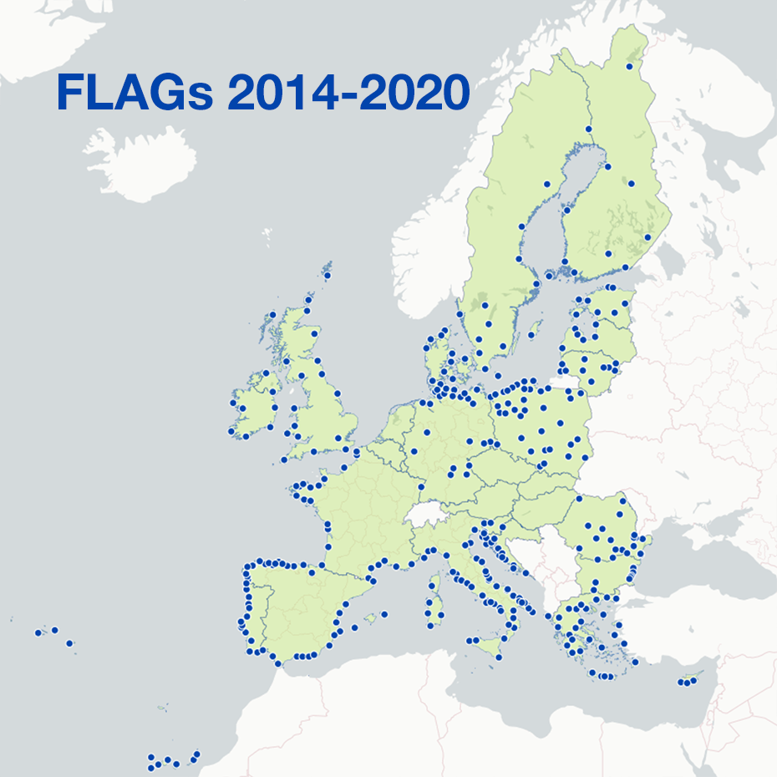
CLLD in the EMFF:
368 FLAGs
20 MS
ca. €690 total public

Slide 9
What is FARNET and what does it do?

Slide 10
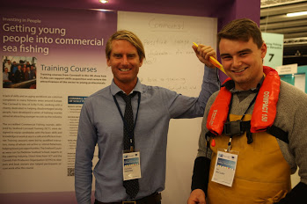
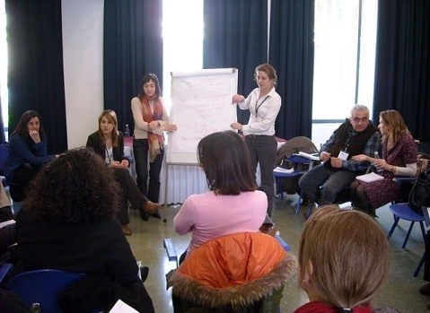
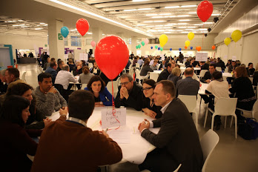
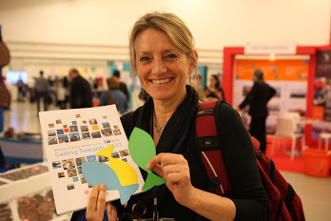
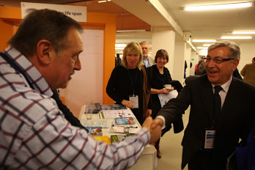
FARNET: The European Fisheries Areas Network
  FLAGs
  NNs
  IBs / MAs
  European Commission
  Other stakeholders
The FARNET Support Unit
  A permanent team of 12
  A Geographic Expert per MS
    Capacity building
    Information dissemination
    Exchange of experience and best practice
    Support to FLAG cooperation
Notes:
The Fisheries Areas NETwork (FARNET) is:
A community - Fisheries Local Action groups (FLAGs); National Networks; Managing authorities and intermediate bodies (National and Regional governments, paying agencies); - FARNET Support Unit; European Commission
The FARNET Support Unit (FSU) is: A team of 8 permanent staff based in Brussels; 21 geographic experts; 1 interdisciplinary advisory group, thinking ahead. Activities: meetings, seminars, conferences, guidance material, website, publications (mag, newsletter…), staff!

Slide 11
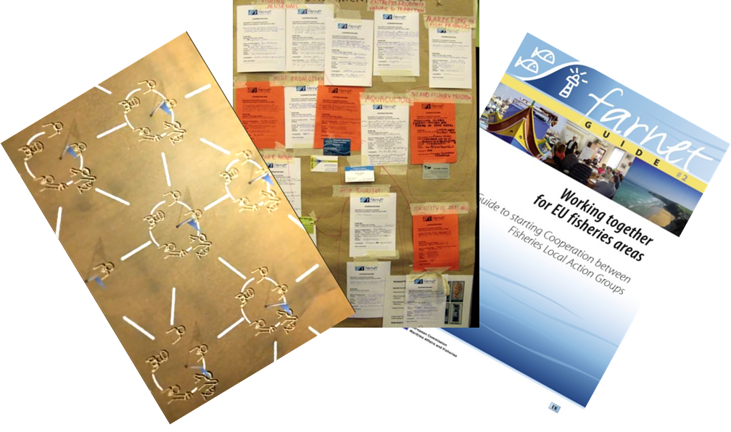
FLAGs and FARNET as tools for cooperation
Dedicated funding for “cooperation projects” for FLAGs
Opportunities to meet and network at FARNET events
National Networks in most MS
Capacity building
Tools in place by the FARNET Support Unit

Slide 12
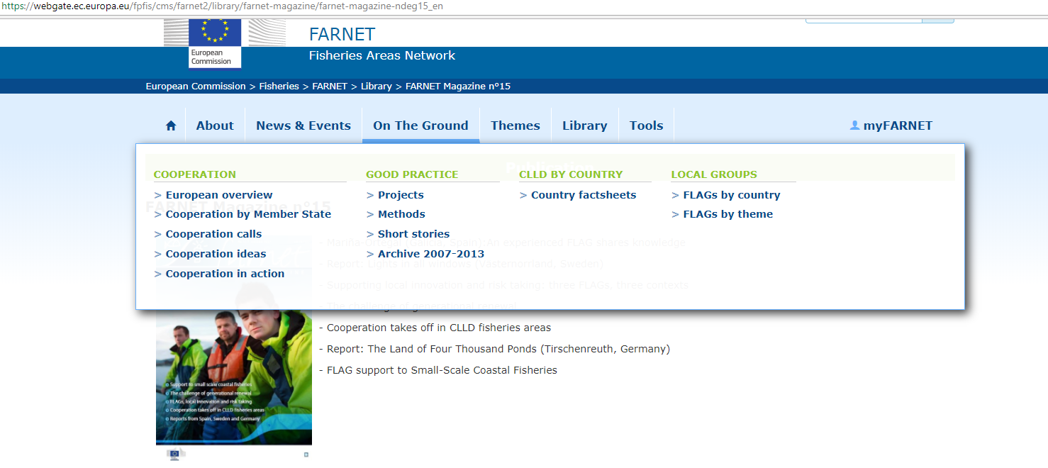
FLAGs and FARNET as tools for cooperation
Tools in place by the FARNET Support Unit

Slide 13
A few examples:

Slide 14
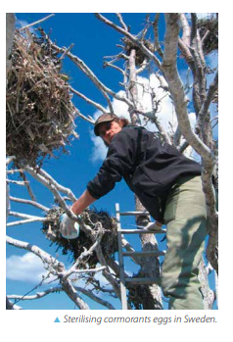
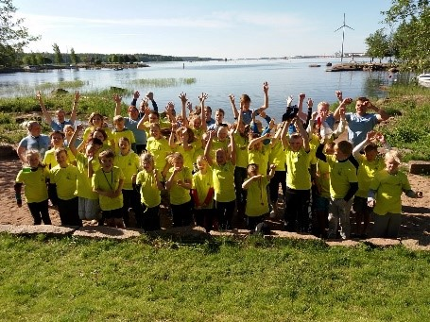
Seals and cormorants:
Baltic transnational
cooperation (16 FLAGs)
Mobilising the Baltic young through LAG-FLAG cooperation

Slide 15
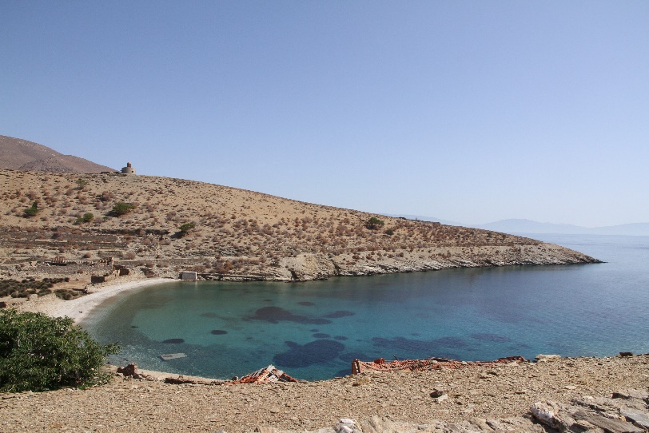
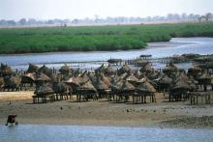
Developing a knowledge hub on Marine Protected Areas in the Mediterranean Sea
Oyster farming cooperation between the Marennes Oléron FLAG (FR) and the Siné-Saloum Delta in Senegal

Slide 16
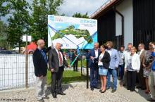
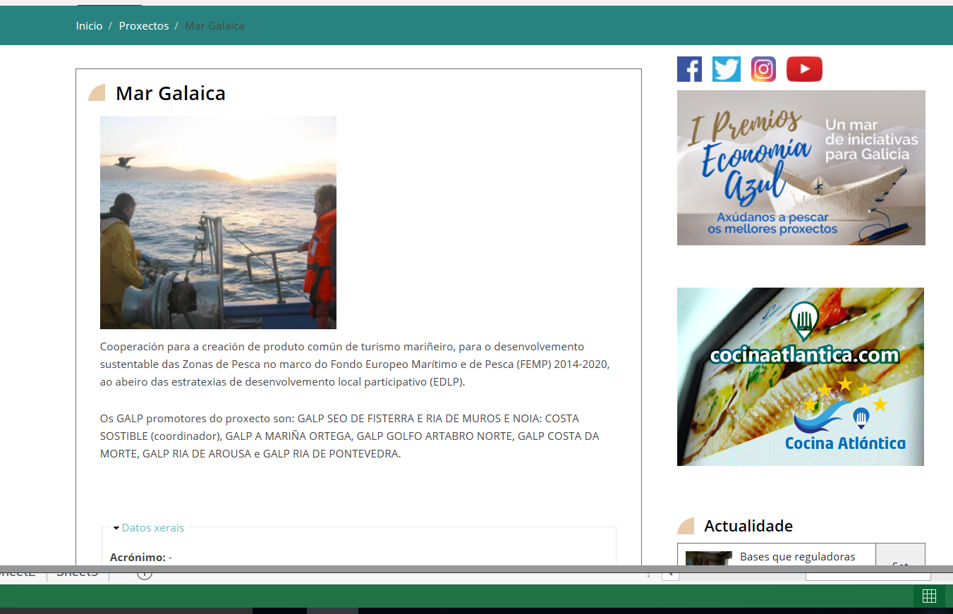
Northern Fisheries Trail: cooperation between 9 Polish FLAGs to promote fisheries and aquaculture heritage
Mar Galaica – cooperation between 7 FLAGs from the Spanish region of Galicia for a coordinated on-line promotion of fisheries tourism attractions

Slide 17
Some lessons…
Ensuring compatible rules between MS (including timing of calls, eligibility of cooperation projects etc.) and administrative complexity
Systematic capacity building and tailor-made support to FLAGs participating in cooperation projects
Identifying and tracing cooperation projects on an on-going basis
Language (especially when involving local actors, not just FLAG managers)

Slide 18
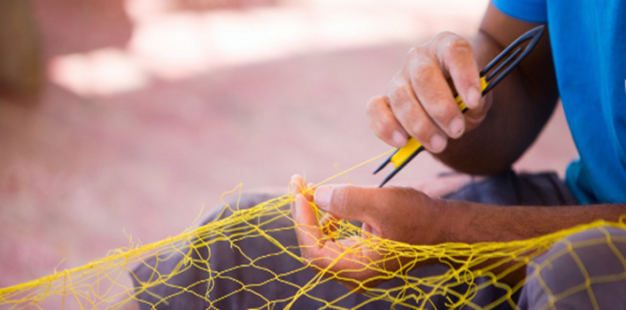
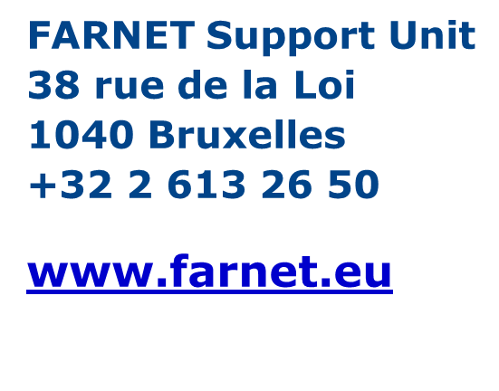
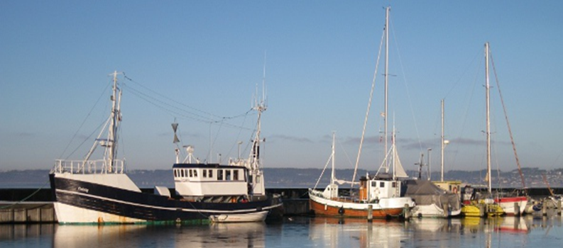
Thank you!
urszula@farnet.eu
The content and views expressed in this presentation are those of the FARNET Support Unit and not those of the European Commission.

