Slide 1
EU Budget for the future Tools for cooperation 28 November 2018 – INTERACT seminar Brussels
#CohesionPolicy #EUinmyRegion

Slide 2
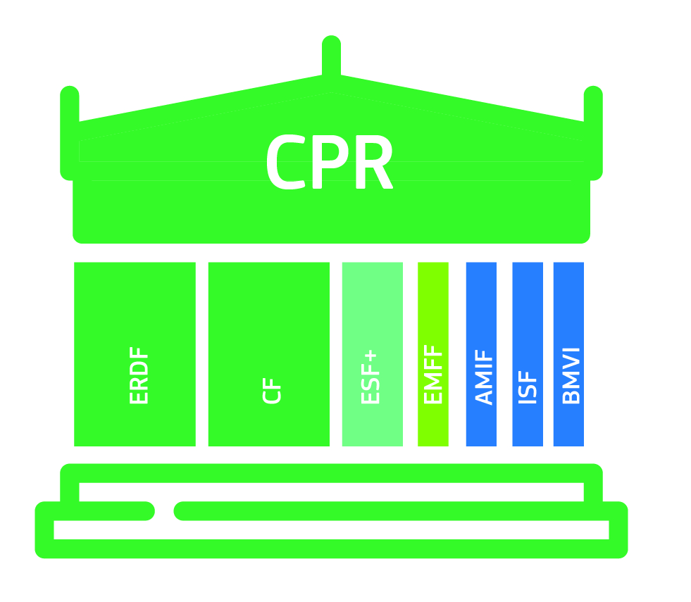
Legal architecture 7 funds, 1 Regulation
CPR covers delivery. 1 set of rules is:
More coherent
Simpler to learn
Simpler to combine

Slide 3
4 (+1) key legal instruments
Common Provisions Regulation (CPR)
Delivery elements are here
Territorial development (22-28)
ITI
CLLD
MSt territorial tools
ERDF/CF Regulation
Cohesion policy priorities are here (e.g. specific objectives and thematic concentration requirements)
Scope
ESF+ Regulation
ETC Regulation
Territorial development (20-21)
ITI
CLLD
SPF (24)
New interregional innovation investments
ECBM Regulation

Slide 4
Shorter & modern menu of priorities 5 Policy + 2 Interreg-specific objectives
A smarter Europe (innovative & smart economic transformation)
A greener, low-carbon Europe (including energy transition, the circular economy, climate adaptation and risk management)
A more connected Europe (mobility and ICT connectivity)
A more social Europe (the European Pillar of Social Rights)
A Europe closer to citizens (sustainable development of urban, rural and coastal areas and local initiatives)
---
1. A better Interreg governance
2. A safer and more secure Europe

Slide 5
Main changes to ETC (Interreg) 5 Components of Interreg
Cross-border cooperation (component 1)
Transnational cooperation and maritime cooperation (component 2)
Outermost regions cooperation (component 3)
Interregional cooperation (component 4)
INTERACT (plus) Interreg EUROPE discontinued, but…
ESPON URBACT discontinued, but…
Interregional innovation investments (component 5) in/direct management

Slide 6
ITI
2014-2020
CPR (36)
Territ . development strategy
Funds, PA, OP
Intermediate body
"certain tasks"
monitoring
ETC (11)
IB = EGTC or joint legal body
post-2020
CPR (24 → 23)
Territ. strategy
Funds, OP, priority
IB, if > selection of operations
authorities select operations
monitoring
ETC (20)
ImplB = EGTC or "c-b legal body"
ImplB = Sole beneficiary

Slide 7
CLLD
2014-2020
CPR (32-35) Omnibus
Sub-regional
Local action groups
CLLD integrated strategy
LAG select operations
LAG = IB (conditions)
ETC (10)
LDG = two countries
post-2020
CPR (25-28)
Sub-regional
Local action groups
CLLD integrated strategy
LAG select operations
LAG = IB (conditions)
ETC (21)
LAG = two countries

Slide 8
JAP
2014-2020
CPR (104-109) Omnibus
JAP = operation
No infrastructure
Min € 5 mill or 5%
No limit for 1st JAP under ETC progr.
COM Decision, steering committee
Financial M&C
ETC (9)
Members of steering committee
post-2020
--

Slide 9
Small project funds
2014-2020
--
De facto
De lege?
post-2020 (Article 24 ETC)
Only for ETC (Interreg)!
Only for Interreg governance?
SPF = "operation"
EUR 20 million or 15% per SPF under an Interreg programme
"Final recipients" implement "small projects" (§1)
Cross-border legal body or EGTC = beneficiary (§2)
Content of grant letter (§3)
Selection of small projects ≠ delegation of tasks to an IB (§4)
20% max. for staff and management costs (§5)
Small project < EUR 100.000 → SCO obligatory (§6)

Slide 10
European grouping of territorial cooperation
CPR: (point 27 of Article 2 – always public expenditure)
ERDF: °/°
ETC (Interreg)
(Recital 8 + Article 3, point 4(a)(iii): Interact)
Recital 27: different roles of EGTC
Article 20: ITI
Article 23(6): Sole beneficiary
Article 24(2): SPF beneficiary
(Article 28(1): Composition MC)
(Article 44(4): MA)
(Article 50(2): Recoveries)
ECBM: EGTC = initiator

Slide 11
European Cross-border mechanism
Voluntary instrument, but effective system on each border obligatory!
EGTC/ cross-border legal body
facing differing legal rules,
when implementing ITI → initiative under ECBM!

