Slide 1
1. EUB in SSR
2. EUB internal structure
3. SSR strategic topics
4. SSR strategic topics and EUB projects and Teacher Competences
5. Preparing a project application
6. Cycle of Productivity

Slide 2

1. EUB in SSR
https://www.stadtschulrat.at
Mayor and Governor of Vienna
Executive President
Director
Comp. Schooling Dept.
Academic Schooling Dept.
Vocational
Schooling Dept.
School Psychology - Counselling Dept.
Presidential Dept.
Legal
Dept.
Staff
Dept.
Finance - ICT
Dept.
Modern Language Initiatives in Viennese Schools
EUB
EUB Projects for Viennese Schools
http://eb.ssr-wien.at

Slide 3
2. EUB internal structure
Head and Dep. Head of EUB
ICT – Secretariat - PR
Content Lead
Finance and Admin. Lead
Modern Language Initiatives Team
(IV. Floor)
Erasmus+ Projects Team
(II. Floor)
ERDF Trans. Projects Team
(III. Floor)
ERDF Cross-Border Projects Team
(III. Floor)
Other EU Projects Team
(III. Floor)
Team Lead
Team Lead
Team Lead
Team Lead
Team Lead
Team Assist
Team Assist
Team Assist
Team Assist
Team Assist
Team Assist
Finance Manager
Finance Manager
Finance Manager
Finance Manager
Viennese Schools and Teachers

Slide 4
3. SSR strategic topics
Executive President
Eight Key Competences for Life Long Learning
1. Children's Rights
3. Basic competences
“Presenting Viennese Schools before the Curtain”
2. Multilingualism
4. Entrepreneurship
5. New technologies
Strengthening Teacher Competences

Slide 5
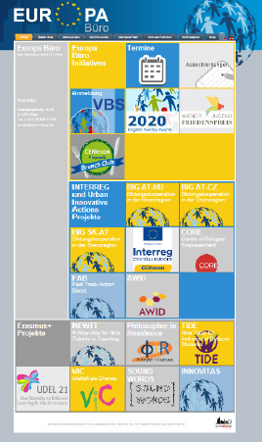
4. SSR strategic topics and EUB projects and Teacher Competences
Approved Projects (20):
CBC AT-HU & AT-CZ & SK-AT (3) – BIG; CBC SK-AT – CODES, RoBoCoop
Interreg CENTRAL EUROPE – CERIecon; Interreg Danube Transnational Programme – InnoSchool;
Urban Innovative Actions – CoRE; EaSI Programme – FAB
KIRAS – AWID;
Erasmus+ - NEWTT; Philosopher in Residence; TIDE; Vielfalt als Chance; UDEL21; VIC; SOUND WORDS, INNOVITAS
Culturally responsive teaching; Donauwelle PLUS;
Interkulturalität & Mehrsprachigkeit
Submitted Projects (3):
CBC AT-HU & AT-CZ & SK-AT (3) – Interreg CENTRAL EUROPE – in situ;
Erasmus+KA2 – ARCHES; Erasmus+KA1 – Orientierung – Vernetzung - Dialog
http://eb.ssr-wien.gv.at

Slide 6
4. SSR strategic topics and EUB projects and Teacher Competences
Strengthening Teacher Competences
Teacher Competence HUB in SSR
Eight Key Competences for Life Long Learning
1
2
3
4
1
2
3
4
5
6
7
8
5
6
7
8
Digital Hub
www.bildungshub.wien
Physical Hub
in SSR
http://eb.ssr-wien.gv.at

Slide 7
6. Cycle of Productivity
Eight Key Competences for Life Long Learning & SSR Strategic Topics
1. Children's Rights
3. Basic competences
EU Projects
2. Multilingualism
4. Entrepreneurship
5. New technologies
Strengthening Teacher Competences

Slide 8
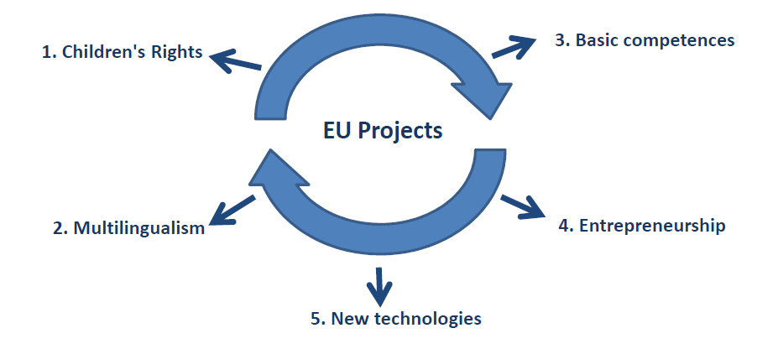
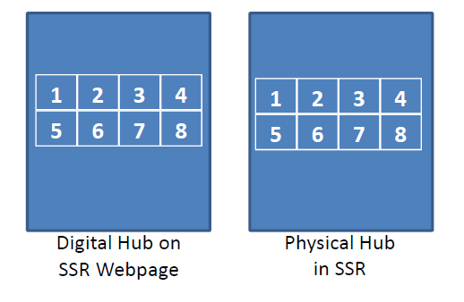
6. Cycle of Productivity
Eight Key Competences for Life Long Learning & SSR Strategic Topics
Direction
Results & Products
Digital Hub
www.bildungshub.wien
Physical Hub
im SSR
Strengthening Teacher Competences

Slide 9
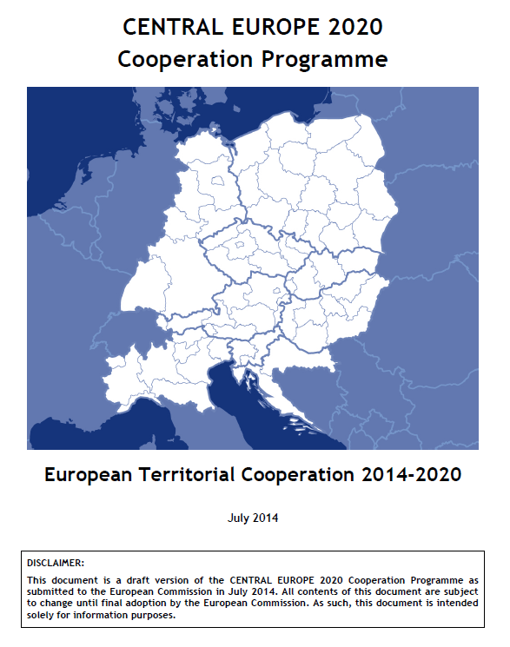
5. Preparing a project application
Funding Period 2014 – 2020
European Commission
2020 Agenda
Smart Growth
Economy based on knowledge & innovation
Green Growth
Resource efficient, greener & more competitive economy
Inclusive Growth
High-employment economy with social & territorial cohesion
Cooperation Programme (CP)
Cooperation Programme (CP)
Programme A
Programme B
Programme INTERREG Central Europe 2020
SSR strategic topics
Project Aa
Project Ab
Project Ba
Project Ba
Project CERIecon
Application Form (AF - eMS)

