Slide 1


Capitalising Interreg
Capitalisation Advisory Greece
26 June 2018 I Thessaloniki, Greece
Interact
Notes:
1

Slide 2
What is capitalisation in Interreg programmes?
Capitalisation, do we all have the same understanding?

Slide 3
Potential definition…
Capitalisation (of results) looks into specific results in thematic fields in order to obtain additional improved results, to boost performance, delivery and to multiply the effects of achievements delivered.
Capitalisation is about gathering, organising and building upon existing programme and projects results, within specific fields.
Capitalisation could concern data about the implementation of programmes, projects, impacts and methods used in order to make this knowledge generated by Interreg (capital) more accessible and usable for other programmes, projects or stakeholder groups.
=
Knowledge Management

Slide 4
Interact Capitalisation Plan
Objectives
To define the main actions and work
Identification, analysis and promotion of capitalisation approaches;
Set-up and implementation of thematic networks;
Promotion of Interreg results.
Clear identification of themes
Specific survey to Programmes, according to thematic choises

Slide 5
Support to Capitalisation
Capitalisation as management practice: Workshops, trainings, publications and tools | Increasing Thematic expertise: Meetings, on-line platforms, pubications
Events on Capitalisation practices and approaches (2014-2020) | Interreg response to migration network
ComCap workshops - hints to promote Interreg results and trainings on communication of results (story telling, social media) | Sustainable transport
Interreg Talks (promotion of results) | Knowledge of the seas network
Publication and repository of capitalisation practices | Climate change network
Publication on promotion of results | Inclusive growth network
Capitalisation Toolkit | Institutional capacity

Slide 6
The publications:
Capitalisation approaches and practices in Interreg. From concept to practice
Communication of capitalisation in Interreg

Slide 7

Capitalisation approaches and practices in Interreg. From concept to practice

Slide 8

Capitalisation approaches and practices
About the content
PRAGMATIC

Slide 9

Capitalisation approaches and practices – selling “pitch”
Get a comprehensive answer to the question:
“What is ´Capitalisation´ anyway and why should I care?”
Short answer:
To make your job easier, relevant, and sustainable.

Slide 10
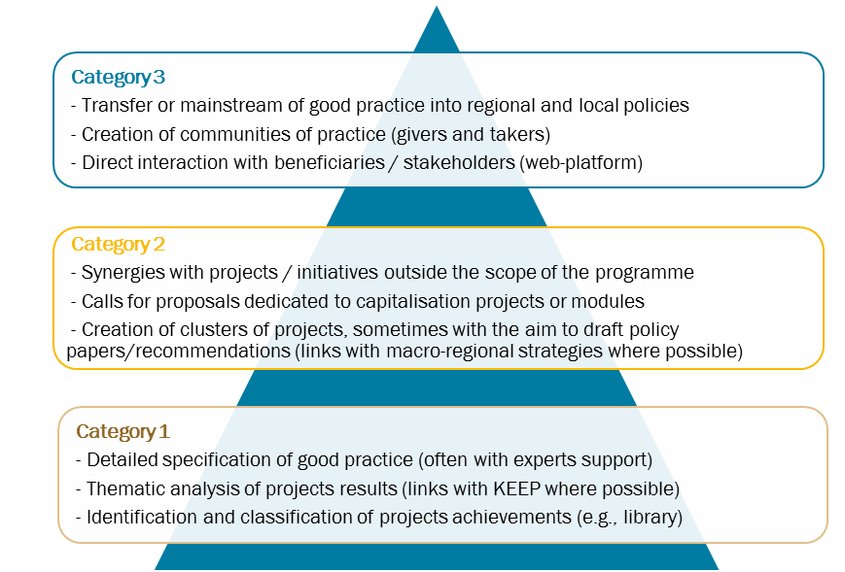
Capitalisation approaches and practices – key features
Immersive, long-term analysis
Well processed information
A LOT of practical examples
Explains:
  “What” – state of play
  “How” – to apply
  “Why” – it matters
  Links to Communication and Evaluation
  Recognizes and addresses challenges and specificities of Interreg world

Slide 11
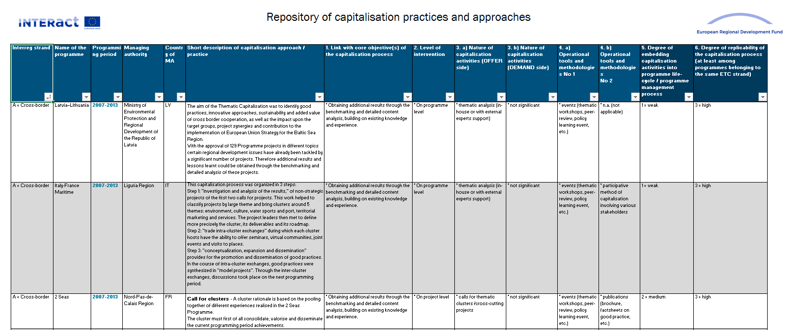
Capitalisation approaches and practices – bonus
Repository of practices and approaches
20 programmes so far – be a part of it
Excel format: filter, sort and edit

Slide 12
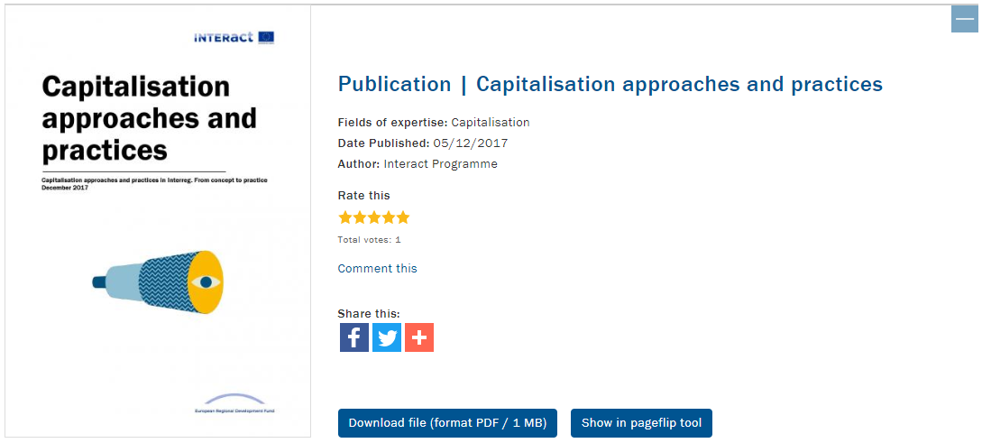
Capitalisation approaches and practices – get it here:
Capitalisation Approaches: https://goo.gl/74uEDA
Repository: https://goo.gl/sFnKgi

Slide 13
Price:
Around 90 minutes of your time

Slide 14



Communication of capitalisation in Interreg

Slide 15

Communication of Capitalisation
About the content
STRAIGHTFORWARD

Slide 16

Communication of Capitalisation – selling “pitch”
Get practical solutions for communicating capitalisation

Slide 17
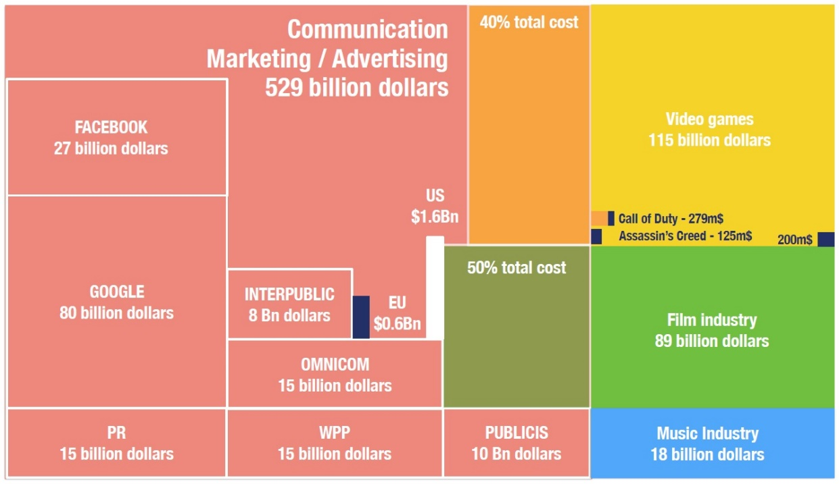
Communication of Capitalisation – key features
Rooted in practical issues
Identifies real challenges:
  Complex terminology
  Lack of resources
  Lack of experience
  The competition
Offers a set of solutions
Plain language – easy to understand, for both experience and new experts.

Slide 18
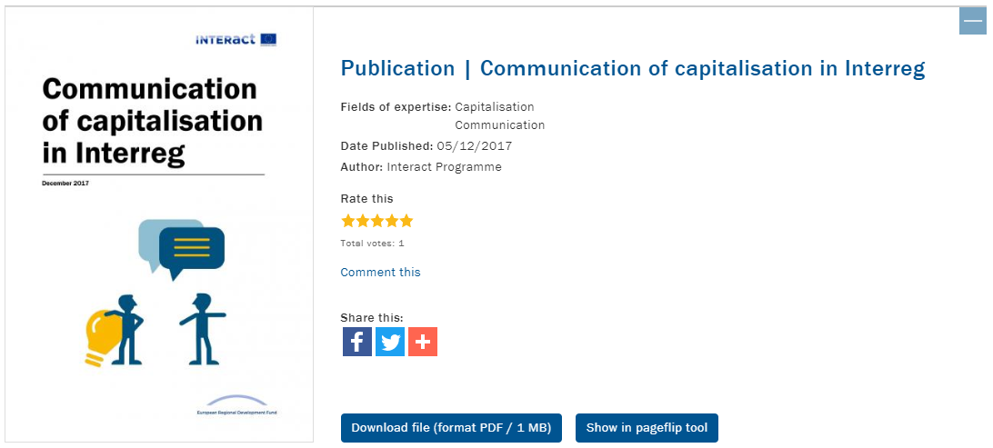
Communication of Capitalisation – get it here:
Communication of Capitalisation: https://goo.gl/2cYNRT

Slide 19
“Price”:
Around 30 minutes of your time

Slide 20
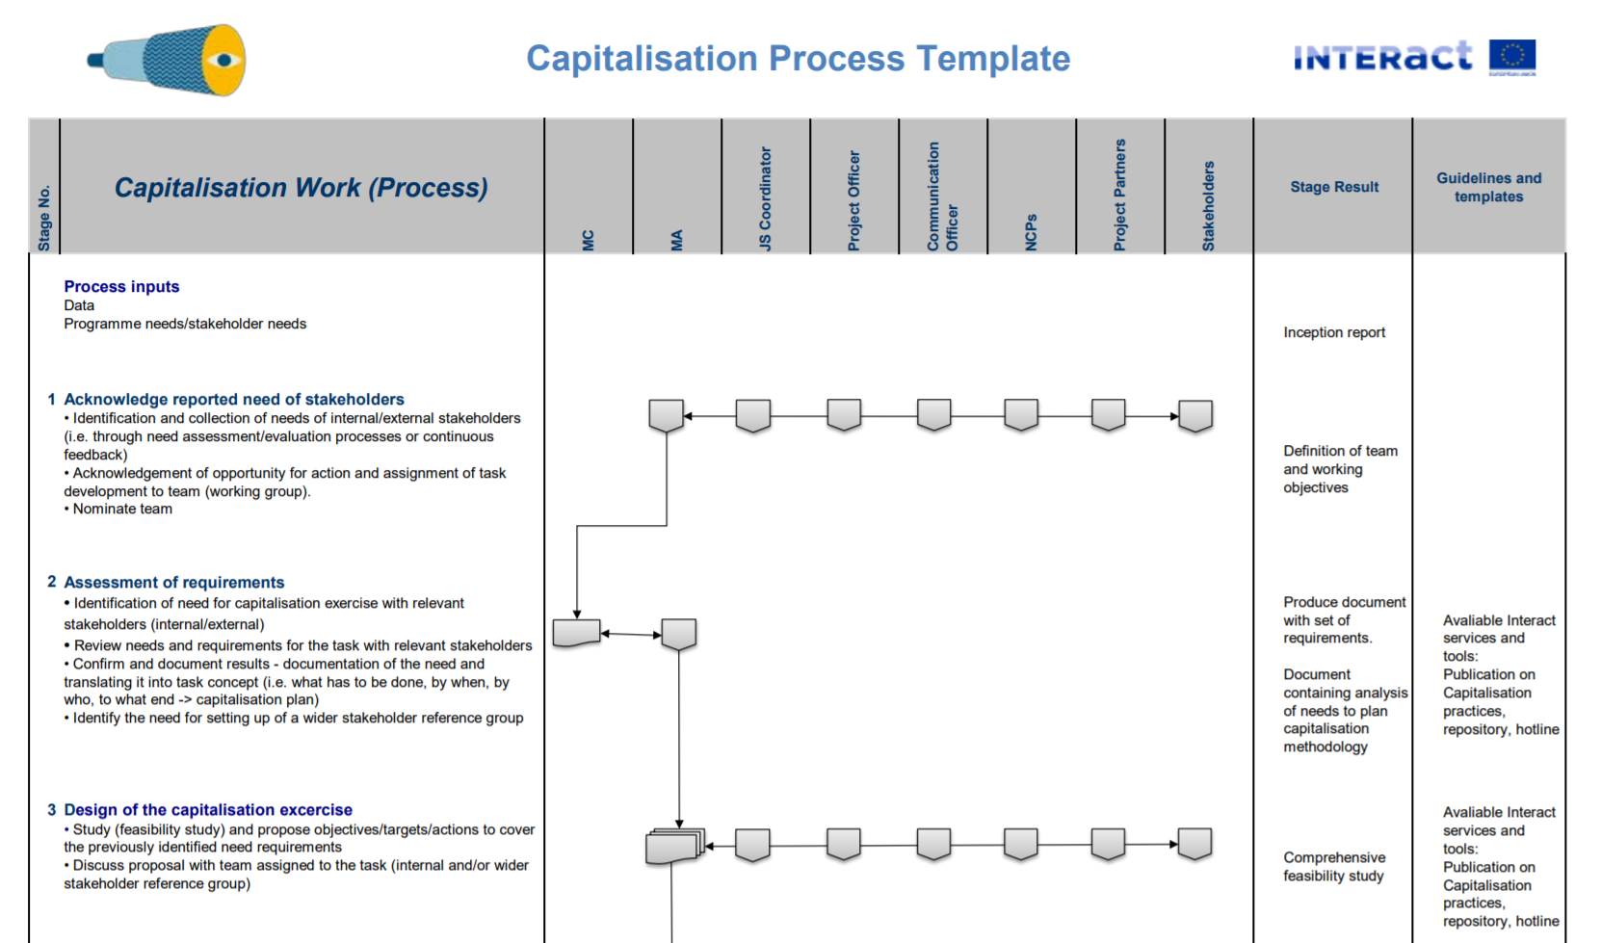
Capitalisation Toolkit

Slide 21
Cooperation works
  All materials will be available on:
  www.interact-eu.net

