Slide 1




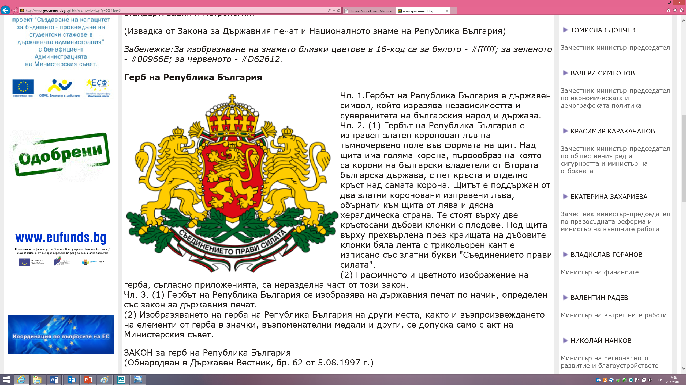












21-22 February 2018, Thessaloniki
Thank you for your attention
Case 1
AS MANAGING AUTHORITY
AS NATIONAL AUTHORITY
Management and verifications in INTERREG
Case 3
AS NATIONAL AUTHORITY
Case 2
WHO WE ARE
FLC ASSIGNMENT
Two different companies are selected by the NA responsible for the verification for each of the two ERDF programmes. The assignment of the definite controller to carry out a definite task is in the responsibilities of respective company.
FLC ASSIGNMENT
The controllers are selected by the MA forming a FLC unit responsible for the verification for all three IPA programmes. The assignment of the definite controller to carry out a definite task is in the responsibilities of the Head of the FLC unit.
FLC ASSIGNMENT
A pool of controllers is selected by the NA responsible for the verification of all multinational programmes. The assignment of the definite controller to carry out a definite task is in the responsibilities the NA.
BULGARIA
MINISTRY OF REGIONAL DEVELOPMENT AND PUBLIC WORKS
TERRITORIAL COOPERATION MANAGEMENT
DIRECTORATE
  MANAGING AUTHORITY
  3 IPA CBC PROGRAMMES –
  AVAILABLE TA BUDGET FOR FLC
1
FLC
FLC CONTRACTING
A framework contract is signed between every controller and the Ministry of Regional Development and Public Works. When a controller is assigned for a concrete verification he/she signs with the respective PP a service contract for carrying out the task.
  NATIONAL AUTHORITY
  2 ERDF CBC PROGRAMMES –
  AVAILABLE TA BUDGET FOR FLC
FLC CONTRACTING
A service contract is signed between every company and the Ministry of Regional Development and Public Works.
2
BULGARIAN
FLC CONTRACTING
A labour contract is signed between every controller and the Ministry of Regional Development and Public Works.
SYSTEM
FLC PAYMENTS
The two companies are paid out of the respective TA budgets of the two ERDF programmes on an annual basis (for the period of the contract) regardless of the number of verifications carried out and the number of controllers involved.
  NATIONAL AUTHORITY
  2 TNC, 1 ENI CBC and 3 IRC PROGRAMMES – NO AVAILABLE TA
  BUDGET FOR FLC
FLC PAYMENTS
The controllers are paid equally out of the TA budgets of the three IPA programmes, receiving remuneration every month, regardless of the number of verifications carried out.
FLC PAYMENTS
Every controller is paid out of the budget of the respective PP. The remuneration is fixed per verification (according to the rules of the definite programme), regardless the verified amount.
3
Velichka Kostadinova – Ministry of Regional Development and Public Works
e-mail: vkostadinova@mrrb.government.bg phone: +359 2 9405 592

