Slide 1
ETC state of play
2014-2020
David Alba
DG REGIO Evaluation and European Semester Unit
12 December 2017, Vienna
RegionalPolicy

Slide 2
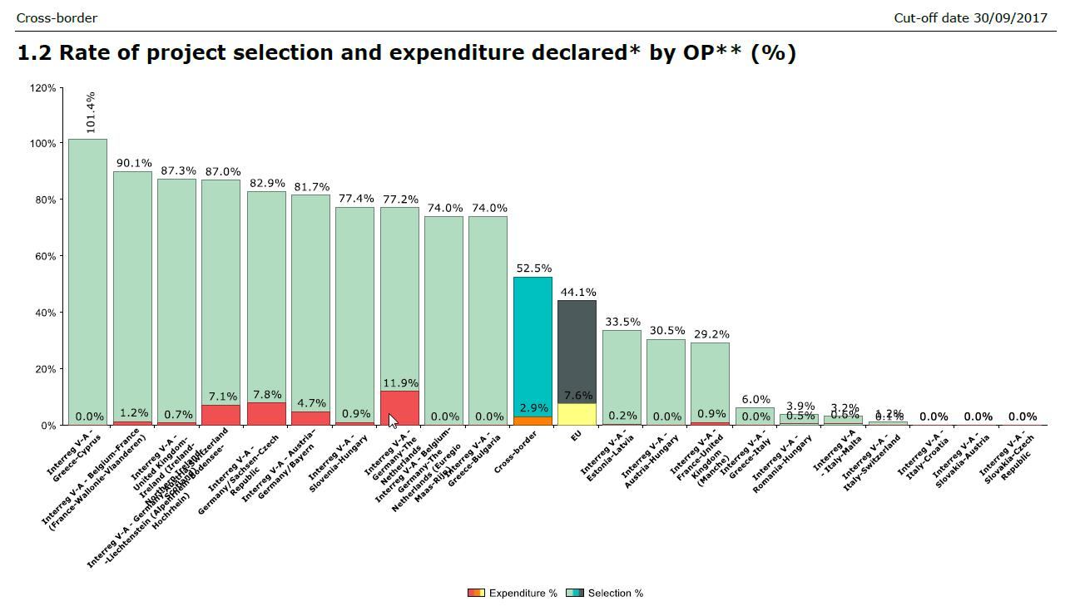
Implementation of ETC programmes 1

Slide 3
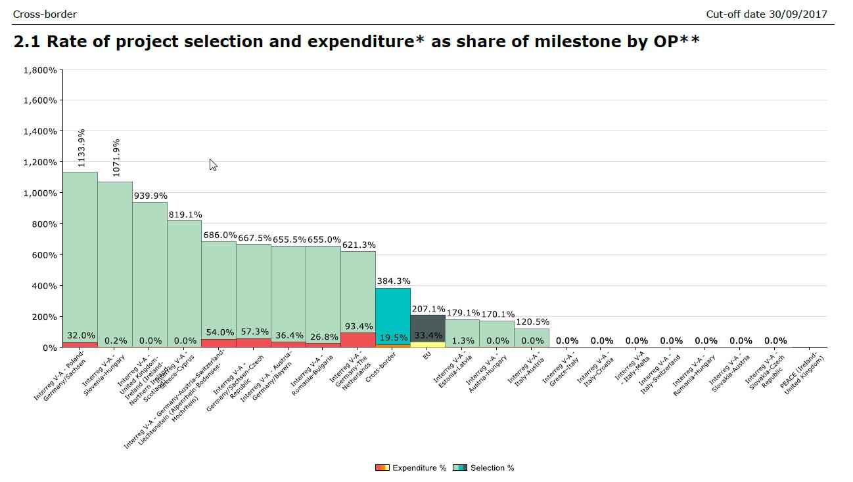
Implementation of ETC programmes 2

Slide 4
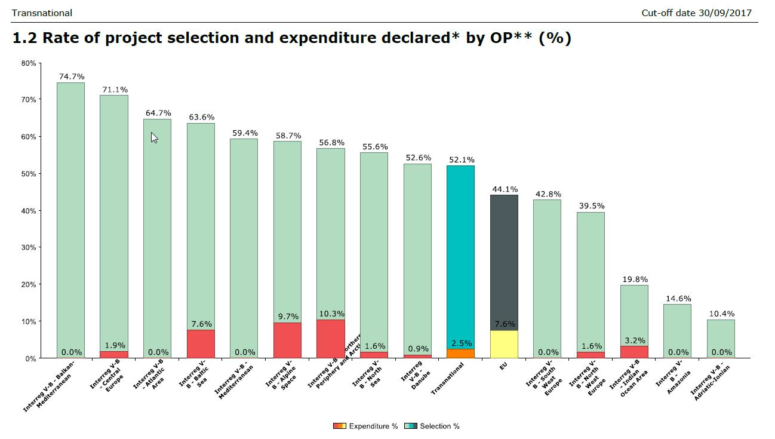
Implementation of ETC programmes 3

Slide 5
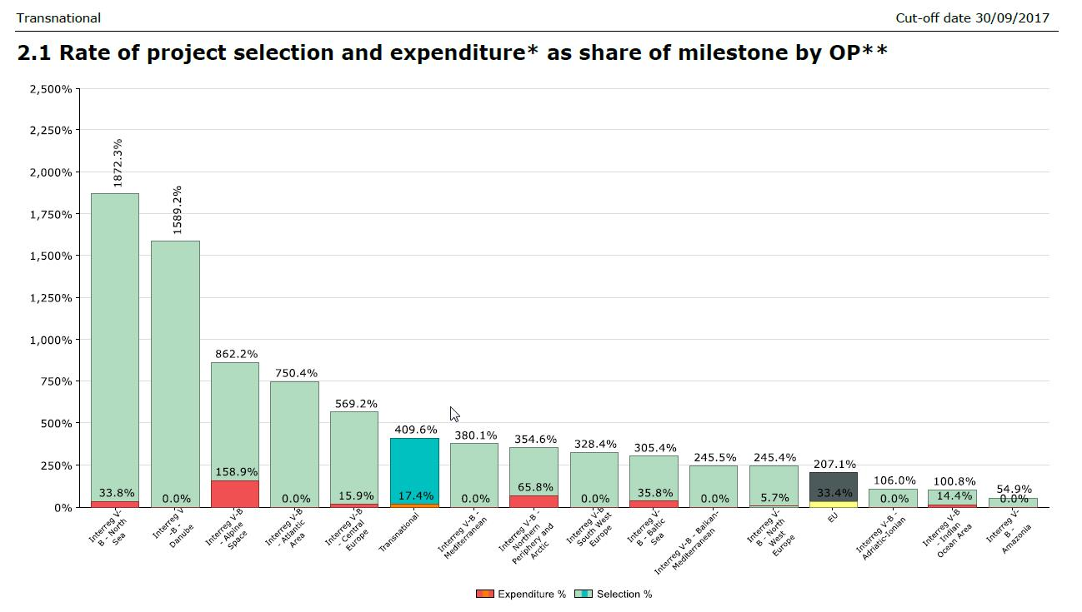
Implementation of ETC programmes 4

Slide 6
Evaluations
    Almost no evaluations from this period this is logical considering the level of implementation
    9 have been identified as being published since we began the Helpdesk
    4 relate to the previous programming period
    Only two are impact evaluations both of them (unsurprisingly) on the previous period
    The remaining are more process oriented

Slide 7
Reporting data lessons from AIR 2016
    Considerably low level of physical achievements (outputs) reported.
    Number of inconsistencies noticed, typical errors:
      No outputs reported while expenditure/selection considerably high
      Outputs selected = outputs implemented
      0 expenditure but outputs implemented
      Targets overachieved, or very much overachieved
      No data reported/Non plausible values reported
      Implications is that wrong data will be reported on the ODP

Slide 8
Quality of evaluation plans
 | Total | ERDF+CF | ESF+YEI | Multi-funding | ETC
1 Management and planning | 2.7 | 2.7 | 2.7 | 2.7 | 2.2
2 Responsibility and coordination | 3.0 | 3.0 | 2.9 | 3.0 | 2.5
3 Design and methods | 2.3 | 2.3 | 2.3 | 2.4 | 1.8
4 Data availability and data systems | 2.3 | 2.3 | 2.3 | 2.4 | 1.8
5 Skills and expertise | 2.5 | 2.6 | 2.4 | 2.6 | 2.0
6 Use and communication | 2.8 | 2.8 | 2.9 | 2.8 | 2.3
Overall average | 2.6 | 2.6 | 2.6 | 2.7 | 2.1

Slide 9
Amendments proposed
In article 5(3), which sets the requirements for the output indicators in the performance framework, the wording for the ERDF, Cohesion Fund and EAFRD to be aligned with the ESF (reporting values based on operations reported in full or on those, which have been started, but where some of the actions leading to outputs are still ongoing);
Notes:
The existing provisions require managing authorities to report – in case of the ERDF and the CF – achievement of outputs in the performance framework only in relation to fully implemented operations (in case of some EAFRD measures – in relation even to completed operations).
This means that achievements can only be reported when the entire operation has been implemented and all the outputs delivered. This applies to all operations including those running for more than one year, which include several projects and deliver outputs progressively (for example, business support aid scheme or infrastructural investments).
By consequence the implementing regulations prevent managing authorities from reporting achievement as soon as any new unit of output is delivered for some programmes, even if article 50(2) of CPR does not exclude such possibility.
Hence the Commission proposal to amend the article 5(3), which provides possibility for the MA, not the obligation to report.
In order to use this possibility, the monitoring system has to allow for reporting outputs delivered by operations, which has not yet been fully implemented, and the indicators used for reporting have to measure outputs, which can be delivered by operations, which has not yet been fully implemented (for example, if the operation is to deliver 10 km of new road, it might be that 10 km is built as a whole or it is divided in two sections and each of them can be used by cars separately).

