Slide 1
How to plan and prepare for the communication of evaluation results?
Ari Brozinski, Communication Manager Central Baltic Programme
Evaluation & Communication, Vienna, Austria, 12 December 2017

Slide 2
Topics
Background/How did we set up the evaluation process?
What is the process for communicating the findings (results) of the evaluations?
Which messages are shared to which target groups?

Slide 3
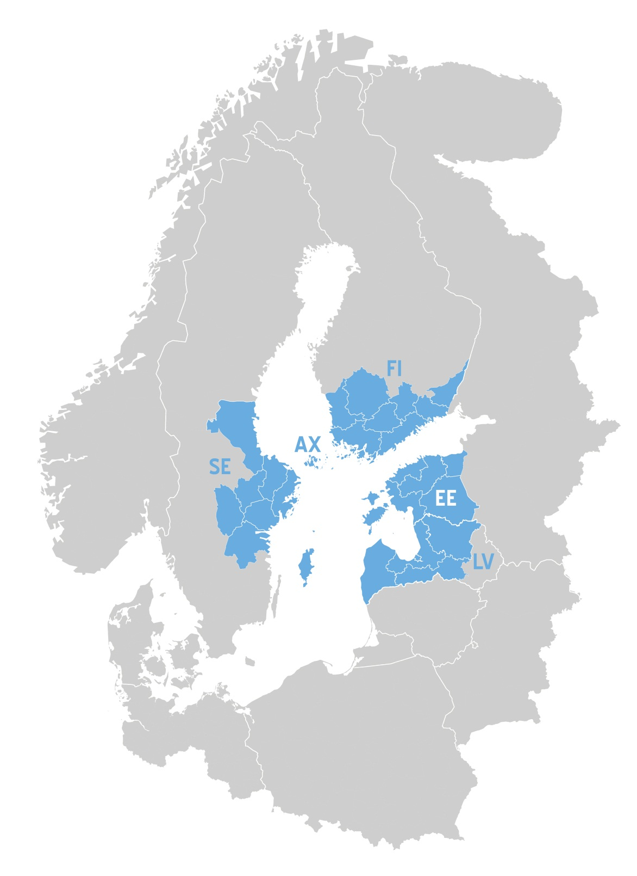
Central Baltic Programme
Finland, Estonia, Latvia, Sweden and Åland
115 MEUR ERDF
Three calls (targeted fourth)
10 project have ended by 2017
Priorities:
Competitive economy
Sustainable use of common resources
Well-connected region
Skilled and socially inclusive region
MA, JS, AA located in Turku at the Regional Council of Southwest Finland

Slide 4
Background/How did we set up the evaluation process?

Slide 5
Evaluation plan
Main evaluation consists of impact evaluation (incl. evaluation of the Communication Strategy)
1-2 follow-ups
MC will agree on follow-up of recommendations
All evaluations are theory-based
Method and data is defined separately for each evaluation question (general, SO’s and Communication Strategy)
Further definitions in ToR, final proposal by service providers

Slide 6
General, SO level and comm evaluation questions
General
How well has the strict result orientation functioned in reaching aimed results?
How has this SO/Priority contributed to wider policy objectives (such as those of EUSBSR, Europe2020 and the horizontal objectives defined by the programme and European Commission)
SO 1.2
Is there a more positive attitude towards entrepeneurship among youngsters?
Communication
Have the communication measures reached the relevant target groups efficiently?

Slide 7
Example from SO 2.1 Natural and cultural resources developed into sustainable tourist attractions
Questions
Are the tourism development organisations aware of the attraction(s) or do they recognise them?
How is the sustainability taken into account, what kind of activities (best practises) take place?
What impact is seen on the movement of people between the CB countries?
Materials, methodology
surveys, interviews
national tourism statistics
project materials

Slide 8
A team effort
Mixed approach of internal and external expertise
The MA/JS will provide basic information, information on the methodologies for getting result indicator data etc.
External evaluators will use this and the data collected by themselves
Final result comes from external experts

Slide 9
Evaluation timetable
Pre 2016: initial plan guided by best practices from 2007-2013 period
2016
Staff wide meeting to consider the evaluation document and questions for each SO + comm
Approval in MC
2017
Analysis of indicator methodologies
Meeting of internal group
Task force meeting
2018
Approving ToR in next MC
Tender process
Evaluation
2019
Evaluation
Results available
Incorporating results into AIR

Slide 10
What is the process for communicating the findings (the results) of the evaluations?

Slide 11
Process of communicating evaluation results
Recognising information valuable to different target groups
Aided by Communication Strategy that defines the information needs of different target groups
Re-checking needs through
Annual CommStrat evaluations (questionnaires & listings)
Day-to-day contacts
Seminars, meetings
Different networks
Europol surveys

Slide 12
Process of communicating evaluation results
Ensuring effective use of different communication channels
Knowledge about what works where (CommStrat and SoMe Annex)
Reflecting that our communications are in line with our communication focal points

Slide 13
Communication focal points
The advanced state of the programme
Result-orientation
Showing concrete improvements for the programme region that are enabled by EU funding
Our operation is in line with the Commission guidelines
The structure of the programme is sustainable for post-2020
Addressing challenges and utilising developing opportunities in border regions within the programme area.

Slide 14
Which messages are shared to which target groups?

Slide 15
Target groups
The Communication Strategy aids in recognizing target audiences and is linked to communicating evaluation results
Audiences are divided between internal and External target groups in the Communication Strategy
In total 19 different groups
Different groups have different communication needs
Different messages for different target audiences
About fulfilling programme goals and creating concrete results, not the message that evaluation has been done

Slide 16
What information do they need? Examples of messages...
MA, JS, AA
Information on what could be still improved during programme implementation
National Contact Points
Information that they can spread in their country to different target groups, prepared by the MA/JS
Monitoring Committee
Information on how the programme works, all of it
Steering Committee
Information that could affect any potential future calls for applications

Slide 17
What information do they need? Examples of messages...
National bodies responsible for coordinating the ETC programmes
Information on the impacts of the programme in their country
Post-2020 sustainability
European Commission
All information of the evaluation outcomes, but not only in the form of the final evaluation report
How developing opportunities in border regions are utilised

Slide 18
What information do they need? Examples of messages...
Project partners
Information on their impact on the whole programme outcomes
Motivation for future and thank you for the done work
Potential partner organisations of the future
Thematically relevant information on how the ETC has changed things close to them
Motivation for future cooperation

Slide 19
What information do they need? Examples of target groups and messages...
Other Interreg programmes
Sharing of knowledge on the evaluation methodology and outcomes
Cooperation in sharing the outcomes
EUSBSR coordinators
Information on how the programme(s) have been able to implement the EUSBSR (if applicable for the programme)
General public
Information on the impact and positive change due to Interreg cooperation, stories of projects and individuals linked to them
E.g. Amount of improved guest harbours and type of improved services, improved possibilities to visit the archipelago off-season/positive effect on economy, call centers for elderly when they feel lonely/increased social inclusion

Slide 20
Thank you!
www.centralbaltic.eu
CentralBaltic
Central Baltic Programme

