Slide 1
Interreg 2 Seas Communication Strategy Internal evaluation
Vienna - 12/12/2017 by Wannes Haemers
(Communication Officer Interreg 2 Seas)

Slide 2
Programme Budget
€ 241m ERDF
4 Countries
3 languages
4 Priority Axes
7 Specific Objectives

Slide 3
Programme state of Play
40 projects
719 partners
€126m ERDF available

Slide 4
Communication Strategy
The assessment of the Communication Strategy is done annually as a part of the Annual Implementation Report.
Key to quality assessment is defining indicators, qualitative as well as quantitative, related to the communication objectives.

Slide 5
Communication Strategy
The assessment of the Communication Strategy is done annually as a part of the Annual Implementation Report.
Key to quality assessment is defining indicators, qualitative as well as quantitative, related to the communication objectives.

Slide 6
Communication Strategy – intervention logic
Programme Objective
Communication Objective 1
1.1
1.2
C.O. 2
2.1
2.2
1.3
1.4

Slide 7
Communication Strategy – indicators
1.1
1.2
1.3
1.4
2.1
2.2
# Applications │ % Succesful applications Satisfaction (internal and external) # Events │ Visibility (offline and online)

Slide 8
Communication Strategy – sources of data
1.1
1.2
1.3
1.4
2.1
2.2
Electronic Exchange Platform Surveys
Reports │ JS administration │ Web statistics

Slide 9
Content
Resources for internal evaluation
Evaluation process planning
Examples
Results / Recommendations
Lessons learnt
MC – role and involvement

Slide 10
Resources for internal evaluation

Slide 11
Evaluation process planning
Measures
Evaluation
Measures
Evaluation
Measures

Slide 12
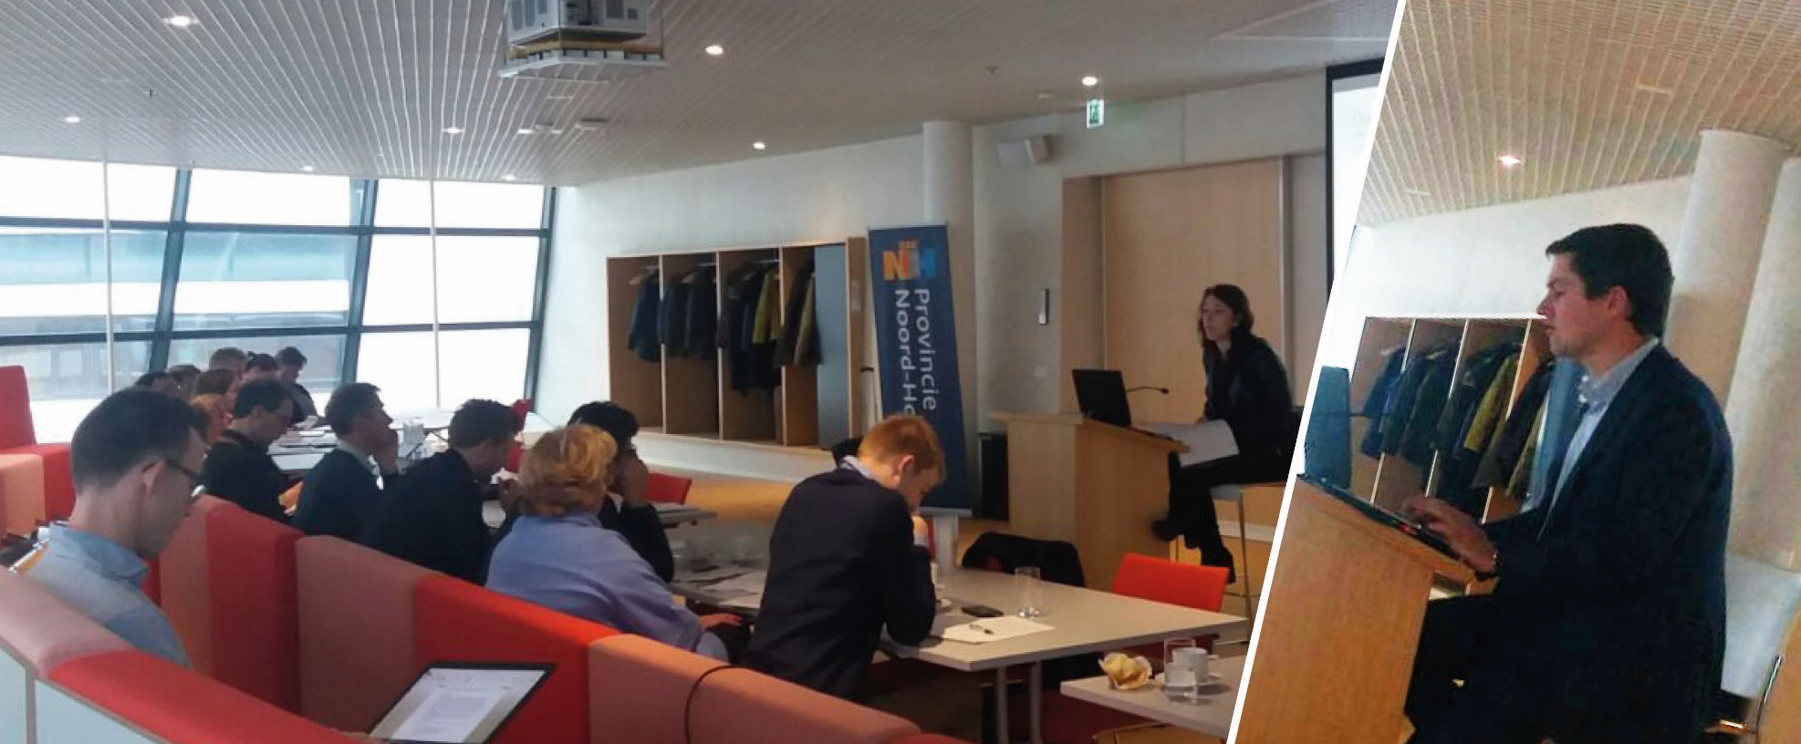
Example 1: Applicant Seminar

Slide 13
Example 1: Applicant Seminar
Evaluation by applicants
Evaluation by Technical Assistance

Slide 14
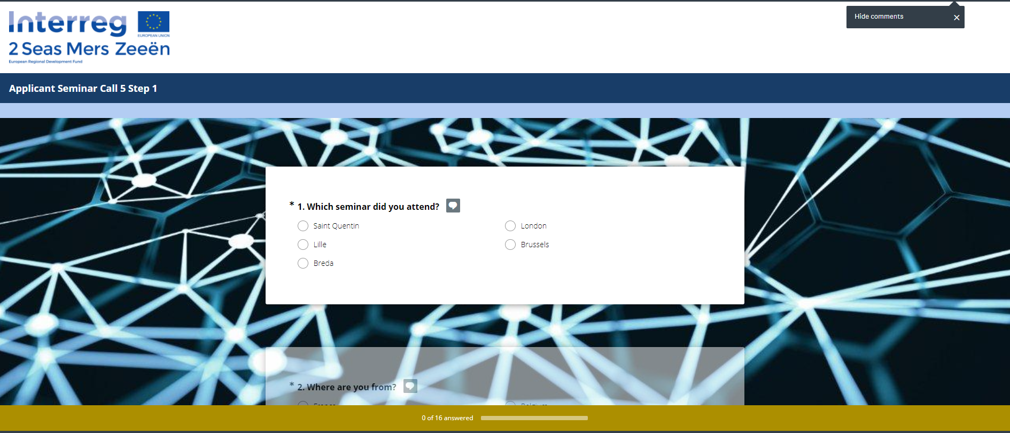
Evaluation by applicants

Slide 15
Evaluation by applicants
Identification questions
Which objectives did you have before the event?
What will be your next step?
Rating questions
both content and more practical
poor / satisfactory / good / excellence
→ Keep It Short and Simple

Slide 16
Evaluation by Technical Assistance
Applicant evaluations analysed and discussed by Territorial Facilitators and Joint Secretariat
Adjust the seminar

Slide 17
Example 2: Beneficiary survey 2016
Global survey on the Technical Assistance linked to information and communication measures for beneficiaries (applicants and approved project partners) provided in 2016.
Events
Website
Social media
Newsletter

Slide 18
Example 2: Beneficiary survey 2016
Measure satisfaction of beneficiaries…
in order to improve services to beneficiaries… and contribute to the Programme performance. (cf. intervention logic)

Slide 19
Example 2: Beneficiary survey 2016
Surveymonkey
5 – 10 minutes
28 questions (short answer + rating)
Broad launch in December 2016 (all contacts)
Targeted reminders in January 2017

Slide 20
Results / recommendations
3 key findings of the applicant seminar evaluation:
Need fo interactive elements and exercises
Need to illustrate theoretical principles (e.g. intervention logic)
Need to demonstrate use of EEP

Slide 21
Results / recommendations
3 key findings of the beneficiary survey:
Website: improve access to documents
Newsletter: update the order of information
Social media: no crazy investments

Slide 22
Lessons learnt
Horizontal mission: as communication is team work, the evaluation of communication should also be dealt with in team.
Planning is crucial. (Foresee sufficient elements of evaluation in Com. Strategy)
KISS principle promotes participation rate.

Slide 23
MC involvement
Annual Communication Plan is presented to the Monitoring Committee in November.
MC members are asked to comment and make suggestions in order to improve any element of these plans (including the part on evaluation).
Challenge: promote the horizontal character of communication

Slide 24
THANK YOU
w.haemers@interreg2seas.eu
www.interreg2seas.eu

