Slide 1
Co-operation Programme
Saxony – Czech Republic
SN-CZ 2014-2020 (INTERREG V A)
Evaluation of Communication Strategy

Slide 2
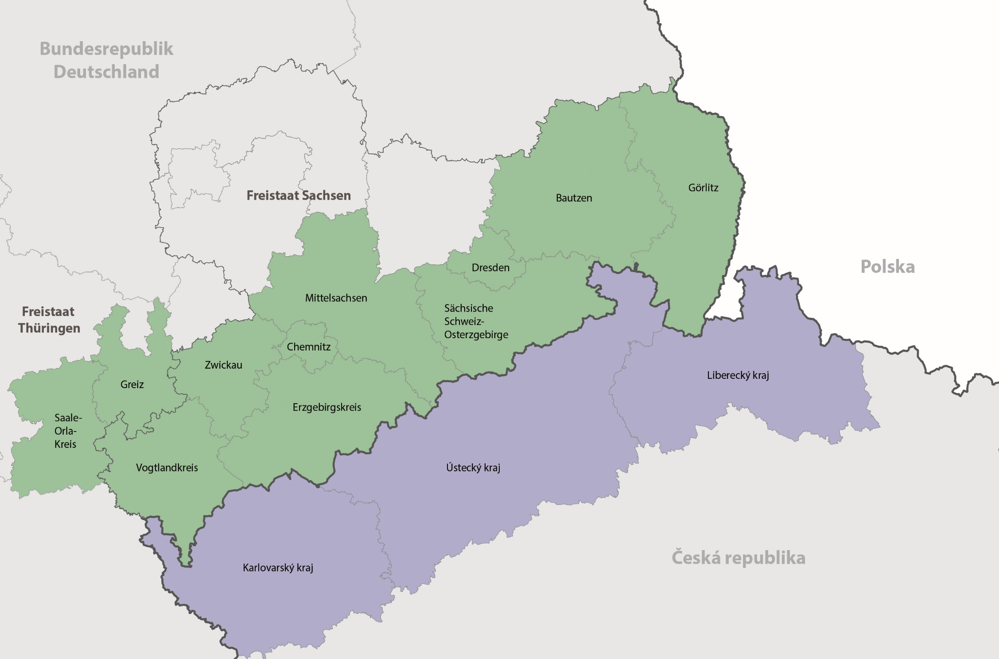
Czech eligible area
Saxon eligible area
Programme area is defined on NUTS-level 3.

Slide 3
Programme budget
CBC Programme Saxony – Czech Republic 2014-2020 (INTERREG V A)
189.274.570 EUR total programme budget
157.967.069 EUR ERDF budget
4 Priority axis for projects
  148.5 Million EUR ERDF for projects
+ 1 Priority axis for Technical Assistance (TA)
  9.4 million EUR ERDF for TA
Status quo: 142 Mio. EUR ERDF approved/contracted
(95,6% of ERDF budget)

Slide 4
www.sn-cz2020.eu

Slide 5
1. Resources for external evaluation
2. Evaluation process planning
3. Content / Questions
4. Results / Recommendations
5. MC - role and involvement
6. Experience with external evaluator /
Lessons learned
6.
www.sn-cz2020.eu

Slide 6
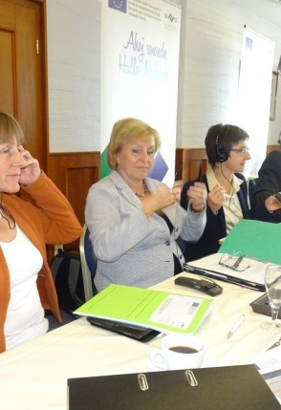
Resources for external evaluation
CBC Programme Saxony – Czech Republic 2014-2020 (INTERREG V A)
Budget / Staff
Indicative financial resources (2015-2023) for evaluation:
473 648 EUR, thereof 307 871 EUR ERDF Technical Assistance and 165 777 EUR national co-financing
Evaluation of communication strategy: 39 802 EUR
Managing Authority:
Yvonne Schönlein, Desk Officer
Uta Juraschek, Assistent Desk Officer
Evalution is one of other tasks and responsibilities
Active involvement of Czech National Authority (MMR):
Jan Pikna, Stanislav Rataj

Slide 7
Resources for external evaluation
CBC Programme Saxony – Czech Republic 2014-2020 (INTERREG V A)
Timeline
May 2017 start of communication strategy evalution
June 2017 workshops with stakeholders and evaluator
July/August 2017 Online questionnaire
October 2017 raw version of evaluation report
24th Oct 2017 Steering Committee meeting
November 2017 draft of final version
January 2018 final version of evaluation report
21st March 2018 Presentation at the monitoring committee meeting
Process time: appr. 1 year

Slide 8
Evaluation process planning
CBC Programme Saxony – Czech Republic 2014-2020 (INTERREG V A)
Operational evaluation
Evaluation methods
First evaluation after contracting the evaluator
Operational evaluation, but with an impact model
NEW: ACCOMPANYING RESEARCH
  12 projects out of 90 chosen
  3 interviews during the whole evaluation process between 2017 and 2021
Analysis of documents (programme, communication strategy, homepage, guidelines for beneficiaries)
Analysis of reports/articles in press, TV, Internet, broadcasting
Workshops with Saxon and Czech participants who are involved in public relation work
Target group oriented online survey (combined communication and procedures/programme administration)
Comparison with other ETC programme (best practice -> Interreg V A DE-DK)

Slide 9
Communication
Strategy Objectives
Successful programme implementation
Programme and possibility of funding solicited
Meaning/Importance of Europa2020 and EU-Cohesion policy made clear
OI14 impelemented training courses
OI16 Information events about Co-operation programme
Internal communication of administration authorities improved
Higher capacity of beneficiaries to implement projects compliant to rules
Potential applicants reached, informed / appropriate partners found and brought together
Special interest groups (interested institions + multiplier in SN+CZ)
Wide public informed (SN+CZ)
Corporate Identity ensured
Programme internal
Training courses
Communication Programme level
Small Project Fonds
Project level
Internal events organised (courses, workshops , Interact...)
OI14
Newsletter, Publications published
OI16
Public events organised
Project oriented consultancy executed
Publications
published
Stakeholders
Communication activities
RESULTS
Events for beneficiaries organised (training courses)
Flexible exhibition
Press articles written and published
Newsletter/
press articles written and published
Information on Website published
Meetings of Authorities
Consulting executed/
performed
Merchandising prod. produced + distributed
Partner contact platform implemented
Events organised
Jour fixe MA+SAB
Brochures
published
Website launched/extendef
Website launched
Programm stakeholders
SMUL
Managing Authority Communication Officer
JS SAB
CZ
District exchange
National Authority MMR CR
Euroregions (SPF)
Beneficiaries

Slide 10
Evaluation of Communication Strategy
CBC Programme Saxony – Czech Republic 2014-2020 (INTERREG V A)
Results / Recommendations (draft of final report)
Complete obligatory elements for information
Specify target groups and objectives for the communication strategy
More target-oriented communication work
Support of communication and public relations work for beneficiaries
New / social media
Annual communication plan
Establish consistent reporting (indicators)

Slide 11
Evaluation of Communication Strategy
CBC Programme Saxony – Czech Republic 2014-2020 (INTERREG V A)
Role and Involvement of Monitoring Committee (MC)
Saxon-Czech Evaluation Steering Group (SG) (sub-group of MC members) constituted in 2017
  1st meeting on 24th October 2017 -> communication strategy evaluation
Tasks:
  Assessment of drafts of final reports and final reports respectively, using a quality sheet (questionnaire)
  Discussions with evaluator in the SG meetings
  Deliver written comment for approving the evaluation reports
Monitoring Committee gets the final reports for check and discussion in the MC meeting
Managing Authority presents the SG vote about approval

Slide 12
Evaluation of Communication Strategy
CBC Programme Saxony – Czech Republic 2014-2020 (INTERREG V A)
MC:
checks, discusses report and get informed about SG vote
SG: assesses and discusses reports
MA: Evaluator delivers draft and final reports

Slide 13
Evaluation of Communication Strategy
CBC Programme Saxony – Czech Republic 2014-2020 (INTERREG V A)
Experience with external evaluator / Lessons learned
Ensure the same understanding for topics and contents respectively
  „Raw“ report versus draft of final report
  Workshop organisation needs approval by MA
A lot of time for communication with evaluator
  Kick-off meeting after having the evaluator contracted
  regular joint telephone meetings
  regular meetings with evaluator
  Short info and short reaction in case of problems
More time for translation (German and Czech language must not descriminated)
Time schedule planning and harmonizing

Slide 14
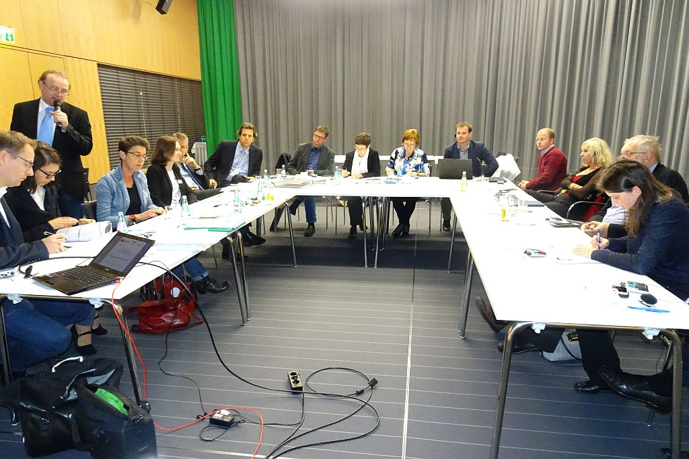
Bildbeschreibung Arial 12 pt

Slide 15
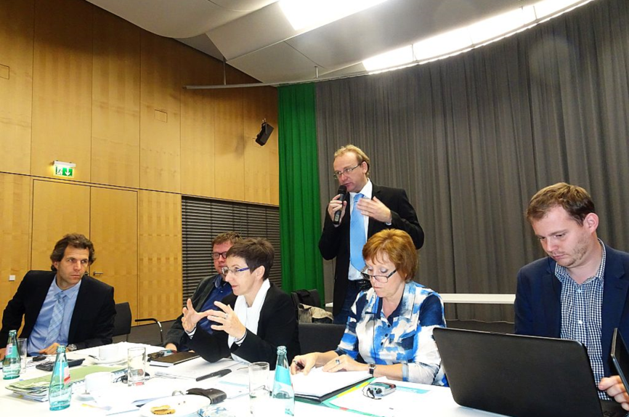
Questions?
CBC Programme Saxony – Czech Republic 2014-2020 (INTERREG V A)
Managing Authority
Saxon State Ministry for Environment and Agriculture
(Divison 25 Cross-border Programmes, Interreg Europe)
Dipl.-Ing. Yvonne Schönlein
Desk Officer
Archivstr. 1, 01097 Dresden
Phone: +49 (0)351 564 2251
Telefax: +49 (0)351 564 2259
E-Mail: yvonne.schoenlein@smul.sachsen.de
Web: www.sn-cz2020.eu

