Slide 1
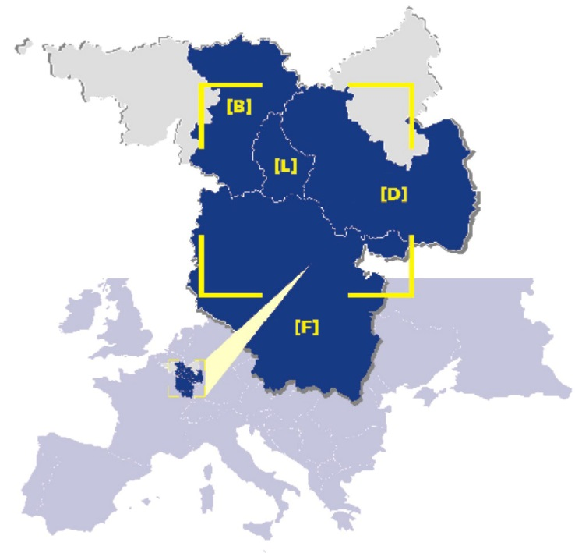
What to consider when writing the Terms of Reference?
12.12.2017 | Interact workshop “Evaluation & Communication”| Vienna

Slide 2
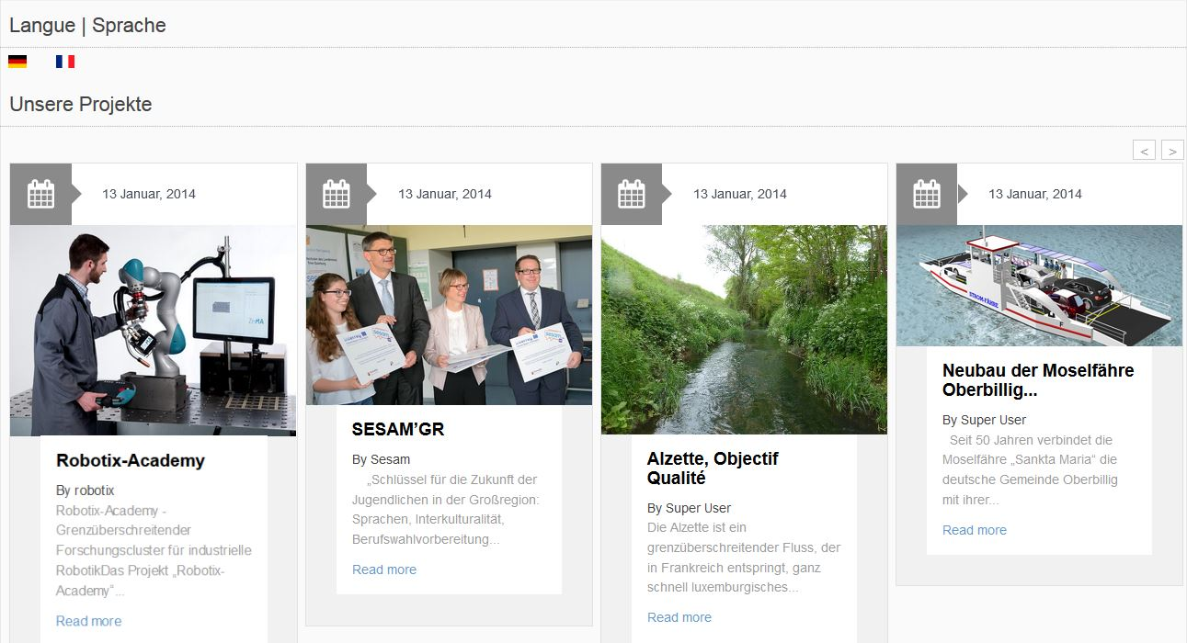
Digital and print communication

Slide 3
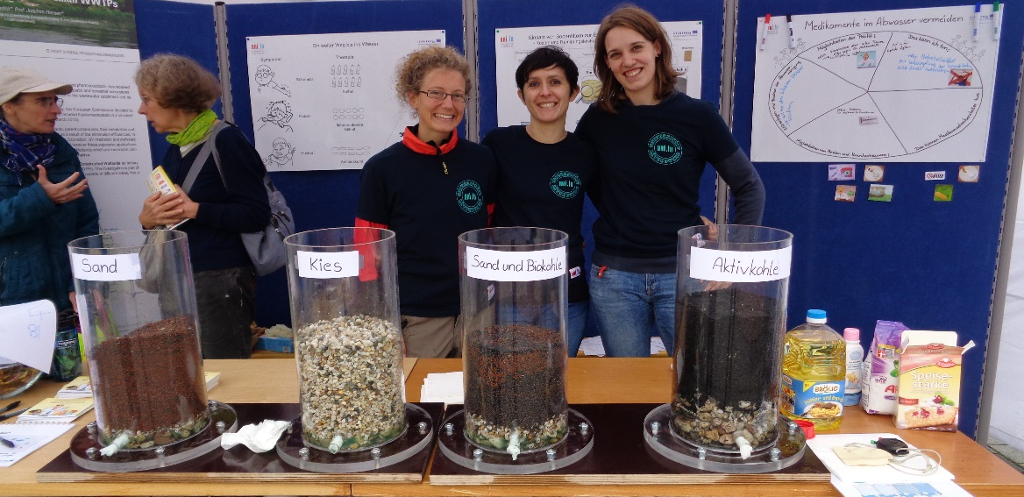
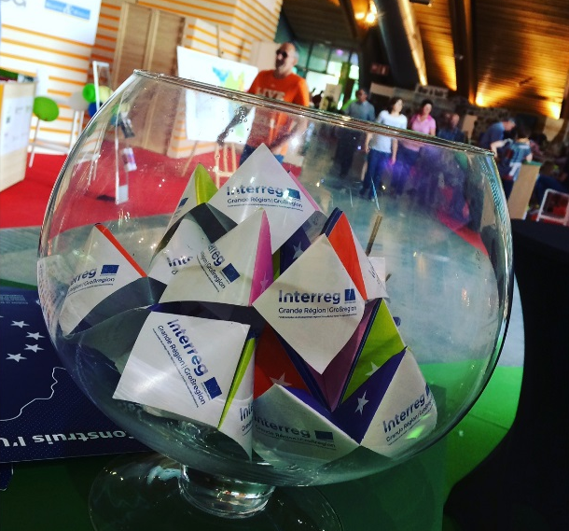
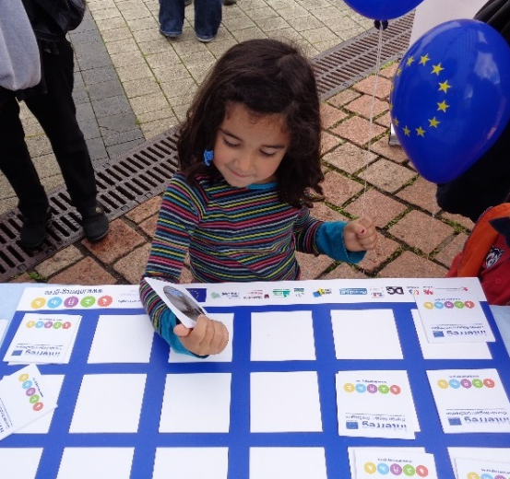
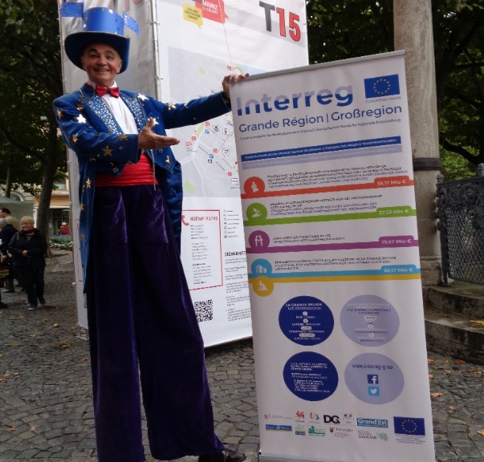
Non-digital communication

Slide 4
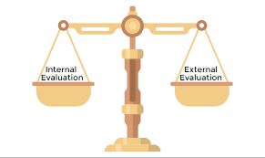
Terms of Reference - context
Our evaluation plan foresees:
Operational evaluation → Internal and ongoing
Externalisation of
Impact evaluation of priority axis 2
Impact evaluation of the priority axis 1, 2, 3 and 4
Budget available: 160.000 EUR

Slide 5
Terms of Reference
Impact evaluation of priority axis 2
(environment, conservation of the cultural heritage)
Revision of the operational evaluation done internally
Impact of the communication measures
Respect of horizontal principles

Slide 6
Terms of Reference – Communication part
Our evaluation plan foresees:
Communication activities will be organised according to the results of the evaluations: Press conferences; press releases, resume in our website, etc.
Terms of Reference:
Need to analyse if the communication measures were adequate in order to attract the highest number of quality projets which will contribute to the programme’objectives.
•

Slide 7
Terms of Reference – Communication part
Questions to be answered = effectiveness and efficiency of communication actions
Communication strategy – has programme’s visibility increased? Has the programme reached the general public?
Have the communication measures been efficient and attracted potential partners?
Have the communication actions in the eyes of project partners been efficient?
Have project partners received sufficiant support from the programme during project implementation in terms of communication?

Slide 8
Bids received– Evaluation of communication activities
Propose a methodology – desk analysis, interviews, online questionnaires
Recall the aim of the communication strategy:
Raise awareness
Increase knowledge and raise interest among potential partners
To make potential partners to create a high quality project (Influence attitude and behaviour)
To support successful partners during project implementation

Slide 9
Find out more about us
Thank you very much for your attention!
www.interreg-gr.eu
10 contact points within the cooperation area

