Slide 1

Evaluation - communication
12 December 2017 I Vienna, Austria
Ivano Magazzu, Interact
Daniela Minichberger, Interact
Linda Talve, Interact

Slide 2



Agenda
Evaluation Capitalisation Communication
Evaluation
of the communication strategy
What to do with the evaluation results related to the impact evaluation?

Slide 3
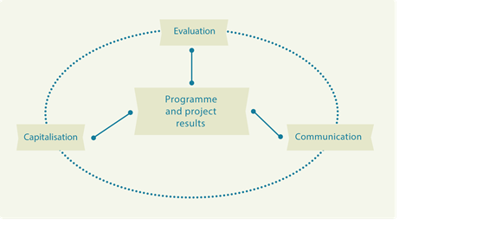
1. Evaluation - capitalisation - communication
How to recognise the links between evaluation-capitalisation-communication?

Slide 4

2. Evaluation of the communication strategy
How to make a good evaluation of a programme communication? What to evaluate and how?
What are concrete questions for the evaluation of the communication strategy? What are the most important ones?
What other programmes assess when evaluating implementation of communication strategy?
Are there any good practices of evaluation of communication strategy? How were the results of the evaluation used?

Slide 5

3. What to do with the evaluation results related to impact evaluation?
How to design evaluations in a way to obtain results that can be effectively communicated (to the general public) and are also meaningful (to the programme itself)?
How to formulate evaluation questions to have it meaningful and most useful?
What to do with and how to communicate the best evaluation reports? How to revise the Com strategies and plans accordingly?
How to best use communication for disseminating the evaluation results? How to coordinate the two?
What are good (innovative and simple) ways to communicate about evaluation findings? Best practice on this?
How to communicate evaluation results on social networks?

Slide 6
Take your phone and come to kahoot.it

Slide 7

Much of the collaboration deficit – between evaluation and communication managers – maybe due to differing perceptions about respective roles and capacities

Slide 8
Roles
Communication officers:
Talk about what in an ideal world could we expect from evaluation officers?
Evaluation officers:
Talk about what in an ideal world could we expect from communication officers?

Slide 9
Feedback:
What expectations did you like?
What do you want to keep?
What do you want to drop?

Slide 10

Evaluation Capitalisation Communication

Slide 11
Capitalisation – do we all have the same understanding?
Capitalisation is about gathering, organising and building upon existing programme and projects results, within specific fields.
Capitalisation could concern data about the implementation of programmes, projects, impacts and methods used in order to make this knowledge generated by Interreg (capital) more accessible and usable for other programmes, projects or stakeholder groups.
Capitalisation (of results) looks into specific results in thematic fields in order to obtain additional improved results, to boost performance, delivery and to multiply the effects of achievements delivered.

Slide 12

How do we implement capitalisation?
Gathering results → analysis (projects), coordination
Promotion of results → promotional and capitalisation events/targeted campaigns, networking events, simplicity of language
Re-use of results → validation/follow-up, effects?
Influence policies → link with public decisions, modifing legislations

Slide 13
What is capitalisation in Interreg programmes?
*Data from “Let’s capitalise” event 2017

Slide 14

How do we implement communication?
Information about programme funding opportunities and activities
Publicity and visibility
Involvement of programme stakeholders and partners
Promotion of results
Raising awareness, Annual Events/targeted campaigns, networking events, simplicity of language
Influence policies

Slide 15

Why capitalisation is needed for 2014-2020?
Now, more than ever, it’s crucial to develop capitalisation activities in order to:
promote programmes’ achievements and demonstrate the added-value of cooperation, thus promoting new answers to territorial challenges
use programmers’ results in order to improve the quality of implementation as well as to improve mainstreaming into regional programmes and policies
make programmes more visible with tangible results and to provide solid inputs in the framework of post-2020 discussions.
… a first answer comes…

Slide 16

What are the links between evaluation-capitalisation-communication?
Notes:
Question in the registration … links besser erklären …Ivano
This seminar is the starting point of discussions: we have our programme and projects results and eval-comm and cap are tools to work with them:
through an evaluation you will be able to learn more about your prgramme and projects results
Through comminication you will be able to sell your projects and programmes results –to show your what you achieved
in capitsalisation you build on the previous experiences of your programme and projects results
Evaluation, communication and capitalisation are also tools which need eath other
First you evaluate and then you communicate the the results of the evaluation and in order to build new projects/programmes you build on the former evaluation results

Slide 17
Key principles
WHAT? | EVALUATION | CAPITALISATION | COMMUNICATION
WHERE? | Legal requirement | Not yet anywhere | Legal requirement
HOW? | Evaluate efficiency, effectiveness and impact of the programme | Go deeper into projects’ achievements/results and contents Where is the impact of project delivery, related to topics IT’S NOT ABOUT PERFORMANCE | Communication of programme’s achievements
WHO? | Learning excercise for programmes authorities, internal or external | Learning and building excercise (communities) for programme authorities and projects, internal | Dissemination excercise for programmes and projects
WHEN? | During implementation of the programme | All along projects’ and programme’s life | All along projects’ and programme’s life
Notes:
Although project evaluation is not a legal requirement, some programmes encourage project evaluations.
If you plan to carry out a project evaluation, you should first ask yourself why you want to implement and evaluation. Evaluations should never be carried out without having a clear picture of why and for whom the evaluation should be done.
Tip: The project should carry out an evaluation in order to improve the project and not to undertake evaluations for their own sake.
17

Slide 18
Interact Capitalisation Plan
Objectives
To define the main actions and work
Identification, analysis and promotion of capitalisation approaches;
Set-up and implementation of thematic networks;
Promotion of Interreg results.
Clear identification of themes
Specific survey to programmes, according to thematic choises

Slide 19
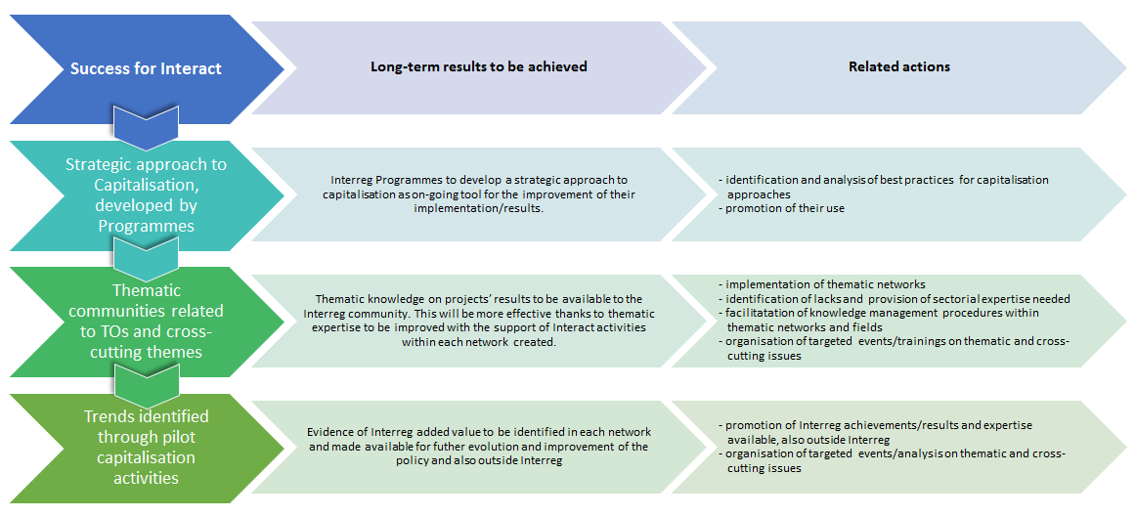
Capitalisation of Interreg results: how?
Interact has defined a series of long-term strategies, results :
1
2
3

Slide 20
Interact Capitalisation Networks
The capitalisation networks:
constitute a resource for gaining new contacts and knowledge, providing opportunities and inspiration;
are a support framework to refer to for advice, support, coaching, mentoring for its members and even beyond.
establish synergies with other initiatives and contexts which are not related to the Regional Policy and whose focus is in line with the issues addressed through the capitalisation networks.
serve both the purpose of learning/receiving as well as of promoting/sharing knowledge, information and achievements of cooperation programmes.
The main users of the networks are the Interreg, Interreg IPA CBC and ENI CBC programmes.

Slide 21
Interact Capitalisation Networks: features
A way to capitalise Interreg results...

Slide 22
Thematic support to programmes
Interreg Europe | Interact
Research, technological development and innovation (TO 1) | Migration
Competitiveness of SME’s (TO 3) | Sustainable transport (TO 7)
Shift towards a low-carbon economy (TO 4) | Maritime issues/Knowledge of the Seas
Preserving and protecting the environment and promoting resource efficiency (TO 6) | Climate change and risk management (TO 5)
 | Inclusive growth (TO 8-9-10)
 | Better governance (TO 11)

Slide 23
Support to Capitalisation 2018
Capitalisation as management practice: Workshops, trainings, publications and materials | Thematic network: Meetings, on-line platforms, pubications
Event on Capitalisation practices | Interreg response to migration network
Capitalisation WG to prepare a Cap toolkit (process and strategy/plan templates) | Sustainable transport
Cap&Com event – Training on communication | Knowledge of the seas network
Evaluation & Capitalisation event | Climate change network
Advisory on capitalisation and hotline | Inclusive growth network
 | Better governance network

Slide 24

Evaluation of the Communication Strategy

Slide 25

Evaluation of Communication Strategy
Legal requirements
What to consider when writing ToR?
Marta Roca, Grand Région Programme
Programme experiences from internal / external evaluation of communication strategy
Wannes Haemers, 2 Seas Programme
Yvonne Schönlein, Interreg Sachsen – Czech Programme
Defining evaluation questions for the communication strategy Group exercise

Slide 26

Legal requirements
Article 54.1. 1303/2013 CPR
Evaluations shall be carried out to improve the quality of the design and implementation of the programmes, as well as to assess their effectiveness, efficiency and impact.

Slide 27

Legal requirements
Article 14.4.b. 1299/2013 ETC
The annual implementation reports submitted in 2017 and 2019 shall set out and assess the information required under Article 50(4) and (5) respectively and the information set out in paragraph 3 of this Article together with the following information:
(a) progress in the implementation of the evaluation plan and the follow-up given to the findings of evaluations;
(b) the results of the information and publicity measures of the Funds carried out under the communication strategy
Notes:
Due date June 2018/2020
6-7 March Lisbon AIR and performance framework event

Slide 28
Group exercise
Evaluation of communication strategy
What are the evaluation questions you must have (to fulfil the requirements and also to be able to feed into the reporting)?
What are the evaluation questions which are nice to have?

Slide 29


What to do with the evaluation results related to impact evaluation?

Slide 30
What to do with the evaluation results?
Introduction
Lessons learned and tips from the EC
David Alba, Evaluation Unit, DG Regio
How to plan and prepare for evaluation findings?
Ari Brozinski, Central Baltic Programme
How to formulate evaluation questions in order to find the relevant information?
Group exercise

Slide 31
2007-2013 2014-2020
Impact evaluation is a new requirement.
From numbers of projects and euro amounts to more qualitative approach and analysis of impact.
Results of the analysis are also to be more widely spread.
Cooperation between evaluators and communicators becomes the key to success!

Slide 32
‘Relevance‘ (demand orientation and solution orientation) and ‘utility‘ of evaluation findings determine whether or not an evaluation is worthwhile.
Study on communicating evaluation results, prepared for the OECD Informal Network of DAC Development Comminicators, 2012
Notes:
DAC DEVELOPMENT ASSISTANCE COMMITTEE
OECD Organisation for Economic Co-operation and Development

Slide 33
Evaluation is of no consequence unless the findings are communicated
Evalsed, Communicating evaluation findings

Slide 34
Exercise: World café bringing the views of the evaluators and communicators together – for the common benefit
Topics of the tables:
Planning evaluations and drafting the ToR: What are the opportunities to cooperate? What are concrete outputs?
Evaluation process: what to keep an eye on during the process? How to guide the external service provider in his/her work?
Follow up of the evaluation: What are the main challenges of communicating evaluation findings/results? What should be done with “negative” or “sensitive” findings?
How to disseminate the results? What can the evaluation/communication officers do with it?

Slide 35

A few words to wrap-up…

Slide 36
Have we answered the questions?
Evaluation of the communication strategy
How to make a good evaluation of a programme communication? What to evaluate and how?
What are concrete questions for the evaluation of the communication strategy? What are the most important ones?
What other programmes assess when evaluating implementation of communication strategy?
Are there any good practices of evaluation of communication strategy? How were the results of the evaluation used?
Notes:
In the registration you raised many questions regarding the eval of communication strategy … it helped us to shape the agenda and the session
We will come back to each of the sessions:
How to make a good evaluation of a programme communication? What to evaluate and how?
The basis of a good evaluation is a clear ToR…. That is why Marta Roca will present their process of drafting of Gran Region: what have they learned
What are concrete questions for the evaluation of the communication strategy? What are the most important ones?
What other Programmes assess when evaluating implementation of communication strategy?
Wannes HAEMERS from 2 Seas will present their internal eval of Com Strat.
Yvonne Schönlein external eval of Com Strat.
Afterwards we will do an exercise where we will look in the questions for the evaluating the ComStr

Slide 37
Have we answered the questions?
What to do with the evaluation results?
How to design evaluations in a way to obtain results that can be effectively communicated (to the general public) and are also meaningful (to the programme itself)?
How to formulate evaluation questions to have it meaningful and most useful?
What to do with and how to communicate the best evaluation reports? How to revise the Com strategies and plans accordingly?

Slide 38
The questions we did not yet tackle:
How to best use communication for disseminating the evaluation results? How to coordinate the two?
What are good (innovative and simple) ways to communicate about evaluation findings? Best practice on this?
How to communicate evaluation results on social networks?
To be continued…

Slide 39
Upcoming Interact events in 2018
February, Brussels (exact date tbc): Indicators post 2020 discussion (Informal working group on indicators)
Communication network event, late February, Bucharest
AIR and Performance Framework, 6 -7 March 2018, Lisbon, Portugal
Evaluation – Communication – Capitalisation, May, Italy
June: Exchange on experience operational/impact evaluation
Cap&Com, summer
Let’s Capitalise conference, summer

Slide 40
Cooperation works
All materials will be available on:
www.interact-eu.net

