Slide 1
INTERACT CAPITALISATION CONFERENCE
TO7 Sustainable Transport –
Cross-Border Greenways
Northern Ireland-Ireland-Scotland

Slide 2
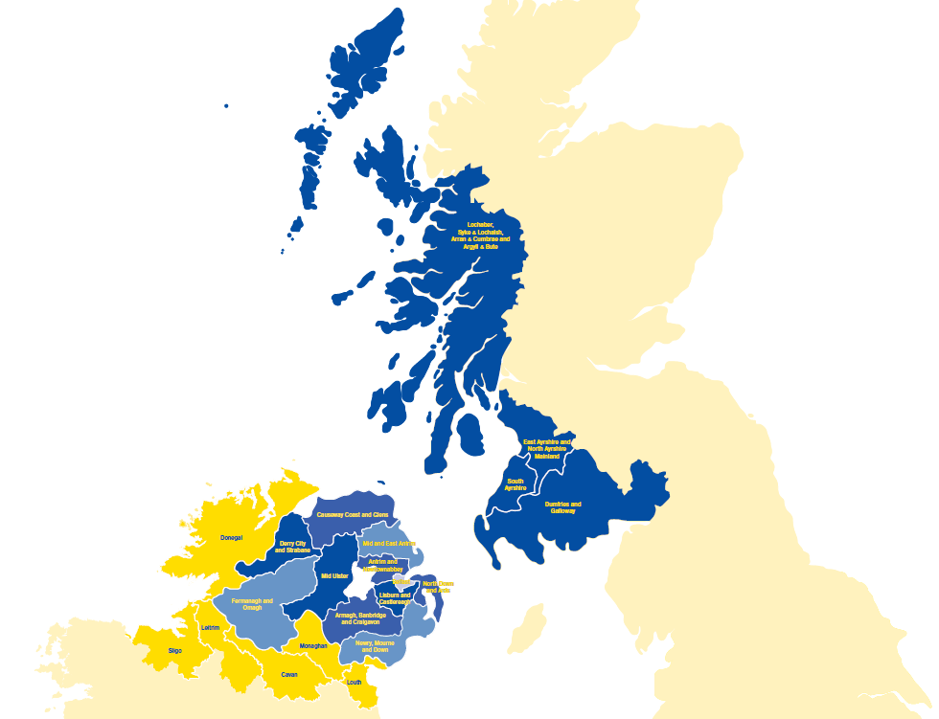
INTERREG VA Programme
Eligible Area
(NI / Border
Region of Ireland /
Western Scotland)

Slide 4
Priority 3 – Sustainable Transport
€40m ERDF available
Priority Objective
‘To promote cross border, intermodal and sustainable mobility in the region.’
2 key outputs:
One cross border multi-modal transport hub
80km of new cross border greenways

Slide 5
Cross-Border Greenways
What is a cross border greenway?
Three greenway projects approved by the Programme
Three separate cross-border locations
€20m ERDF committed
78.6km of greenways to be constructed

Slide 6
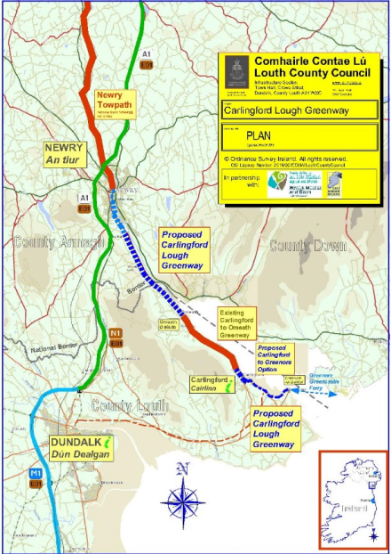
Carlingford Lough Greenway
10.1km of new cross border greenways constructed;
Up to 60,000 visits/users of the Greenway crossing the border in either direction in Year 1 rising to 100,000 users by Year 3;
1,500 participants involved in activities delivered through the Greenway Activity Programme in Year 1, increasing by 10% in each of Years 2 and 3.

Slide 7
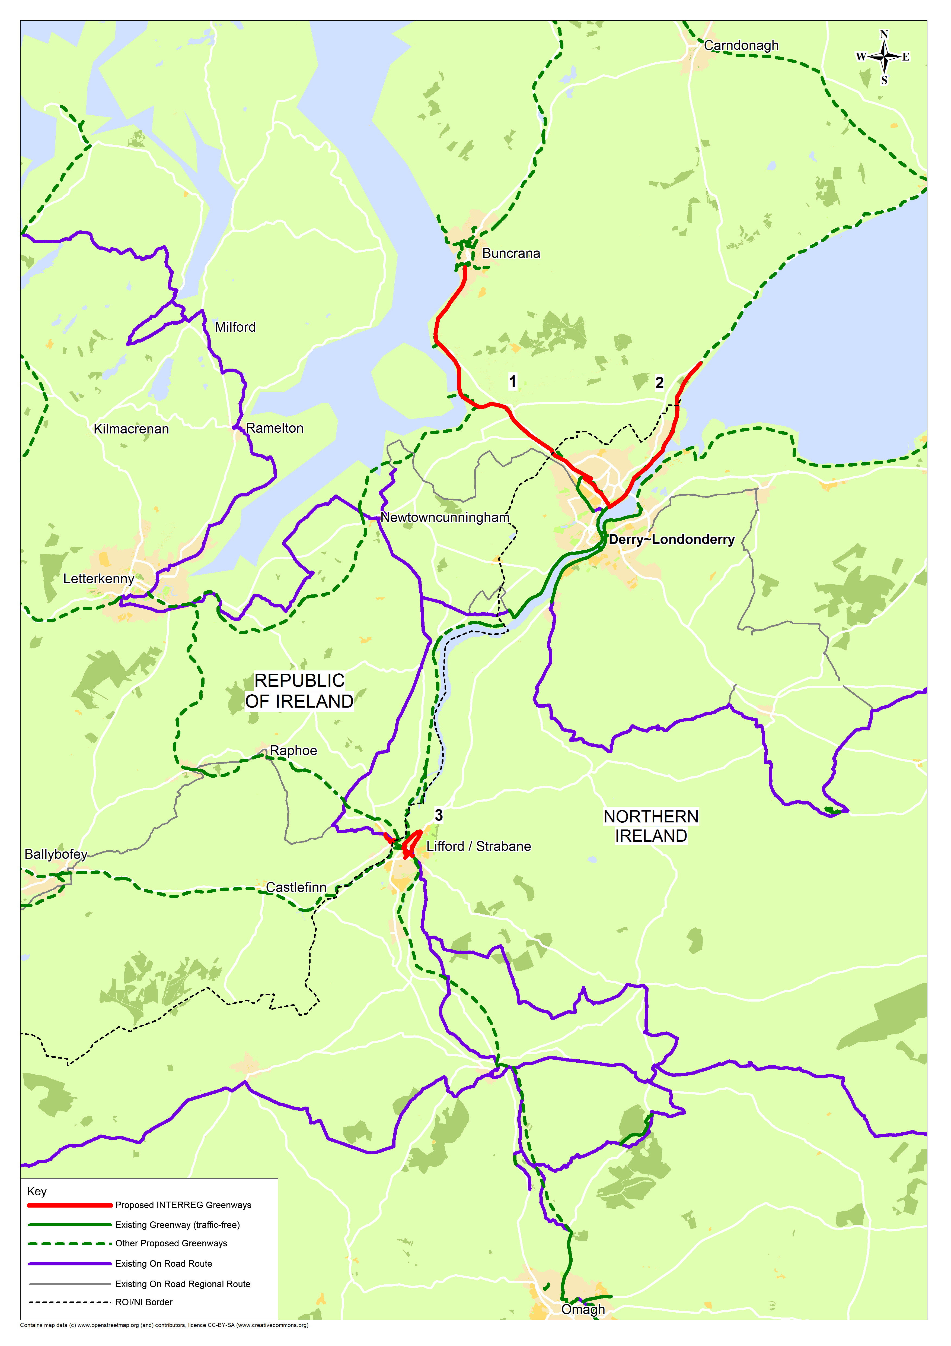
North West Greenway
46.5km of new cross border greenways;
When completed this will link with already existing foot/cycle paths to form a Greenway network in excess of 250km in Derry & Donegal (North West Region);
The project aims to increase cross border commuting and utility journeys by cycling and walking.

Slide 8
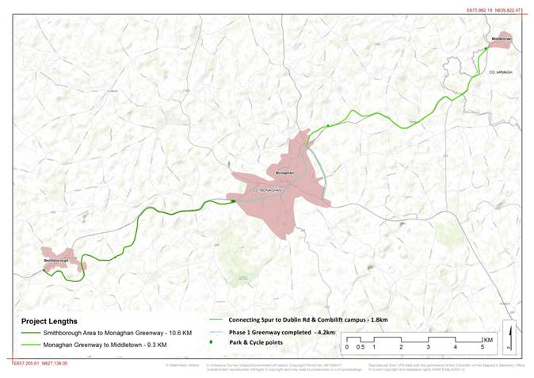
Ulster Canal Greenway
22km of new cross border greenways developed – from Monaghan in Ireland to Armagh in Northern Ireland;
The project aims to create a minimum of a 4.5% modal shift from cars to walking /cycling in this area by 2023 by cross border commuters.

Slide 9
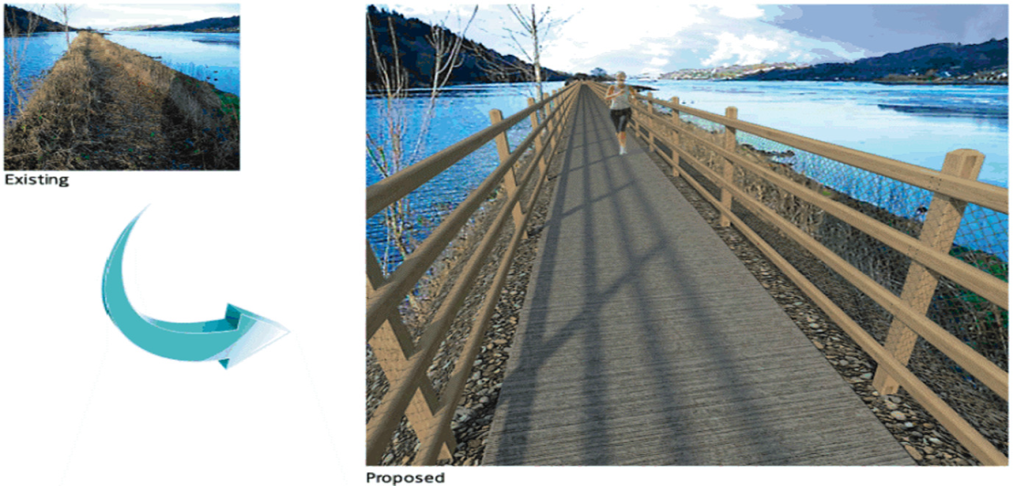

Slide 10
Communications Strategy - Greenways
Need to highlight positive impact of EU funding in region
Maximise opportunity to publicise approved projects
Assessed good angles to make the story interesting
Focus on impact
Delivery of a Greenway Activity Programme to encourage cross-border commuting and usage
Capitalise on conferences that are taking place in border region
News items – BBC News Report

Slide 11
